Slide 1
Procurement Training Updated: 3/26/2025

Slide 2

What We Do
The Procurement team is dedicated to providing the best strategic sourcing, procurement, negotiation, financial and informational resources as it relates to the acquisition of quality goods and services for Bloomberg Industry Group and providing the most effective and efficient procurement processes and procedures in support of INDG's mission and goals.
The Procurement of goods and services is governed by the following policies that can be found on the Procurement Confluence Page:
INDG Purchasing Policy
INDG P-Card/V-Card Policy
INDG Contract Signing Authority Policy
Notes:
Deborah 2-6

Slide 3
The Procurement Team
Deborah Crimes, Procurement Manager, Senior
Steve Washington, Procurement Specialist, Senior
Son Truong
Procurement Specialist (CW)
Ana Kavtaradze
Finance Associate
Marketing
Product (BLAW, BTAX, BGOV)
Facilities
HR
Supplier Diversity Program
Finance College Recruitment
Finance Young Professionals Program
Hardware
Software
Technology Services
Technology Development Services
Product (User Experience)
Sales
Finance
News
Training/Coaching
General Counsel
NDAs
Communities
DEI Champions
New Vendor Onboarding
IT Jira Requests
Notes:
Your Procurement category or BU lead

Slide 4
The Procurement Process

Slide 5
Things to Know Before Starting the Procurement Process
Where do I start when I want to purchase a good or service? The first stop is with the Procurement department. Contact your Procurement Business Partner (see list in this deck or on the Procurement Confluence page). Please do not contact Legal first, they will tell you to reach out to Procurement.
Does my BU/department have an approved budget for this purchase? Has this been vetted through the Department Lead and Finance?
What vendor will I use? Contact Procurement for the current vendors list which includes diverse and small business (15% sourcing goal for 2025)
Do I have Procurement level access in Coupa to submit the required forms for my purchase? If I don't, how should I proceed? Submit a Jira ticket and request Procurement Access.
If I have a vendor that I want to speak with about a possible engagement, what should I do first? Before having a conversation, submit a Contract Request in Coupa for an NDA (non-disclosure agreement) to protect both parties’ proprietary information.
If I have a new vendor/speaker, how do I onboard that vendor? Go into Coupa homepage and select Forms, Supplier onboarding. You will need to have all the contact information for the new vendor. Once you complete the information, the form is routed to AP/Procurement/Risk for approval. The vendor will then receive a link to provide its W-9, banking information, and Supplier Diversity status. AP & Procurement will work together to onboard the vendor into Coupa and SAP. This process can take 2-7 business days.
If I have received a contract from a vendor, what do I do with it? Submit a contract request in Coupa and Procurement will start the review process.
What other approvals will I need besides an approved contract (Procurement & Legal) and an approved requisition? You will need to submit a VIRA (link is in the Contract Request) to the InfoSec department. They will make they capture the potential risks associated with working with the vendor on the engagement.
How long will the entire Procurement lifecycle process take? The process for a new project/new vendor could take 4 – 6 weeks, please plan ahead!
Who can sign contracts and commit the company to goods/services? Only those persons with the titles listed in the Signing Authority policy which can be found on BHOME or on the Procurement Confluence page.
Notes:
Ana & Finance Director bullet point two / Legal bullet point 5 – NDAs / NVO – Nancy
When you want to purchase a good or service, that is when you would work with procurement department and contact your Procurement business partner which are listed on one of the slides within this presentation and on procurement webpage within Bhome.
Finance will speak about budget for the purchase in a little
If you need to submit required forms for your purchase you would need Procurement level access in Coupa which is gained through submitting Jira ticket. Link is on this slide.
If you have a vendor you want to speak with, you need to have NDA, nondisclosure agreement in place which you can initiate by submitting the contract request in Coupa. Do the same if you received contract from vendor and attach the document within Contract request.
Note that Only those persons with the titles listed in the Signing Authority policy can sign contracts.

Slide 6
The Procurement Process – Quick Overview
The process is as easy as 1-2-3
Step 1: Submit a Contract Request (“CR”) in Coupa
If there is a contract needed for the purchase, complete the information in the Contract Request form and complete a VIRA request. The information provided in the VIRA will be reviewed by InfoSec to assess vendor risk. This will also kick of a software review if needed and an AI review (if the vendor uses AI). Those departments will contract the vendor or BU for more information if needed.
Step 2: Submit Supplier Onboarding (“NVO”) form in Coupa to onboard a new vendor
This is only required if the new vendor is being paid by PO or check. If this is not a new vendor, skip to Step 3. If paying via v-card or p-card, skip Steps 2 and Step 3.
Step 3: Submit a Requisition (“req”) in Coupa.
This is to have the funding approved. Once the req is fully approved, Procurement will be able to send the contract/order form for signature according to the Contract Signing Authority policy. If paying with a v-card or p-card (one-time purchase, if vendor only accepts credit card, or pre-approval by procurement), no req is required
Submit Contract Request & VIRA
Submit Req
Submit NVO
Notes:
Ana
procurement process could take 4-6 weeks. And has following 3 outlined steps.
Step 1: Submit CR in Coupa
Step 2: Submit Supplier Onboarding (“NVO”) form in Coupa to onboard a new vendor
Step 3: Submit a Requisition (“req”) in Coupa. To have funding approved.
Please note that you may need to submit VIRA assessment to submit CR. This depends on the services vendor is providing. Infosec will go over this later.
You can skip Step 2 if new vendor is not being paid by PO or check or is this is an existing vendor. If paying with Vcard or Pcard, skip step 2 and 3.

Slide 7
Procurement Scenarios
Procurement Scenario | Business Unit Action Item(s)
Have a Need/Requirement over $25K | Reach out to the Procurement Business Partner or BU Lead (Marketing only) to conduct a sourcing event (RFx)
Talk with a vendor Non-disclosure Agreement (NDA) needed | Submit a contract request for an NDA before starting conversations
Purchase a good/service Current vendor No Contract Pay by Purchase Order (PO) | Submit a requisition
Purchase a good/service New vendor No contract Pay by p-card | Submit a new vendor onboard request
Purchase a good/service New vendor Contract(s) needed Pay by PO | Submit new vendor onboard request Submit contract request Submit requisition
Purchase a good/service Current vendor Order form (vendor paper) Pay by PO | Submit contract request Submit a requisition
Notes:
Skip
After-the-fact procurements is a violation of the procurement policy and will be reported as such
Plan ahead and allow 2 -4 weeks for the procurement process

Slide 8
Definitions
Contract Request (CR)
NDA (MNDA) – (Mutual) Non-Disclosure Agreement
MSA – The Master Services Agreement establishes the overarching terms and conditions for a business relationship between two or more parties.
SOW – The Statrement of Work describes the terms for a specific engagement including scope, deliverables, cost, contract start and end dates, etc. May also be an Order Form or licensing agreement.
Supplier Onboarding – This is specific to adding the vendor in Coupa. It requires the vendor to submit payment information, a W-9 form, and supplier diversity form. A requisition cannot be entered until a vendor is fully onboarded.
Requisition – This is entered in Coupa to get financial approval to pay for the engagement. This generates the Purchase Order #.
Vendor Assessments*
VIRA (Vendor Inherent Risk Assessment) – The InfoSec Compliance team assesses the security posture of the vendor to determine the risk of engaging with the vendor. SLA is 10 business days.
Software Review – The Security team assesses the security posture of the software itself. SLA is 10 days.
AI Review – The AI Committee must review vendors using LLM/GenAI-enabled features per the LLM/GenAI Review Process
*These are outside of the Procurement process, but must be completed prior to signing an MSA
Notes:
skip

Slide 9
Responsibilities
 | BUs | Procurement | Legal | InfoSec Compliance | Security Engineering | AI Committee | Finance
NDA | Enters CR | Works directly with vendor and legal for execution. | Reviews, redlines, approves
Vendor Assessments (VIRA, Software Review, AI Evaluation) | Fills out questionnaire or JIRA form | Confirms completion prior to sending MSA for signature | References for MSA/SOW approval | Conducts vendor assessment (VIRA). | Conducts software and review. Provides approval for use. | Conducts AI evaluation. Provides approval.
MSA | Enters CR | Works directly with vendor and legal for execution. | Reviews, redlines, approves |  |  | May suggest additional terms.
Supplier Onboarding | Fills out Coupa form | Reviews and approves
SOW | Enters CR | Works directly with vendor and legal for execution. | Reviews, redlines, approves
Requisition | Enters request, management approves (CEO approves $100k+) | Reviews and approves. |  | Approves | Approves (if Software) |  | Approves
Notes:
Ana
When BU submits CRs for NDA, MSA, or SOW, Procurement works with vendor and legal for execution. Vendor assessments are conducted by compliance, infosec/engineering, and AI Committee.
Requisitions are approved by various parties, whereas supplier onboarding is done by procurement and Accounts Payable.

Slide 10
Vendor Risk Management

Slide 11

Vendor Risk Management
Vendor Risk Management Process
Our Goals
Example of Third Parties
What is a Vendor Risk Management?
It's the process of identifying, assessing, monitoring, and mitigating risks associated with third-party vendors or service providers
Identify & document potential risks
Implement measures to reduce or eliminate risks associated with third parties
Protect our and our customers data
Ensure operational continuity
SaaS Providers (Salesforce, Coupa, Ceridian, Workday)
AI/LLM Services (OpenAI, Anthropic)
Consultants (Ernst & Young, Deloitte, KPMG)
Infrastructure (AWS, Azure, Google Cloud)
VIRA Intake Form
Determine Inherent Risk
Perform Vendor Risk Assessment
Determine Residual Risk
Risk Assessment Summary: Conclusions and Key Recommendations

Slide 12
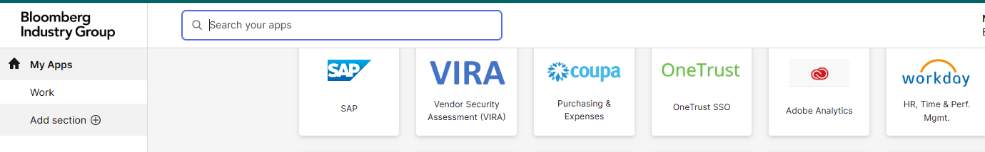
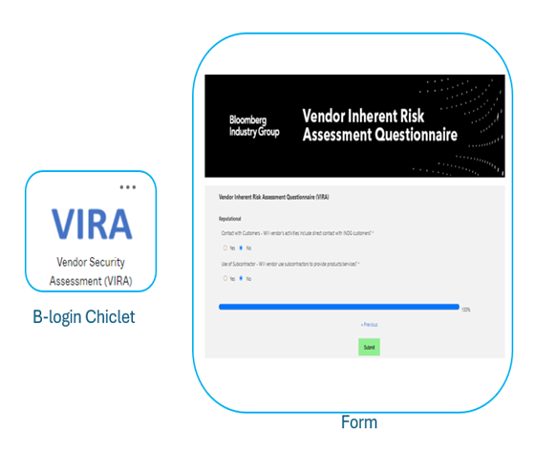
How to submit a VIRA form?
Vendor Inherent Risk Assessment (VIRA) Form: This form must be completed to evaluate the vendor's risk. It is recommended to initiate the vendor review process at least 4 weeks prior to onboarding/purchasing.
Key Notes:
InfoSec Compliance Team: Assesses the vendor's security posture to determine the risk of engagement. SLA: 10 business days.
Software Review: The Security team evaluates the risks associated with the software. SLA: 10 days.
AI Review: The AI Committee reviews vendors and software using LLM/GenAI-enabled features according to the LLM/GenAI review
Following the assessment, the business unit or requestor will receive a report with recommendations.

Slide 13
Continuous Monitoring (Vendor Risk Re-Assessment)
Residual Risk Level | Re-assessment Frequency
5 – Very High | Very high vendors are not recommended at INDG
4 – High | Annually
3 – Moderate | 2 years
2 - Low | N/A
1 – Very Low | N/A
To ensure that risk levels remain within the expected threshold and vendors uphold their privacy and security standards, continuous monitoring of the vendor and engagement is essential. Consequently, Infosec Compliance conducts re-assessments.
Vendor Risk Re-Assessment Triggers:
Business units or requestors are asked to inform us of any changes in the scope of the engagement with the vendor.
Additionally, Infosec Compliance will conduct periodic re-assessments based on the risk profile, as detailed in the table.

Slide 14
The Sourcing Process Request for Proposals (RFP)
Notes:
Deborah 11-14

Slide 15
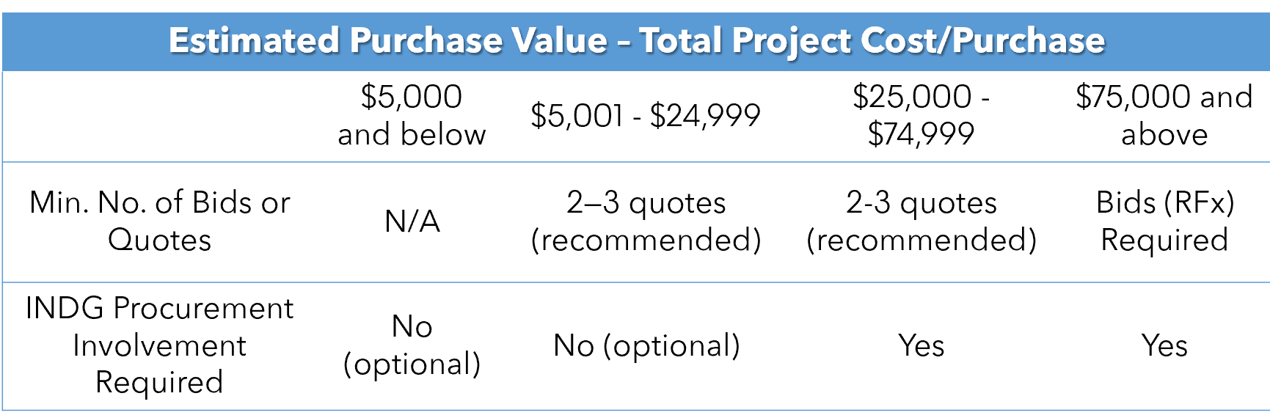
The Sourcing Policy & Process
Navigating the RFx Process
The process of issuing a Request for Quotation (RFQ) or Request for Proposal (RFP) is to solicit bids from suppliers.
Each supplier receives the same directions, information, terms and conditions. Procurement only considers valid those submissions from suppliers that meet the bid requirements and are sent to Procurement by the specified deadline.
Bid Requirements
Business requestors are responsible for following the appropriate procurement process based on the table below:
NOTE: The Estimated Purchase Value (EPV) refers to the aggregate amount a requestor expects to spend per project or individual purchase.

Slide 16
The Sourcing Policy & Process
Engage INDG Procurement
When a business requestor has a requirement for a good or service of value of $25,000 or more, he or she must engage their Procurement Business Partner for:
Support procurement conceptualization (SOW)
Supplier evaluations
Bidding (bidders list includes one diverse supplier)
Contract negotiation
Procurement and contract approval process execution
E-mail procurement@bloombergindustry.com or contact your Procurement Business Partner for your function for support as noted on page 3.
If a business unit has an engagement where there is a single source, the single source justification form (coming soon!) must be submitted and approved by Procurement before proceeding.

Slide 17
Strategic Sourcing (RFP) Process
Develop Requirements
Conduct RFx Negotiate / Contract
Identify and Research Sources of Supply / Develops RFx
Get Requisition Approved / Execute Contract Per Policy
Business requestor develops and finalizes all functional, technical, and operational requirements
Procurement and business requestor works together to determine if an existing supplier can fulfill requirements (If so, go to Requisition)
Procurement and business requestor assemble preliminary contract requirements and templated documents as developed from Legal
Business requestor and Procurement work together to identify potential new sources through supply market research
Business requestors and Procurement must invite at least one diverse supplier to participate per the Supplier Diversity Sourcing Requirements*
Procurement and business requestor partner to tailor and finalize RFx documents from templates
RFx includes:
Terms and conditions (contract template)
Technical requirements
Functional requirements
Pricing questions
Other questions
Procurement publishes RFx with a minimum of three bidders
Procurement receives proposals including all pricing plus marked templated agreements
Procurement and business requestors, and other stakeholders score the proposals against requirements and objective evaluation criteria
Procurement conducts multiple rounds of negotiations to get to best and final commercial terms including pricing
Legal negotiates and finalizes legal terms
Contract finalized
Requisition submitted and approved in Coupa
Required approvals include:
Finance
Procurement (In some cases)
Management per policy
Contract executed via Docusign per Contract Signing Authority Policy
Procurement provides PO information and fully executed contract to supplier

Slide 18
Coupa Contract Request, Requisitions, New Vendor Onboarding & Receiving an Invoice

Slide 19
Coupa Demonstrations
Submit a Contract Request (NDA, MSA, order form, SOW)
New engagement
Renewals
VIRA & AI process
Submit a Supplier Onboarding Request (new vendor)
Revision of current vendor (address, name change, EIN#) – Jira ticket
Submit a Requisition – funding approval
New engagement
Increase Funding (change in scope or underfunded) – Jira ticket
Add detailed justification - 5 Ws (who, what, where, when, and why)
Attach quote/SOW if applicable
Verify GL code, Internal Order, Cost Center, add Asset # (Accounting request), change requestor/ship to
AP received invoice, no PO found or PO doesn’t have enough funds (violation)
Approval process/authority
Receive an invoice – a/k/a approve an invoice for payment
Notes:
1. Deborah – Legal to talk about contracts that we’ve signed years ago (2017 or earlier), can we use them / 2. Ana & AP –L1 on w9 and other tips / 3. Steve & AP 4. Steve

Slide 20
Contract Request: Coupa CLM Frequently Asked Questions (FAQs)
Q. Do I need a Coupa license/access to Coupa Procurement to enter a Contract Request? Yes
Q. Should I submit a Contract Request for agreements with both new and existing vendors? Yes, a contract request for a new Master Service Agreement (MSA), Non-Disclosure Agreement (NDA), Statement of Work (SOW), order form must be submitted for both new and existing vendors.
Q. What do I do if I have more than one requested Contract Type for my Request? If you have more than one contract type for a respective vendor, please submit one request per Contract Type. An NDA is always required first. Procurement will submit the remaining requests on your behalf, but please make a note that they will be needed.
Q. Where does a Contract Request go after I submit it? Your Contract Request is sent to Procurement and Legal for review and to be assigned to someone on the Procurement Team. Upon review, Procurement creates the contract document using the appropriate Legal template. The Contract is then negotiated, approved, and once the requisition is fully approved, and the risk review (VIRA) is completed (if applicable), the Contract is sent for signature via Docusign.
Q. How do I change or cancel a Contract Request once it's been submitted? Contact Procurement@bloombergindustry.com to make a change or cancel a request.
Q. Will the system automatically notify me to create a Requisition once I submit a Contract Request? No, the system will not, however, you can submit the Contract Request and Requisition (only if vendor is already onboarded) simultaneously or your Procurement specialist will remind you.
Q. Will I be able to input notes or read notes from the Procurement or Legal team? Yes, but only on the Contract Request side or if tagged in a note on the "Contracts" side.
Q. Will I be notified once a Contract is approved and ready for signature? The first Coupa notification you will receive means that your Contract Request is being assigned to a Procurement specialist. The remaining notifications will be from your contract specialist directly, giving you updates or letting you know that the contract is being sent to the vendor for signature. The Procurement or Legal team (MSAs and edited NDAs only) will get the Contract signed via Docusign as noted above. You are not allowed to sign contracts!
Notes:
Deborah

Slide 21
Requisitions Frequently Asked Questions (FAQs)
Q. Where do I get the cost center #, GL code, or internal order to put on the requisition? Check with your assigned Finance Manager/Director
Q. Can I put in a requisition if the vendor is new/not in Coupa suppliers list? No, you need to request that a vendor is onboarded into Coupa before you submit the requisition. You will not be able to pull up a non-onboarded vendor and the requisition will not be routed for approval. See job aid on the Procurement Confluence Page, How to Onboard a New Vendor.
Q. Who approves the requisition? For example, in Marketing, Maite is the final approver for reqs, up to $100K. Anything over $100K will need to be approved by Josh. If one of the approves is going to be out of office for a week or more, that person should delegate their authority to someone else (policy).
Q. What happens once the requisition is fully approved? Once the req is fully approved, the Purchase Order (PO) is automatically generated and the contract (if applicable), is sent for signature by Procurement. Once the contract is signed. Procurement will send the signed contract (if applicable) and the PO to the vendor and the requestor noted on the requisition.
If there is no contract associated with the req/PO, the requestor is responsible for printing (See job aid on the Procurement Confluence Page) and sending the PO to the vendor with the following language: “Attached is the PO for xxx. Please submit invoices including the PO# to invoices@bloombergindustry.com If you have a question related to payment of the invoice, please send an email to ContactAP@bloombergindustry.com”
Q. How can I increase funds on an approved PO? Submit a Jira ticket to the, Procurement Service Desk, Insufficient funds on PO to cover an invoice to request the increase and give the justification. Procurement will then increase the funding and reference the Jira ticket and justification in the comments section of the PO. Procurement will send the revised PO to the requestor and the vendor.
Q. If I have a renewal, do I need to submit a new requisition for the new year? Yes, you will need to submit a new requisition.
Notes:
Steve / Madra walk through delegation process, add process into the deck.

Slide 22
New Vendor Onboarding Frequently Asked Questions (FAQs)
Q: Where is the new supplier request routed? Following the successful submission of a New Supplier Request, the form will be routed for approval to Procurement and sometimes to Info Sec.
Q: Will the vendor receive any type of notification? Once all approvals have been received, the vendor will receive an email to complete their onboarding form. Note: Forms that have not been completed in 30 days will be canceled and the process must be reinitiated.
Q: What are the next steps once the vendor submits the information? Following the submission of the External Vendor onboarding form, Accounts Payable and Procurement will complete the onboarding process within Coupa and create the Supplier within SAP.
Q: How do I initiate vendor information update? Vendor address / banking update request can be submitted through AP dashboard within Financial Operations Service desk.
Notes:
Ana

Slide 23
Knowledge Check – What Would You Do?
What would you do if you have a new vendor?
What would you do if you have a new project and you need multiple bids?
What would you do if you get a contract that needs reviewed and signed?
What would you do if you get an invoice to be paid?
What would you do if you need to renew a contract?
What would you do if you want to purchase something using a p-card?
What would you do if you want to talk with a potential new vendor about a project?
Notes:
Son

Slide 24
Tips & Tricks
Never sign a contract that is presented to you by a vendor (signing authority policy).
Never discuss a new project/initiative with a vendor without getting a signed NDA.
If you have a new project/initiative and you want to bid it out, the first step is to contact your Procurement Business Partner for assistance.
Always include a diverse supplier in the bidding process (purchasing policy).
If you want to purchase something using the v-card/p-card, check in with your Purchasing Business Partner first and make sure you are familiar with what can be purchased (p-card/v-card policy)
Contract types:
order form, licensing agreement = vendor paper
NDA, MSA, SOW, professional services agreement = INDG paper
Notes:
Deborah

Slide 25
Questions & Answers
Notes:
Steve 20-21

Slide 26
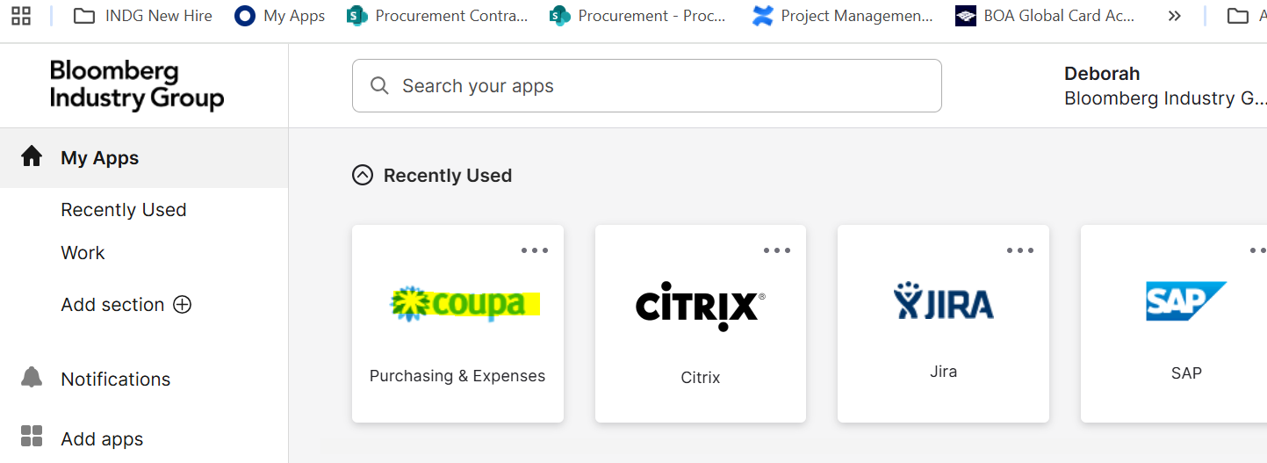
Contract Request
Coupa Access & General Navigation: Desktop (1 of 2)
Go to My Apps and select COUPA

Slide 27
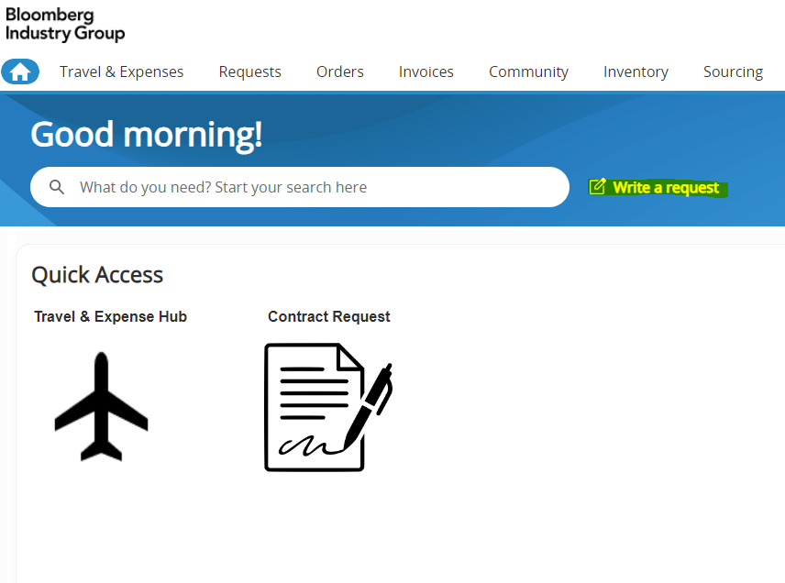
Requisitions
Go into Coupa and then select Write a Request. Complete all required information in the form and submit it. The requisition (req) will be routed for approval. Once the req is fully approved, the req will automatically be converted into a purchase order (PO). If there is a contract associated with the purchase, the contract will not be signed until the req has been fully approved.
Notes:
Deborah 15-16

Slide 28
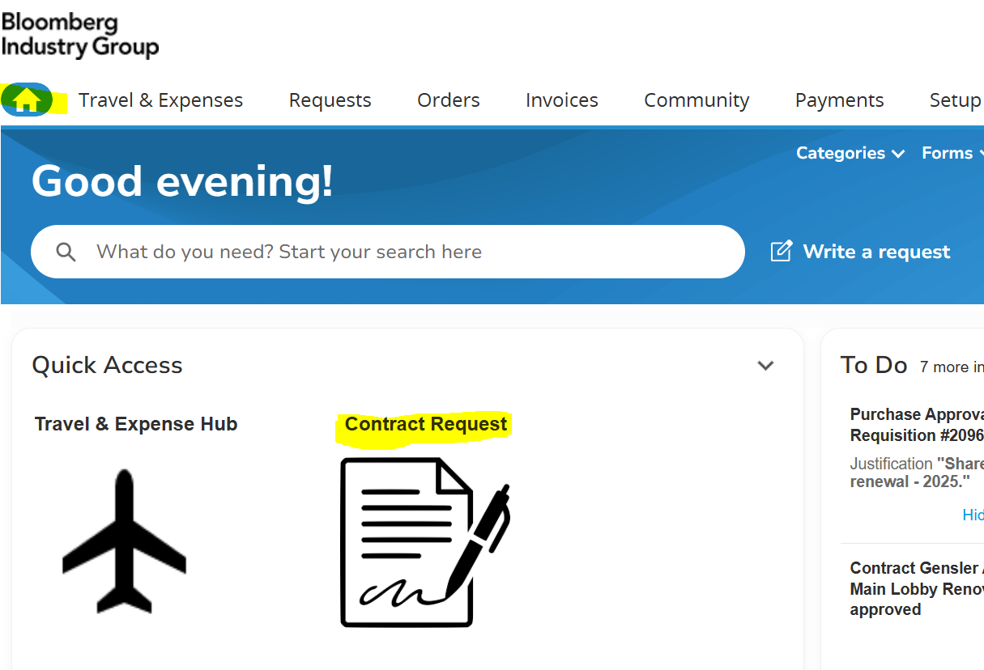
Contract Request
Coupa Access & General Navigation: Desktop (2 of 2)
From the HOME page in COUPA, select Contract Request to complete and submit the form for review of a new or existing contract.

Slide 29
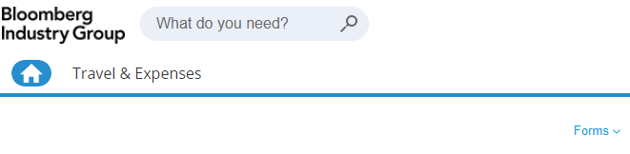
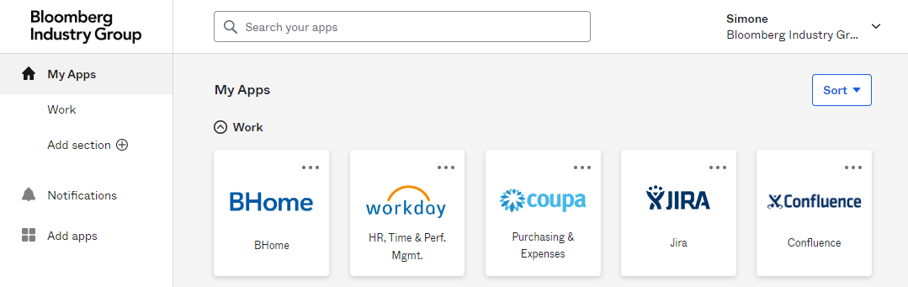
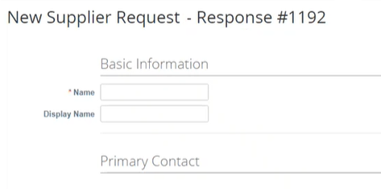
New Vendor Onboarding
Navigating to Coupa Supplier Onboarding Form
1. Click on My Apps and select the Coupa icon, to launch the application
2. Click on the Forms drop down and Supplier Onboarding to begin creating a new Supplier Onboarding form.
3. Enter the requested details to the form.
Notes:
Roshni 17-19

Slide 30
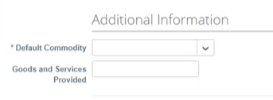
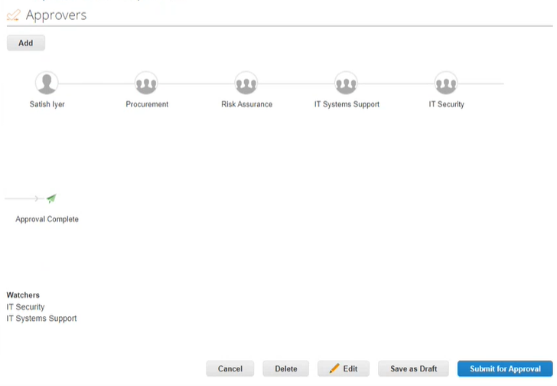
New Vendor Onboarding (cont.)
4. When finished, click Submit for Approval to send your form for business unit approval and receive your submission confirmation.
NOTE: The information provided in the Default Commodity drop will determine the required approval process prior to requesting information from the vendor.
Approvers
All new vendors must be approved by Procurement.
If the new vendor is providing a Technology Products or Services or Outside Services (consulting or outside services), a Vendor Information Security Assessment and IT Security Review is required.
If the requested new vendor will have access to Bloomberg data or systems, the Risk Assurance team will require additional information and will be required to approve.
If the new vendor will be providing Software, the IT Systems Support and IT Security team will require additional information and will be required to approve.
NOTE: If hierarchy approver is not automatically added, email procurement@bloombergindustry.com

Slide 31
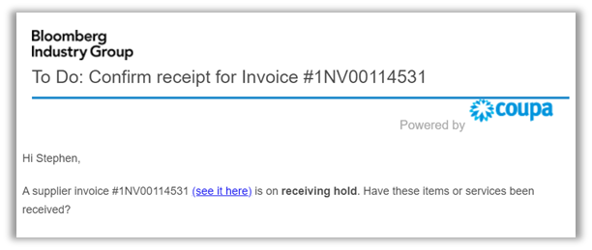
The Invoicing Process
Vendors are instructed to send invoices including the PO # to invoices@bloombergindustry.com
Once an invoice is received by Accounts Payable (AP), AP will send an email to the business area requestor listed on the PO to “confirm receipt” for the invoice. The business owner must verify and receive the items in Coupa (validate that you have received the goods or services). See job aid on the Procurement Confluence Page.
Once the invoice has been received, AP will pay the invoice.
NOTE: Questions related to invoices and payments should be directed to ContactAP@bloombergindustry.com
Notes:
AP - Michelle

Slide 32
Common Non-Negotiables for Legal
If vendor has access to sensitive, confidential, and/or INDG’s customer data: Legal requires uncapped liability for breach of confidentiality and data privacy/protection obligations
If business wants to use vendor product/software within our own products: Vendor must agree to indemnify INDG for any intellectual property infringement claims brought against INDG related to the vendor product and vendor cannot limit their liability for such obligations (i.e., no financial cap)
If Vendor uses generative AI to provide the services: Explicit restriction against using our content to train any generative AI models
Publicity: We never allow terms where a vendor can use the INDG name or logo for any reason without Legal’s consent
Renewals/Existing Vendor: If the use case changes to include any of the above scenarios, then Legal must renegotiate these terms if they are not already included (or the use case will not be approved, if vendor cannot agree to our terms).

Slide 33
Important Notes from Legal
Contracts may require a VIRA and/or Generative AI Review
Legal may rely on recommendations resulting from these reviews, as part of its contract negotiation
Business owners are responsible for submitting and managing ticket requests and ensuring completion of these prior to Legal’s approval of contract for signature
In addition to Legal and Procurement’s review, Business owners are also responsible for reviewing SOWs/Order Forms and informing Legal/Procurement of any business changes or concerns with those terms

