Slide 1
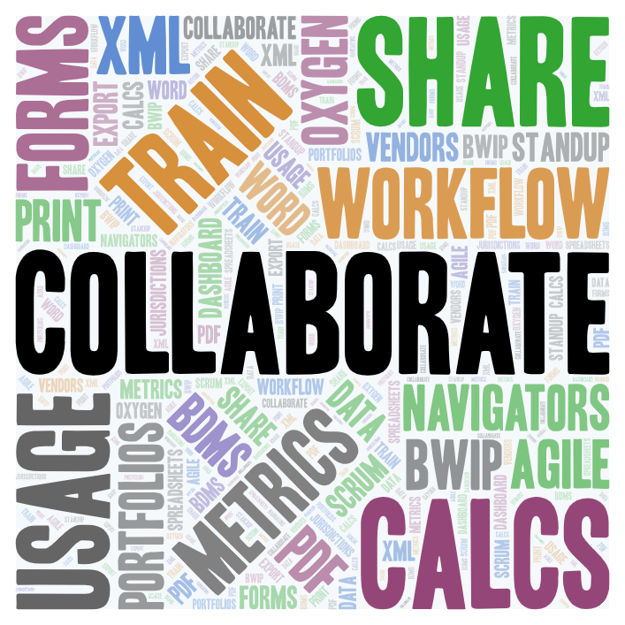
Tax
Content Production and
Content Oversight
Summer 2024 Projects…..
….well-positioned moving into 2025

Slide 2

Summer Objectives
DISTRIBUTE work
REDUCE level of effort
DECONSTRUCT silos
Increase Productivity & Capacity
team
opportunities
for
Build
deeper understanding
visibility
TRANSPARENCY
ANALYSIS and visualization
REPORTING
collaboration
leadership
cross training

Slide 3








Aligning 2024 Goals with Summer Projects
FORMS
PORTFOLIOS
Cross-training
Greater visibility across manuscript life cycle
Complete print transition
METRICS
Update TPQA sprint dashboard
Resource tracking: Jira, Forms data into single dashboard
Vendor performance: Establish metrics for task performance
Reduce
volume
Workflow
Increase efficiency
Integrate usage data into workflow decisionmaking
“Team”
pilot
Acquisition
into
Content Oversight
Acquisition

Slide 4
Project Teams
Systems & Process, Calcs
Acquisition
Portfolio Workflow Revamp
Metrics

Slide 5






Portfolio Workflow Revamp
Cross-Training
Candice Butts
Consolidated Portfolio Dashboard (in Jira)
Ricky Cruz
Refactor Obsolete Cite Workflow
Paula Firestone
Productionize Print Workflows
Shawne Hicks
Ammanuel Haile, Scrum Master
Shawne Hicks, Project Manager
Master Portfolio Spreadsheet
Shawne Hicks

Slide 6

Cross-Training Goals?
Cross-Training
Lead: Candice Butts
RESOURCES
Training recordings and presentations
  Anthology Update "Go To" Field
  Composition Training - Part 1
  Composition Training - Part 2
  QA Print PDF
Documentation
Portfolio Print Replacement Workflows
QA Print PDF
Compose Print PDF
Exporting a Clean Starting File
Outcomes
Eliminate silos of portfolio expertise
Expand skills
Create more flexibility for distributing work
Author files
  Export files for author review
Print
  Compose Print PDF
  QA Print PDF
  Anthology Update “Go To” Field
Train-the-Trainer
Training complete
QA Print PDF (June 5)
Anthology “Go To” (June 11)
BWIP/Oxygen (June 24)
Compose Print PDF (June 25)
Export (August 25)
More team members involved in
Print and Author file prep workflows
KNOWLEDGE-SHARING ▪ CONTINUOUS IMPROVEMENT ▪ TRANSPARENCY ▪ STANDARDIZED PROCESSES

Slide 7

What is the problem?
Consolidated Portfolio Dashboard (in Jira)
Ricky Cruz
Outcome
  Single portfolio workflow dashboard deployed
The team:
Built shared understanding of different workflows
Introduced consistency in Jira ticket tagging
Worked with C&A Acquisition team to align TMTT tickets
Built dashboard
Lack single point of visibility
across separate areas of
TPQA portfolio workflow:
1. Author-adjacent tasks
  Honorariums
  Export manuscripts for author review
  Coordinate with C&A Acquisition team
2. Production of portfolios for release
  Enter redline edits
  Oversee vendor work
  General oversight, prep, release
  Proofreading
  Obsolete cites
3. Print prep and release
  PDF Composition
  QA
  Vendor coordination
ENABLES PROACTIVE DISTRIBUTION OF WORK ▪ TRANSPARENT ▪ ELIMINATES BOTTLENECKS

Slide 8


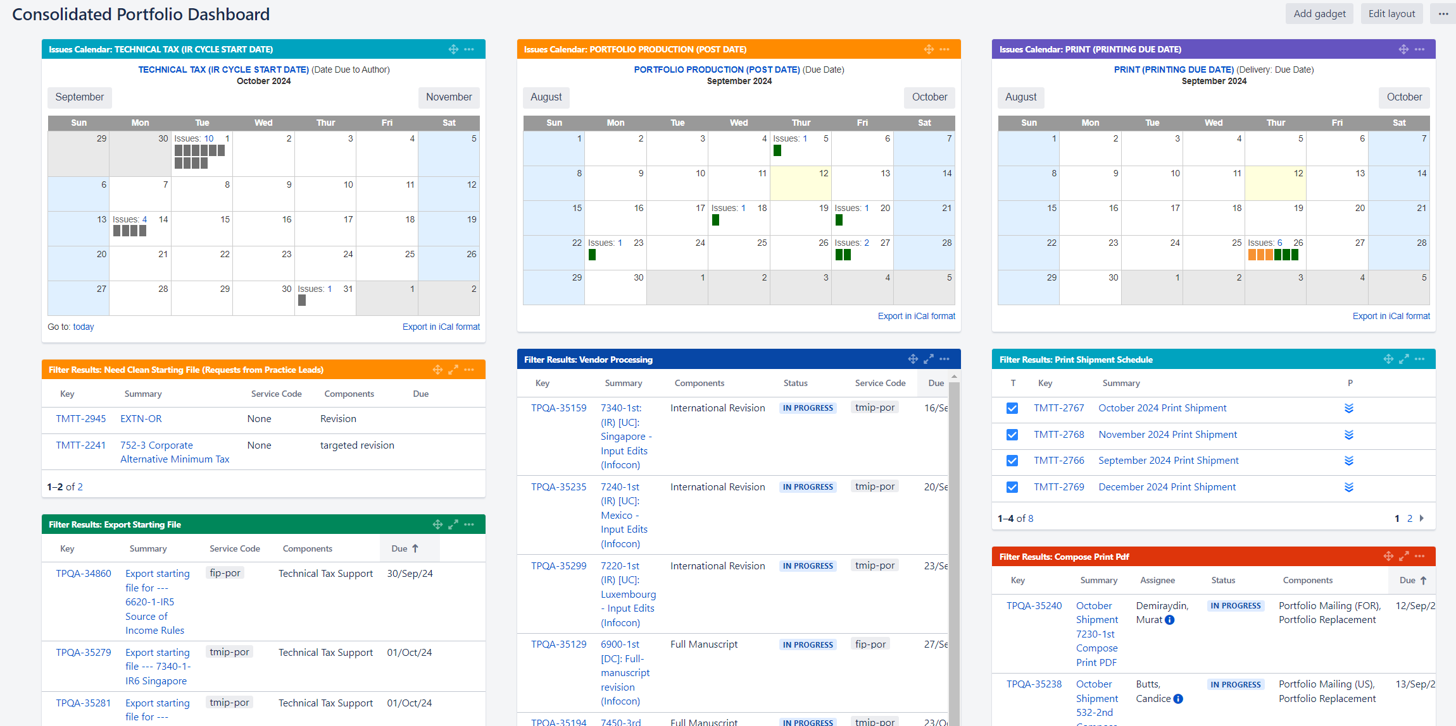
  Provides visibility into and across workflows, facilitating better load-balancing across available resources

Slide 9
What is the
Obsolete Cite Workflow?
Refactor Obsolete Cite Workflow
Paula Firestone
Outcome
New obsolete cite workflow implemented
(Identify, Reporting & Updating tasks moved to vendor)
To support this workflow, team:
  Created consolidated Instructions
  Developed boilerplate template for JIRA ticketing
  Trained vendor resources
  Designed Jira dashboards to surface and track work.
POC in motion
  Vendor working on two portfolios
  Initial work returned from vendor looks promising
1. When new portfolio edition published, references to that portfolio reviewed for relevancy
  e.g., pinpoint cites in portfolios,
  BNA Picks, etc. may no longer
  be relevant in new edition.
2. Content Oversight compiles these “obsolete cites” for C&A team
  Analysts review identified
  cites needing change,
  provide guidance
3. TPQA makes
content updates
future AI-based workflow solutions likely
but in meantime,
present workflow is
Manual &
Time-consuming
SIMPLIFIES ▪ REDUCES TURNAROUND TIME ▪ TRANSPARENT ▪ FREES INTERNAL RESOURCES

Slide 10
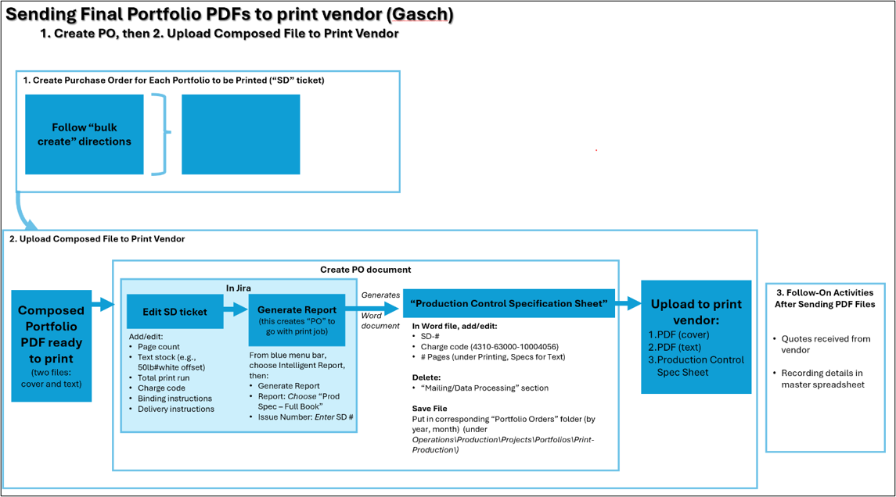
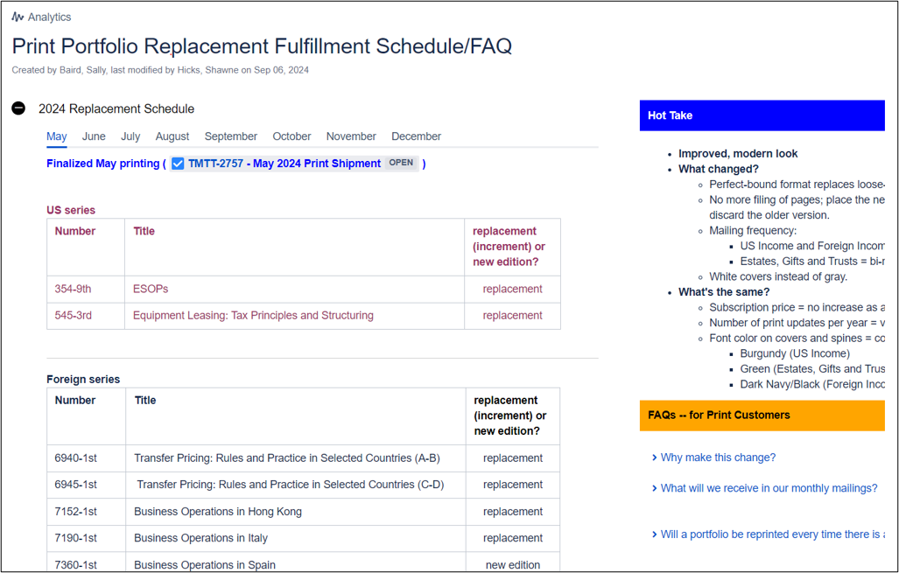
Productionize Print Workflows?
Productionize Print Workflows
Shawne Hicks
Outcomes
  Team norms solidified
  (print composition/QA tasks, Jira tickets, working with vendor, Sales Success, documentation, internal communication)
  Vendor relationship
  (monthly vendor meeting, Order Management training, consistent communication practices)
  Sales Success protocols
  (still a work-in-progress)
  Documentation
Goals​
New print workflows finetuned and solidified within team norms and practices
No silos going forward​
New workflow(s) documented
Standardize protocols with Sales Success Team​
Establish norms and practices for ongoing vendor relationship
Transition ongoing tasks across team
…
STANDARDIZED TICKETS ▪ TRANSPARENT ▪ KNOWLEDGE-SHARING

Slide 11
Why a Master Portfolio Spreadsheet?
Master Portfolio Spreadsheet
Shawne Hicks
Outcome
Single source for key info about entire Tax portfolio collection, and each portfolio, including:
  Current edition
  Past editions
  Update dates
  Release date
  Print cost (unit, total run)
  Last date printed
  Page count
Eliminate current need to search across multiple sources for answers to basic questions.
Work in initial stages
Draft completion December 2024

Slide 12
Portfolio Workflow Revamp
PERCENT COMPLETE
Cross-Training
Consolidated Portfolio Dashboard (in Jira)
Refactor Obsolete Cite Workflow
Productionize Print
Workflows
Master Portfolio
Spreadsheet

