Slide 1
Legislative History documents
Content Production QA
Checking links,
Document navigation, and
Verifying against master code section list

Slide 2
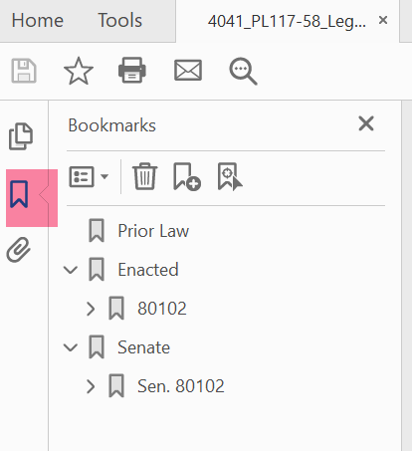
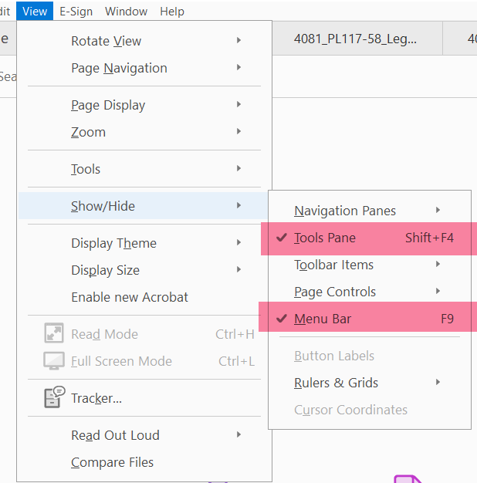
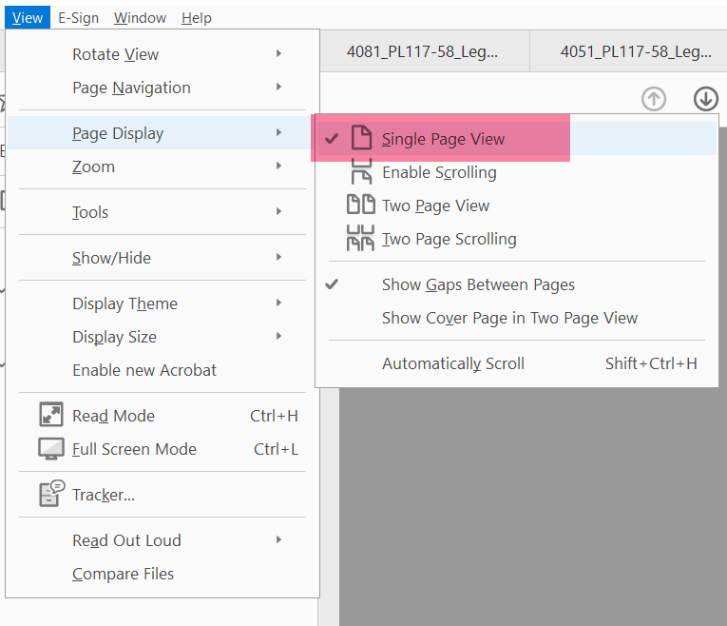
Default Acrobat Settings for this Task
(should be able to just set once)
Open bookmarks
Under View:
Show/Hide: Select Pane and Menu Bar
Page Display: Single Page View

Slide 3
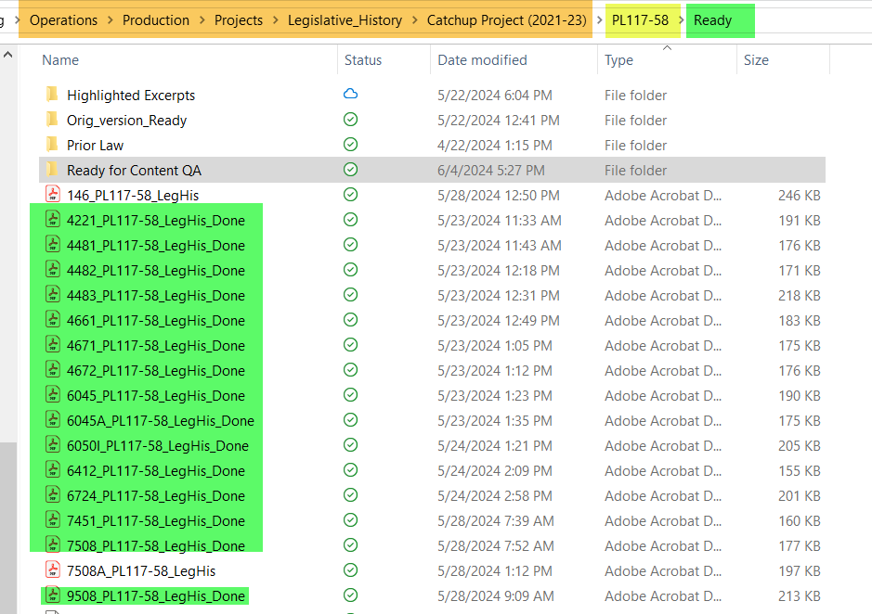
Where are the files?
Files ready for Production QA named “_done”
When Production QA task done, move to Ready for Content QA folder

Slide 4
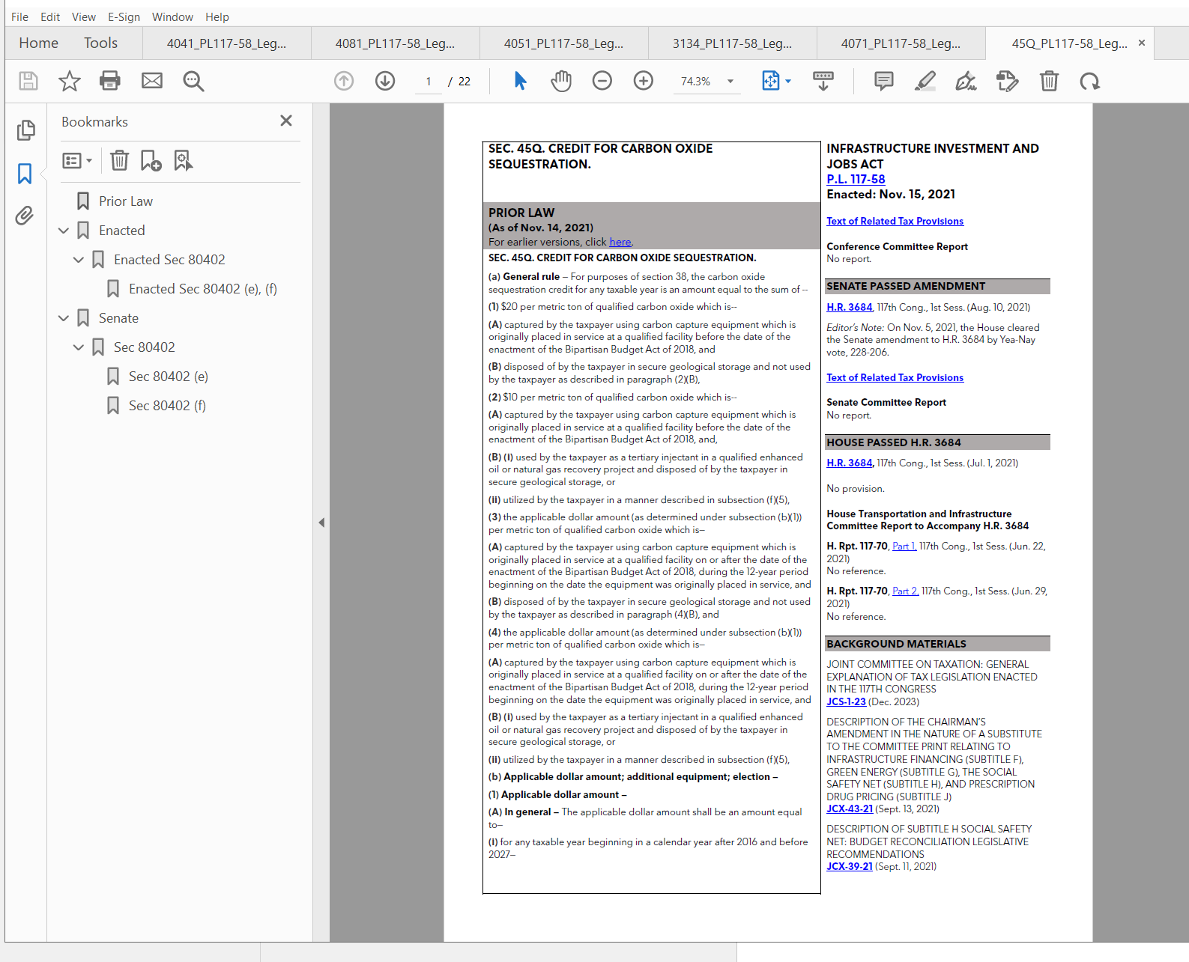
Legislative History
Document
Opens to
1. Bookmark pane
and
2. Document

Slide 5
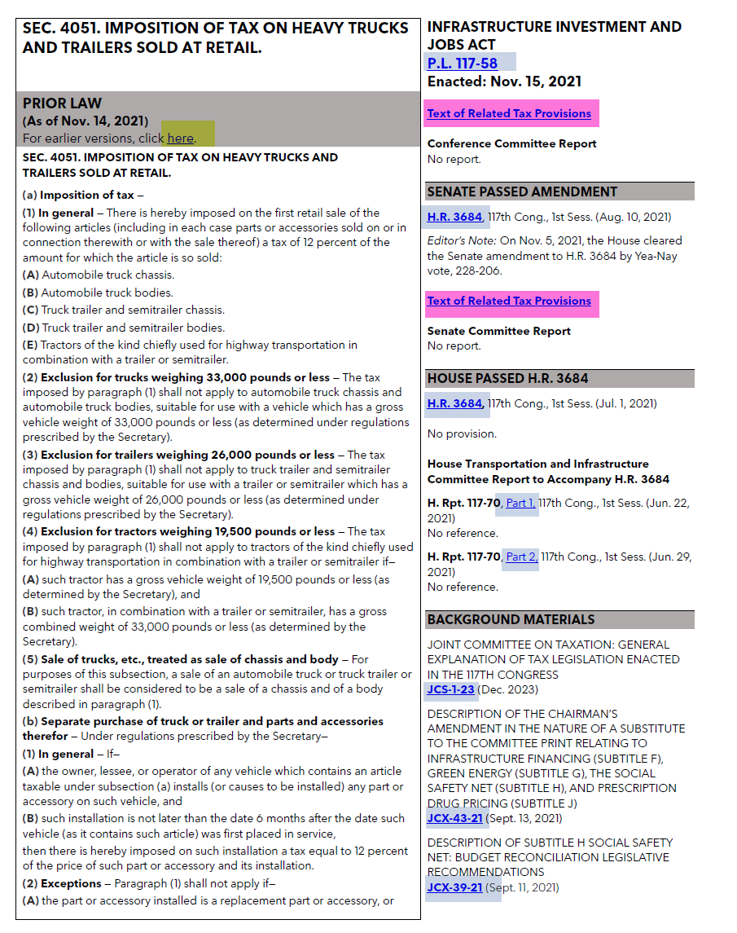
Legislative History
document
Documents and tax provisions Public Law, as enacted
Senate-passed bill text, tax-related provisions, and related documents
Note that sometimes there will be no provision.
Text of code section before changes made by this Public Law
House-passed bill text, tax-related provisions, and related documents
Legend:
Link to external document
Link to IRC code section in BTax
Link to another page in this PDF
Other related documents

Slide 6
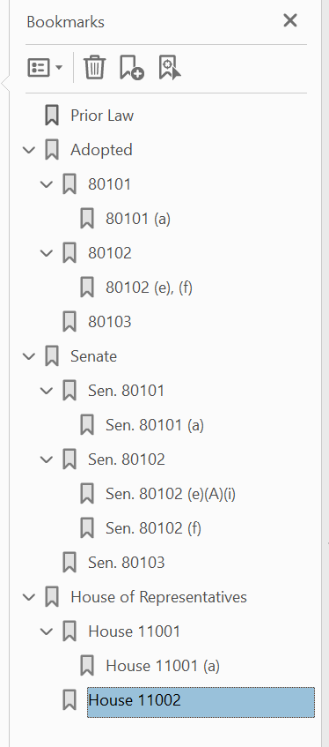
Legislative History
bookmark pane
First page
To cover page for Adopted/Enacted bill section(s)
To page with start of each Adopted/Enacted bill section title
To page where relevant text for Adopted/Enacted bill section begins, noting section of the bill (e.g., “(a)”)
Note: always include section containing Effective Date
Where do links go?
To cover page for Senate bill section(s)
Note: bookmark name is prepended with “Sen.” so bookmark name is distinct from # for Adopted/Enacted
Note: Senate or House may be missing, if that body had no provision for that code section
To cover page for House bill section(s)
Note: bookmark name is prepended with “House,” but doesn’t need to be since # is distinct from Senate or Enacted.

Slide 7
Legislative History,
Links to be checked
Legend:
Links to external document – do not need to be checked.
Link to IRC code section in Btax – hover over to ensure it’s going to correct code section.
Link to another page in this PDF – check that these links go to correct location in document.

Slide 8
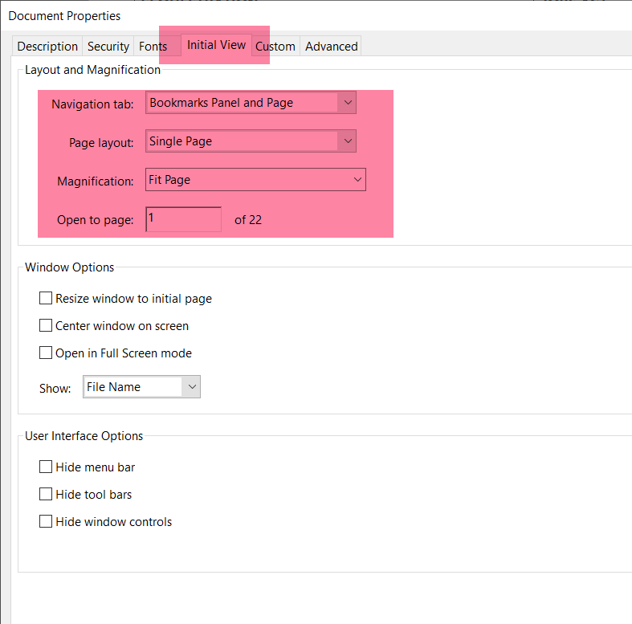
Initial View for LegHis file
Document opens to this view, with bookmarks displayed and full page
If it does not open to that view, adjust Document Properties to below:

Slide 9
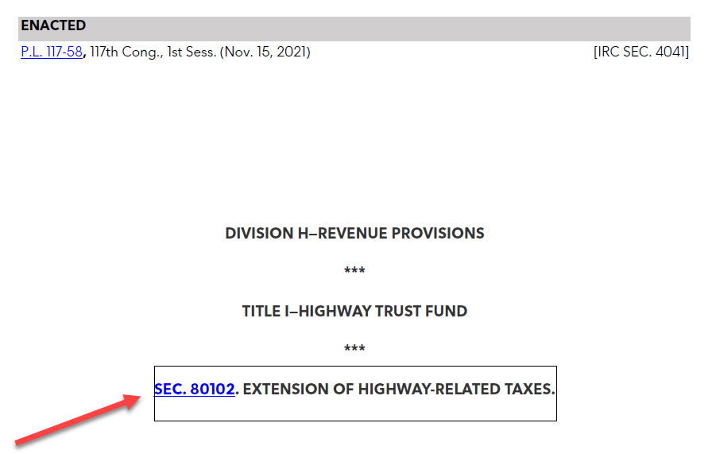
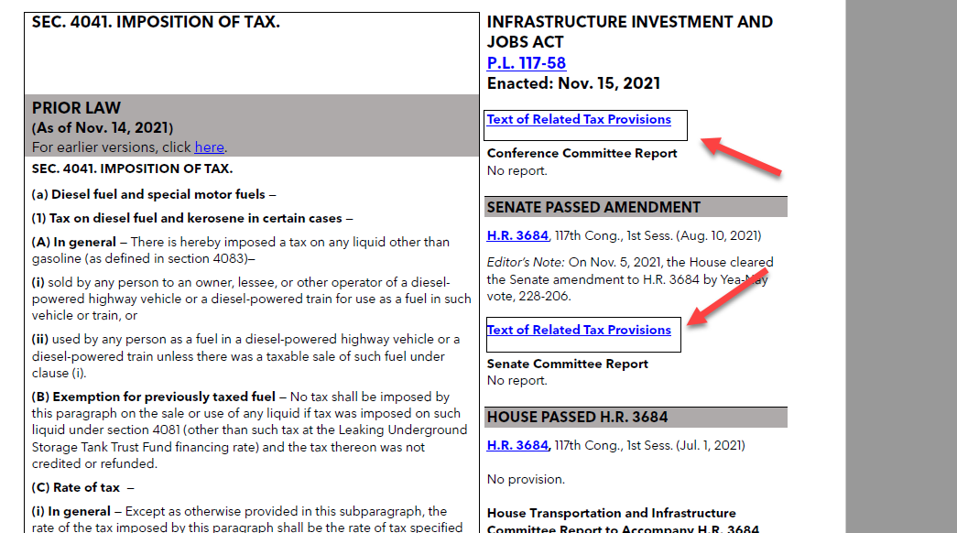
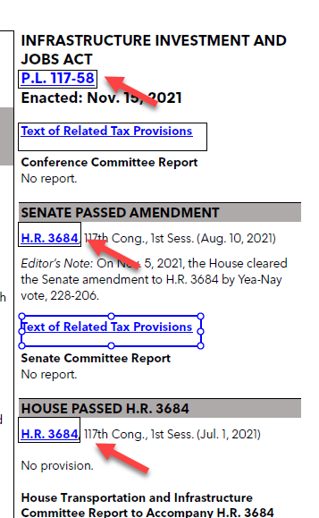
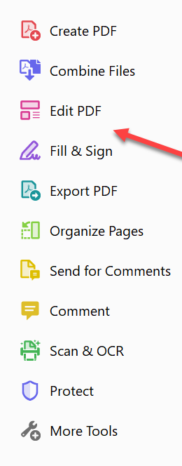
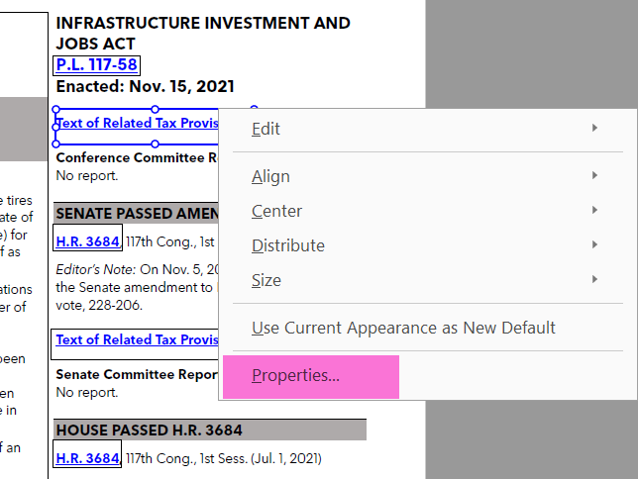
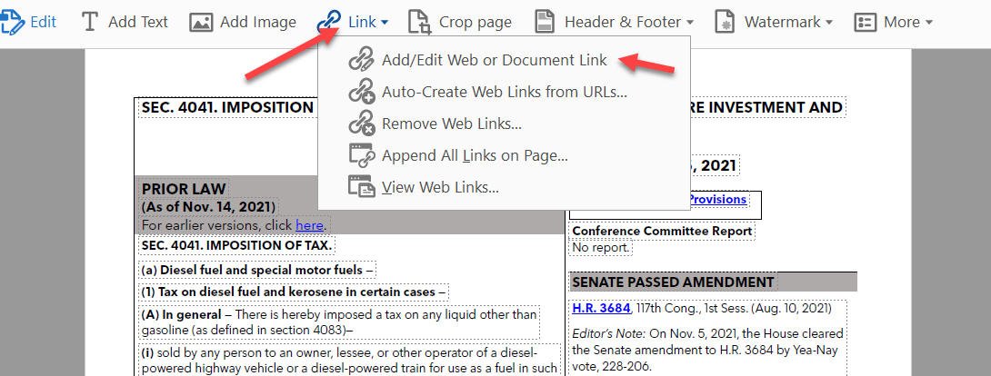
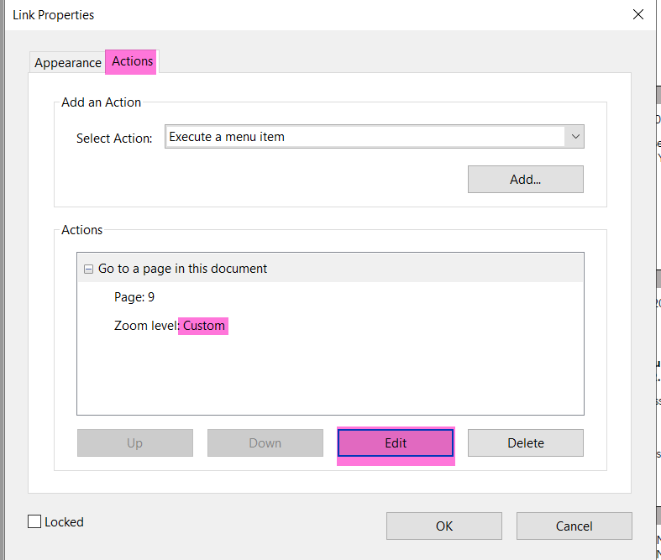
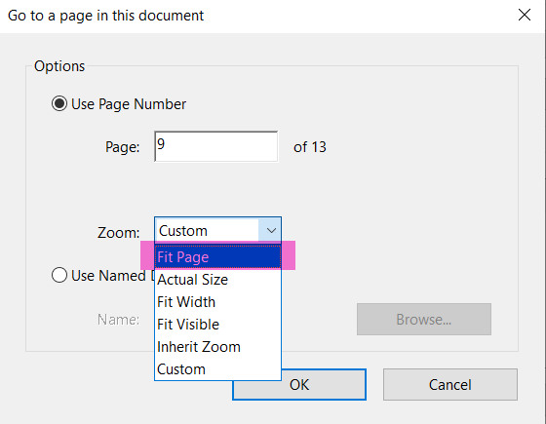
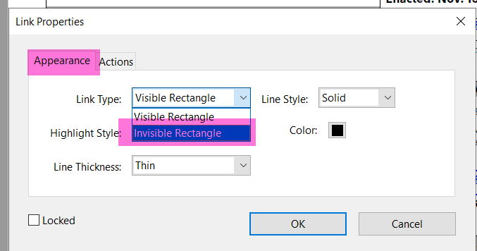
Links should be invisible boxes
Note:
Once you select, “Add/Edit Web or Document Link”, all links will appear to have visible bounding boxes. So, make note of which boxes you need to edit before selecting that tool.
To fix:
Select “Edit PDF” tool
then Link, Add/Edit Web or Document Link
then, right click on box around the link, select Properties
Under Appearance, and Link Type, select Invisible Rectangle
Under Action, select Edit, then under Zoom, select Fit Page, OK, OK.
incorrect
1
3
2
5
4

Slide 10
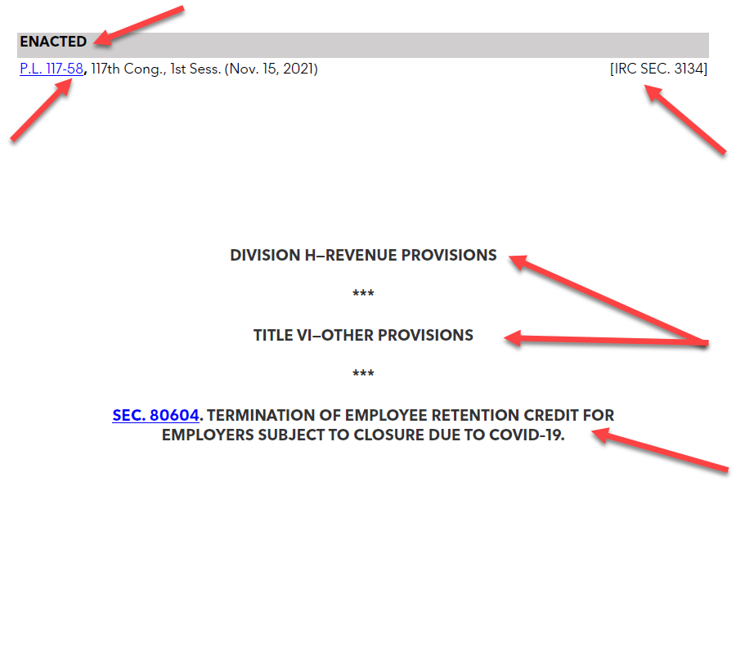

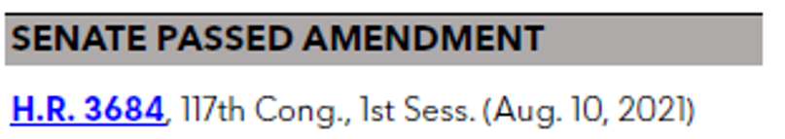
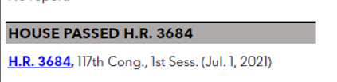
“Cover Pages” within LegHis file
Will be ENACTED, SENATE, or HOUSE
should be same for all Enacted (and should match same from first page:
For Enacted:
For Senate:
For House:
This info was copy pasted for all pages, so if one correct, no need to check each time.
Verify that these are correct

