Slide 1
PORTFOLIO QA FOR PRINT
Reviewer’s Checklist
(prepared specifically for replacements)
May 2024
Version 1.0

Slide 2
Overview

Slide 3
Journey of portfolios to printer…
Portfolios are first published online
Then, they are published in print. How?
    They are composed in house, using a PDF maker (Prince).
    Each PDF is reviewed carefully.
    Corrected PDFs are sent to printer.
You, the reviewer, will be reviewing Replacements:
  Formerly known as Supplements.
  Printed previously at least once.
  Revised portfolios to be reprinted in whole with the same edition number.
This presentation offers guidelines as to what to look for in the page layout.

Slide 4
Your task IS:
Review each page for possible errors in style and format used in Bloomberg Tax portfolios, and;
2) Mark them for composers to fix
Your task IS NOT:
Copyedit, or;
2) Proofread (exceptions later)

Slide 5
A typical portfolio consists of:
Cover
Front matter
  Title page
  Portfolio description
  Table of contents (TOC)
Detailed analysis (DA)
Table of worksheets (TOW)

Slide 6
General Checklist:
Each page footer should have:
Copyright info
ISBN number
Page number (except for blanks)
Portfolio number (with edition no)
Current mailing date (mm/dd/year)
Example:

Slide 7
Cover

Slide 8

COVER
Read carefully (proof) to ensure these items are correct:
Portfolio’s series (“FOREIGN INCOME”, “U.S. INCOME”, or “ESTATES, GIFTS, AND TRUSTS”)
  Front
  Spine
Portfolio’s title
  Front
  Spine
Portfolio’s number and edition
  Front (2)
  Spine (1)
Portfolio’s mailing date (month year)
  Front (2)
Revision language
  Front
Alpha letter (A, B, C, etc.)
  Spine
Everything else is standard

Slide 9
Front Matter

Slide 10
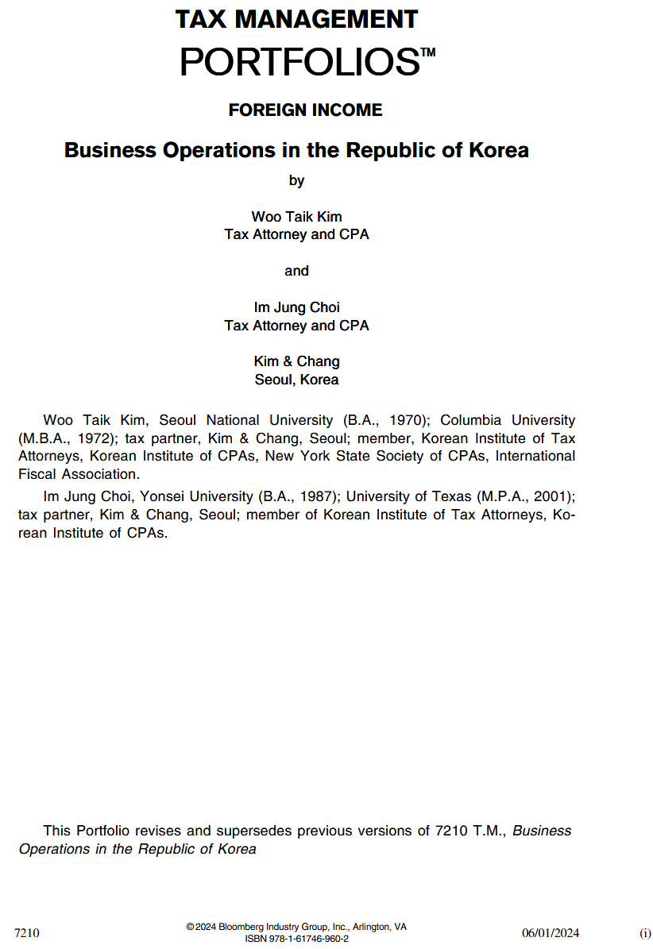
FRONT MATTER
(Title page)
Limited to 2 pages
First two lines of text on top are permanent
Third line indicates portfolio’s series (all caps):
  FOREIGN INCOME
  U.S. INCOME
  ESTATES, GIFTS, AND TRUSTS
Author’s names are listed separately using space around “by” and “and”
Authors’ bios
Standard revision language should be placed all the way on the bottom: “This Portfolio revises and supersedes previous versions of 7210 T.M., Business Operations in the Republic of Korea.” (full portfolio title in italic)
All front matter files have page numbers in lowercase roman numeral put in parenthesis

Slide 11
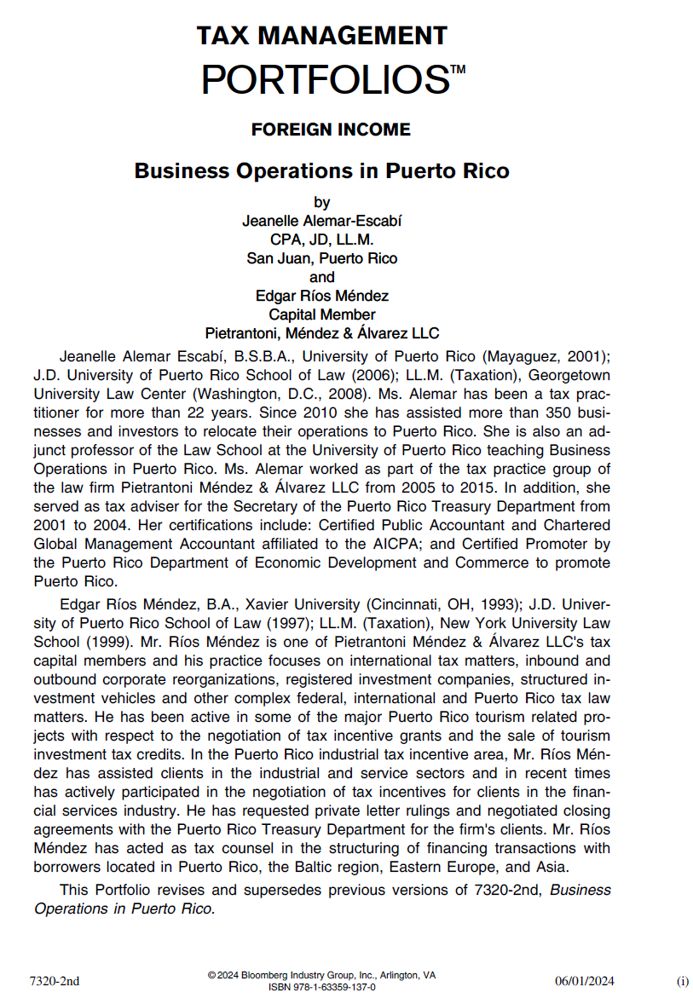
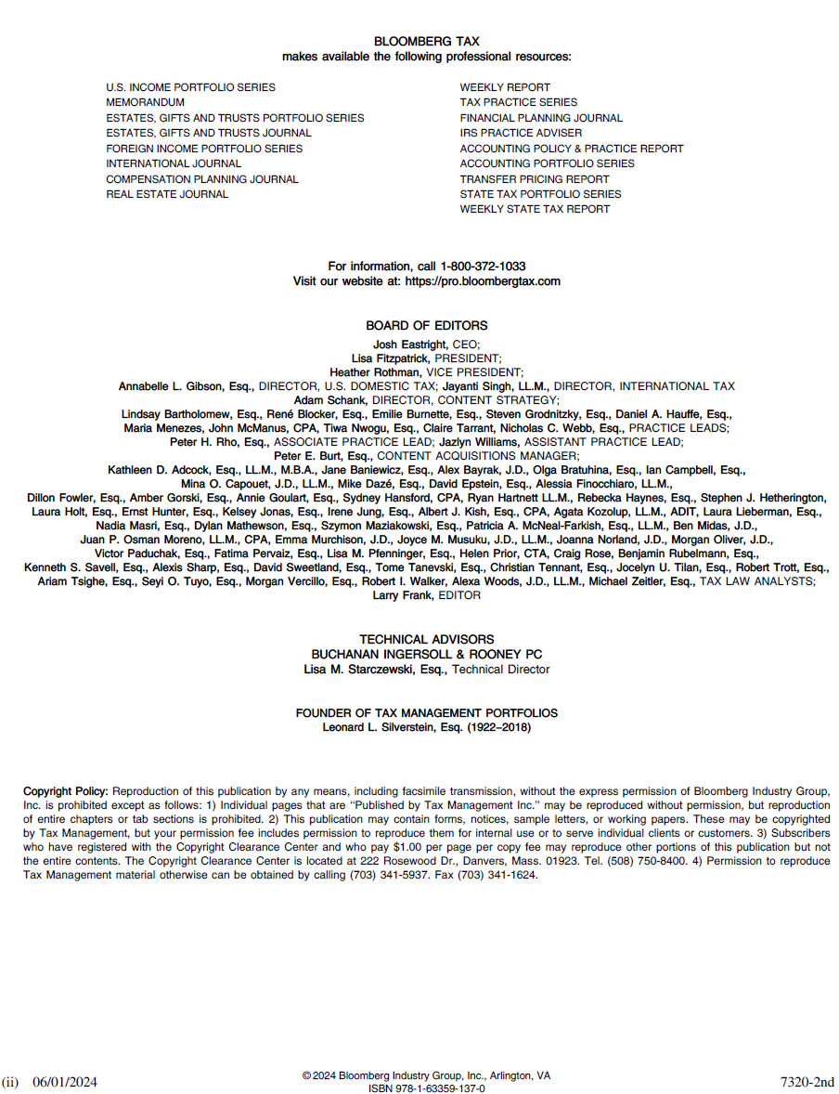
Space may have to be sacrificed to fit all info on front page (see below)
Back page is standard (see below)

Slide 12

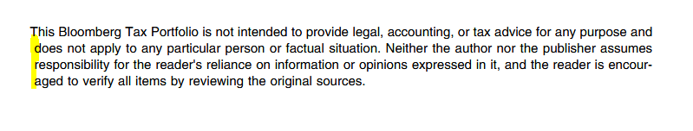
FRONT MATTER
(Portfolio description)
Can be as many pages as needed.
First two lines of text are permanent.
Third line indicates portfolio’s series (all caps):
  FOREIGN INCOME
  U.S. INCOME
  ESTATES, GIFTS, AND TRUSTS
“PORTFOLIO DESCRIPTION” is all caps.
Disclaimer that starts with “This Bloomberg Tax Portfolio…” should be smaller in font size, and be located all the way at the bottom. Correct the disclaimer if it starts any differently, such as:
  This Tax Management Portfolio…
  This Bloomberg BNA Portfolio…
Make sure disclaimer is NOT outdenting (see below)

Slide 13


If there is no space left on title page for authors’ bios (see below)…
Then, said bios are moved to back of portfolio description file starting on a new page (see below)

Slide 14
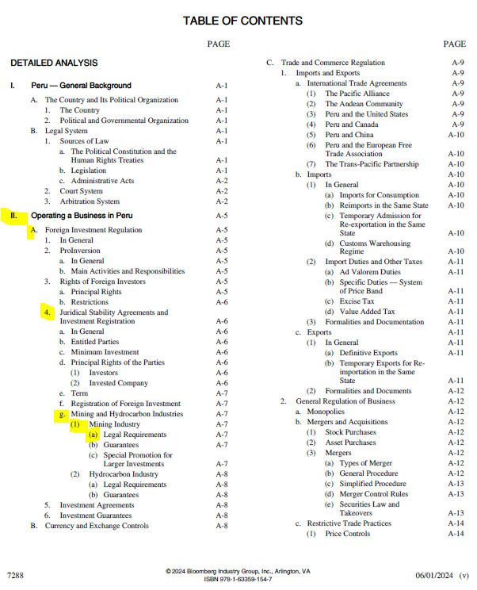

FRONT MATTER
(Table of contents a.k.a. TOC)
Reflects headings of content groups (sections in DA) and their page locations.
Ensure:
Chapter numbers are sequential.
There are no missing or duplicate chapters.
Each chapter begins in an odd number.
All cascading levels are in correct order (nested accurately).
Standard progression of levels:
I., A., 1., a., (1), (a), (i), (A), (I)
Last entry in TOC reads as follow:

Slide 15
Detailed Analysis (DA)

Slide 16

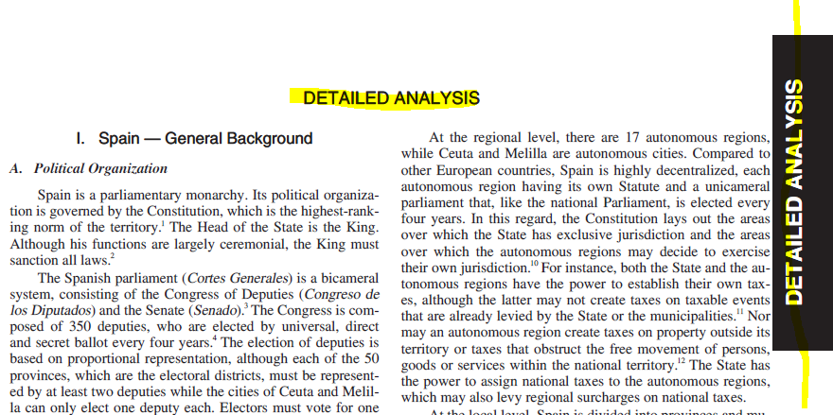
DETAILED ANALYSIS
Main body of discussion in portfolios
Composed of chapters
Each chapter should start in an odd number (e.g., A-1, A-15, A-167)
First page should have:
  DETAILED ANALYSIS banner on top
  DETAILED ANALYSIS tab on right margin

Slide 17
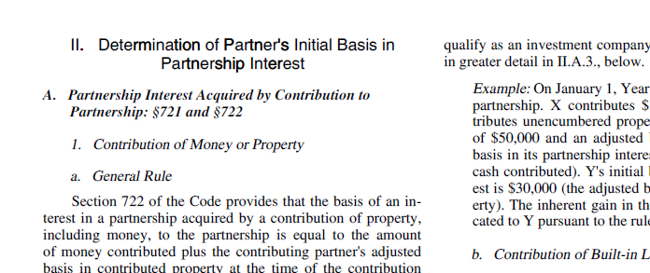
All chapters and section headings that follow should be title cased.

Slide 18
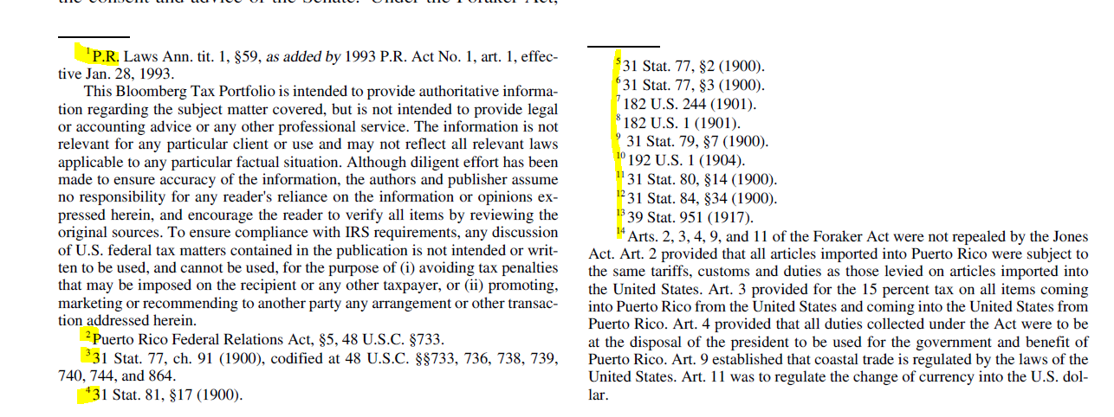
Footnotes should be in sequential order
First chapter starts with footnote no. 1 (if any)
Following chapters pick up numbering from previous chapters (there are exceptions)

Slide 19
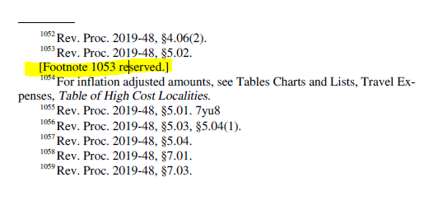
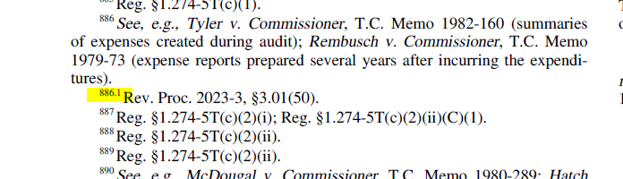
There should be NO reserved footnotes
There should be NO point footnotes

Slide 20
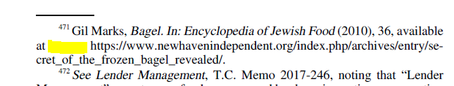
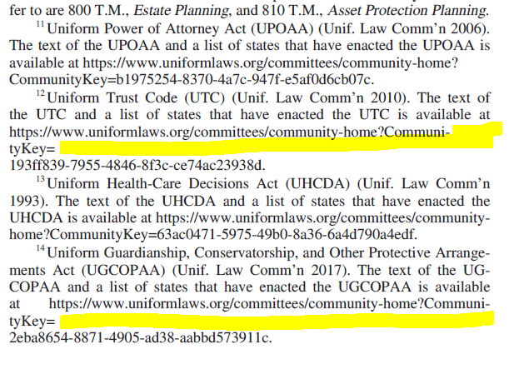
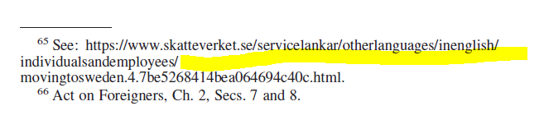
Long URLs found in footnotes could create white space
Some are acceptable. See below.
Some are NOT acceptable. See below and right.

Slide 21
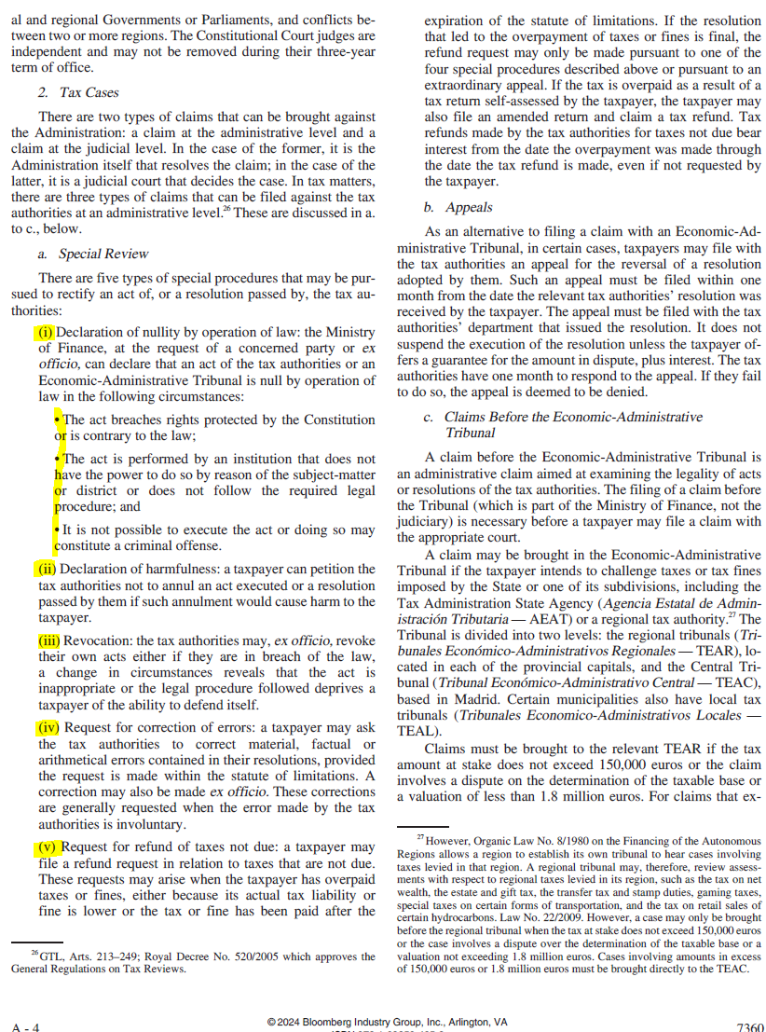
List items should be in correct indentation and level

Slide 22
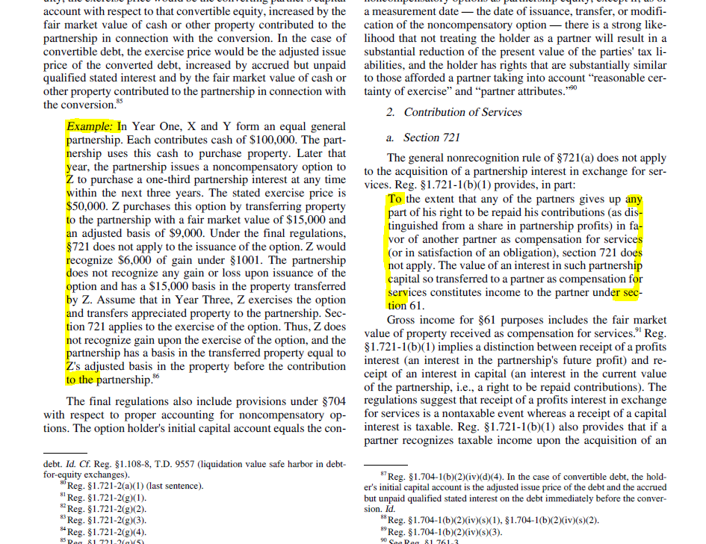
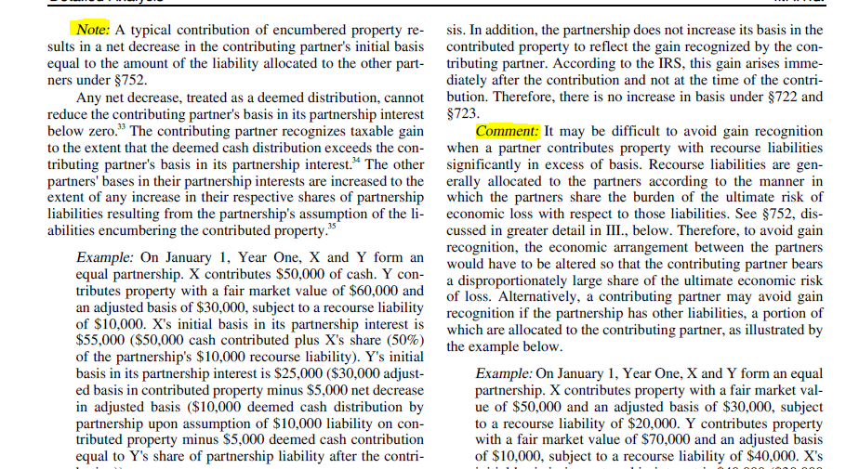
Examples are left-indented and italic
Quotes are left/right-indented
Notes and comments are in italic.

Slide 23
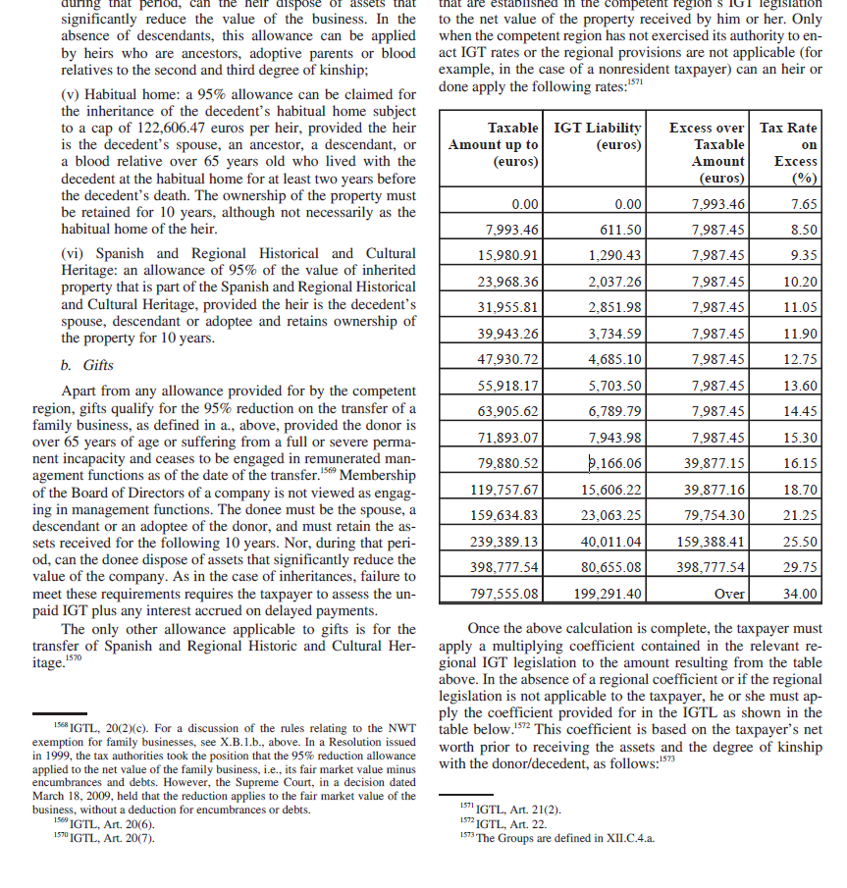
Most tables will fit in one column.
Column headings should be unbroken.
Numeric data is right-aligned.

Slide 24
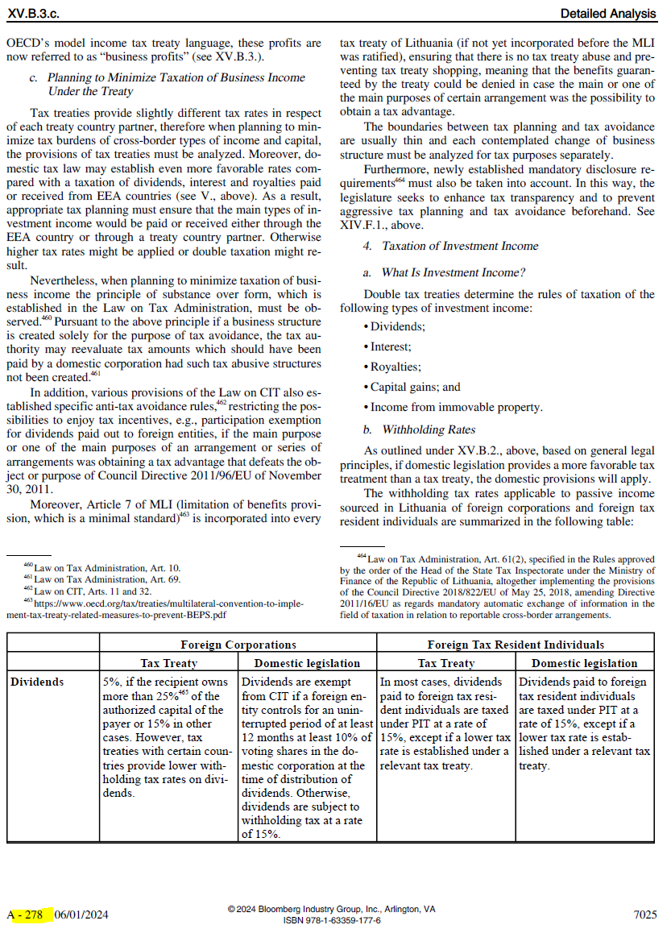
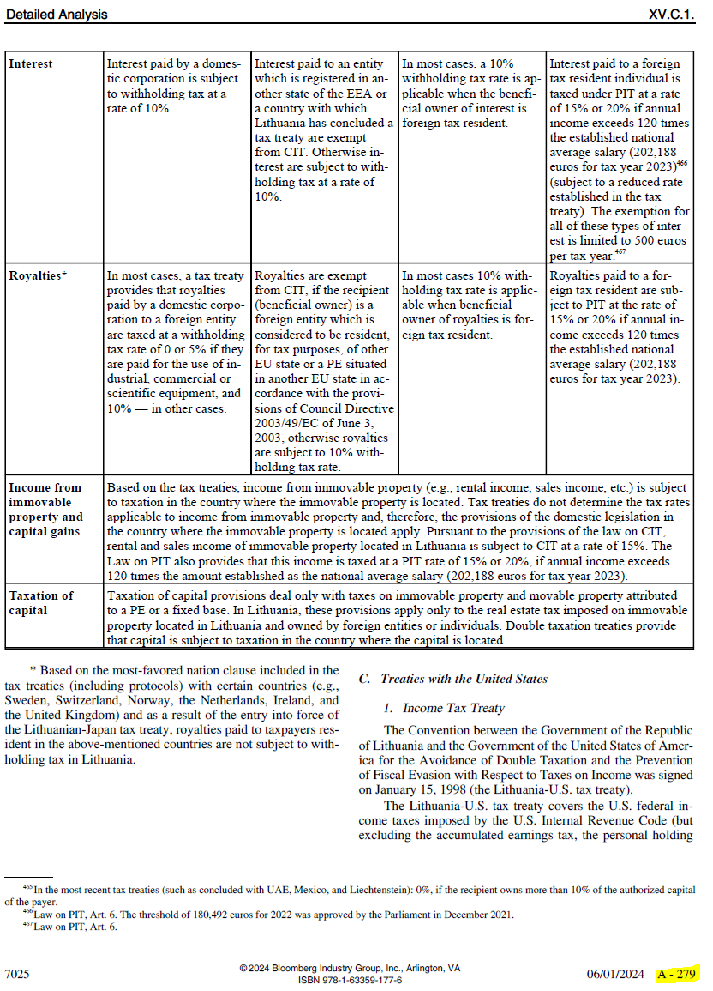
Tables can start on an even-numbered page, and continue on an odd-numbered page.

Slide 25
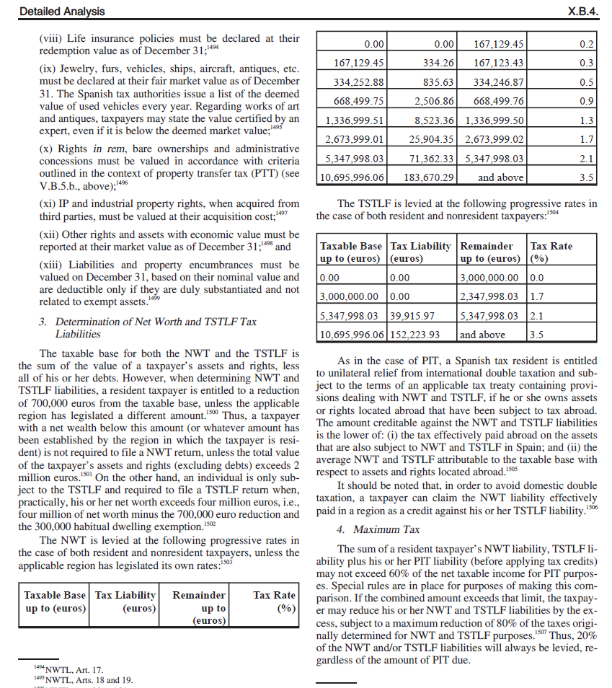
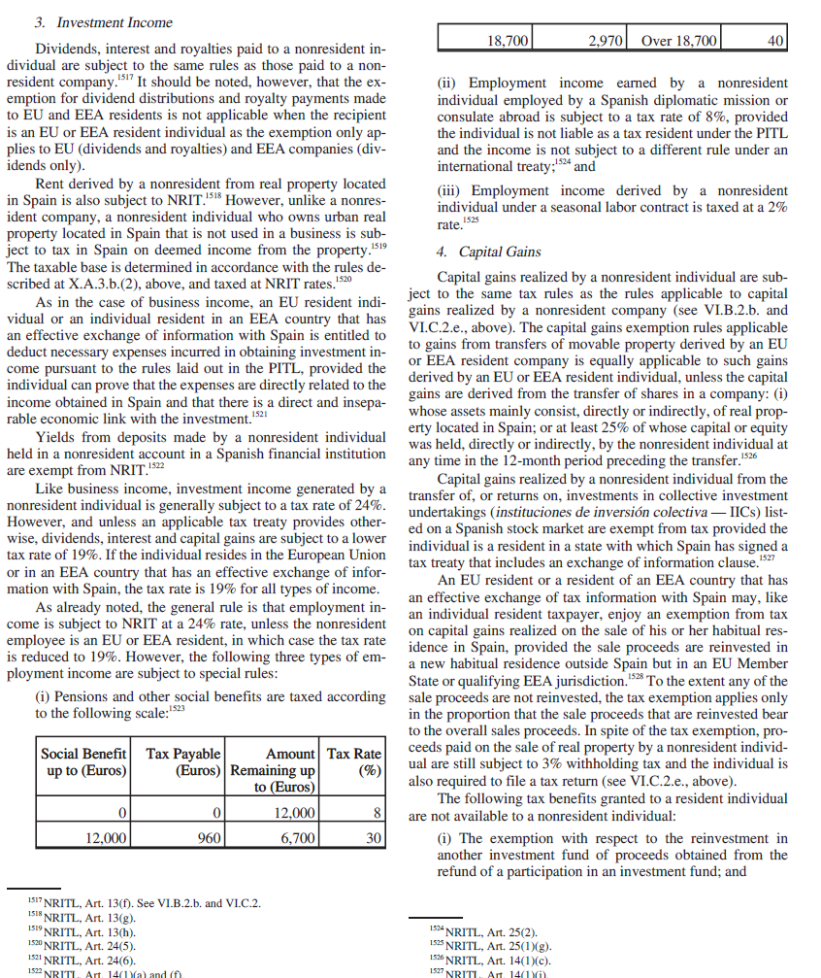
First or last row should not be in a column all by itself.
Tip: Move whole table to right

Slide 26
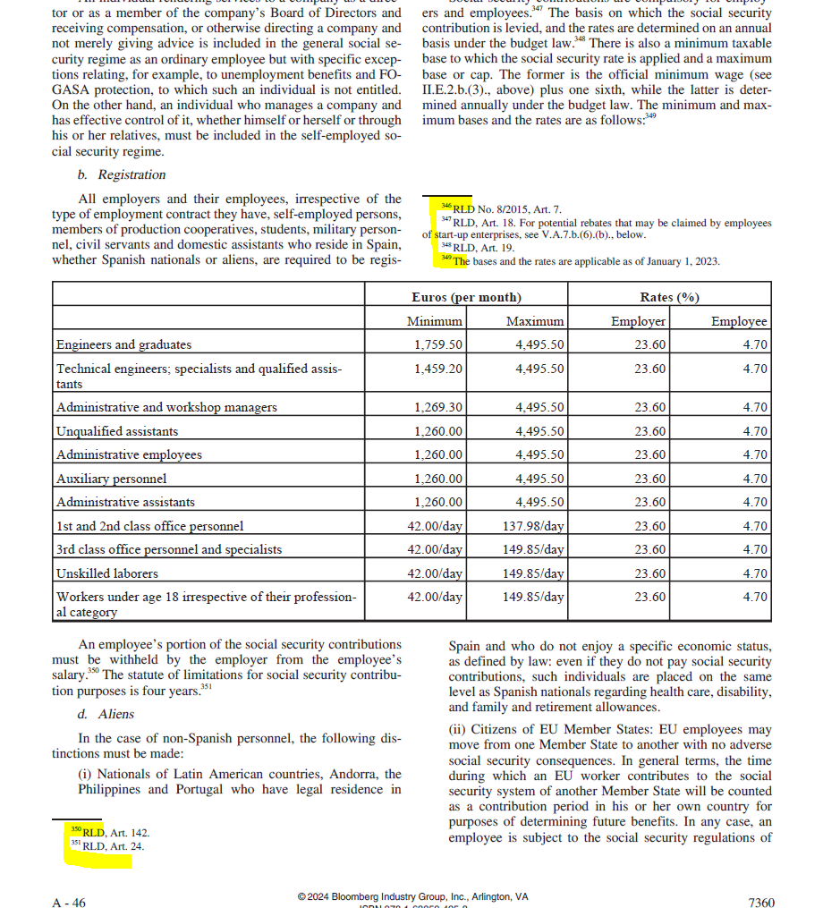
Page-wide tables could have preceding footnotes listed above the table.

Slide 27
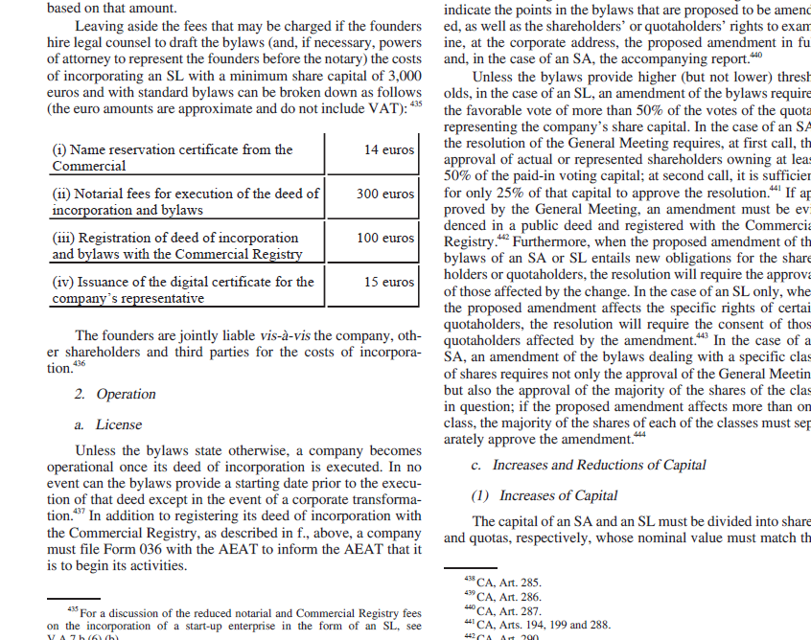
If there are row/column separators and a frame to a table, bordering lines should be unbroken and complete.

Slide 28
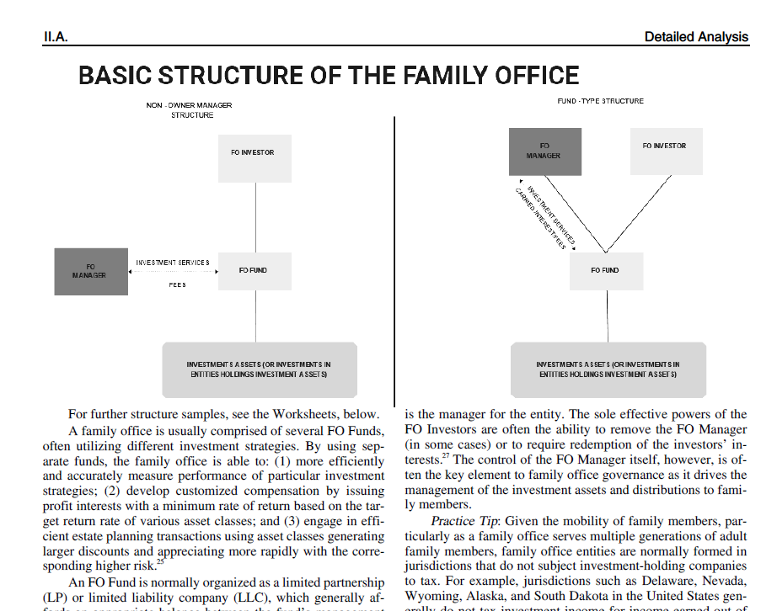
Images should be legible.
If an image is page-wide, preceding footnotes listed above the image is fine.

Slide 29
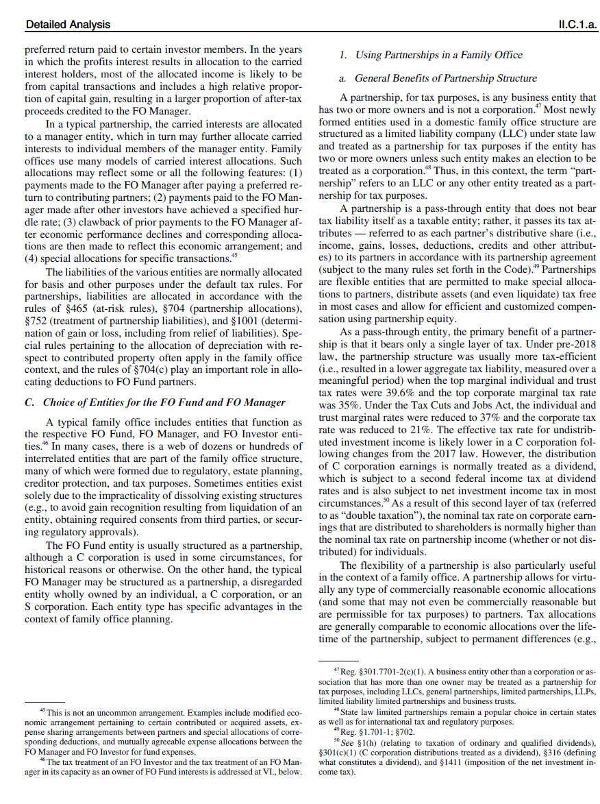
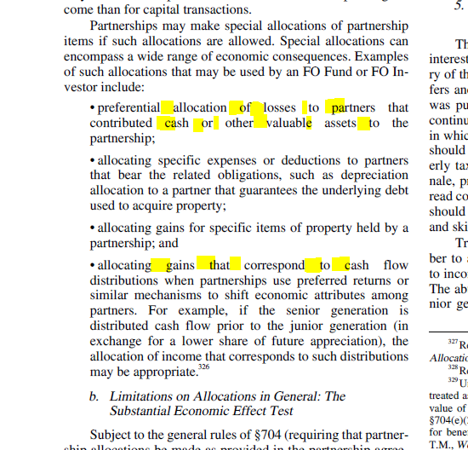
Where section headings cannot fit, some columns will have space instead (see right)
Text in list items (bullets, etc.) cannot be hyphenated. Hence the whitespace (see below)

Slide 30
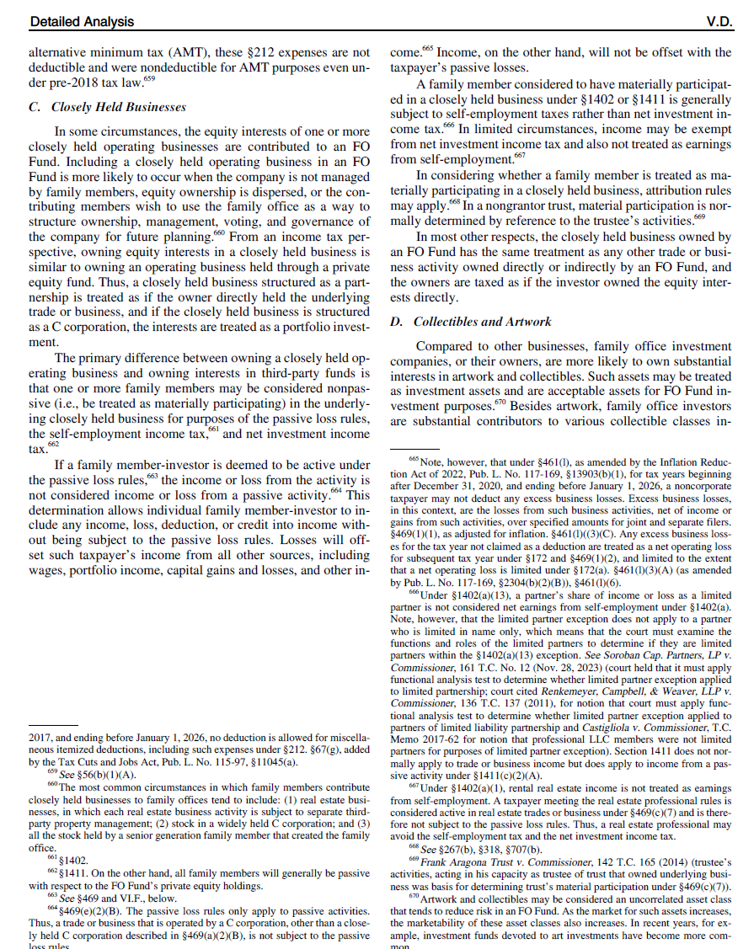
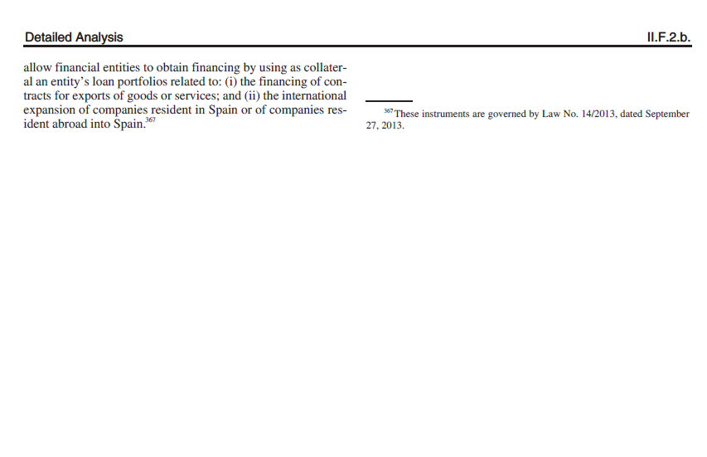
In some cases, there will be large gaps created in an attempt to keep text and its footnotes in the same column (see right)
Last page of a chapter may have its footnote text appearing in opposite column (see below). Fixable.

Slide 31
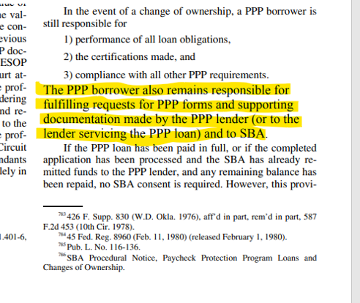
Last, but not least…
Our new PDF maker (Prince) is still in development
It behaves in unpredictable ways when a certain set of conditions coexists
Production is aware
While many errors are data-related, and could be fixed, others might be Prince-related, and currently not resolvable.
These irregular behaviors often need reporting, further investigation, or a home-made workaround for the time-being.
The example on the right (font size enlargement) is one of many errors we have fixed with a workaround.
As older portfolios get composed in Prince for the first time, we are likely to see several more of these.
When in doubt, question!

Slide 32
Table of Worksheets

Slide 33
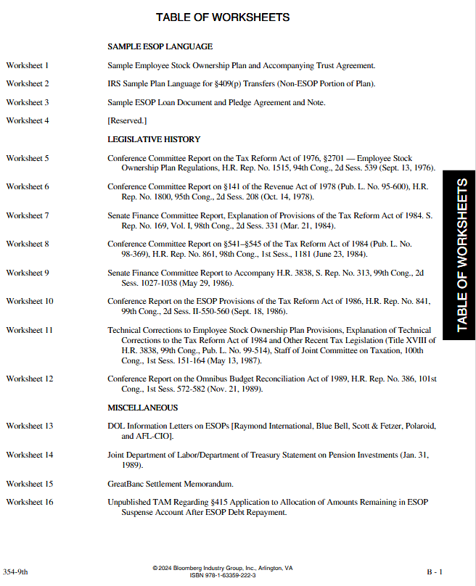
TABLE OF WORKSHEETS
Worksheets themselves do not get printed.
Could have a subgroup heading (e.g., SAMPLE ESOP LANGUAGE, all caps, left aligned)
Worksheet numbers should be listed sequentially
There could be [Reserved.] worksheets in between
Worksheet titles should be in title case, unbroken (not hyphenated), and should end in a period

Slide 34
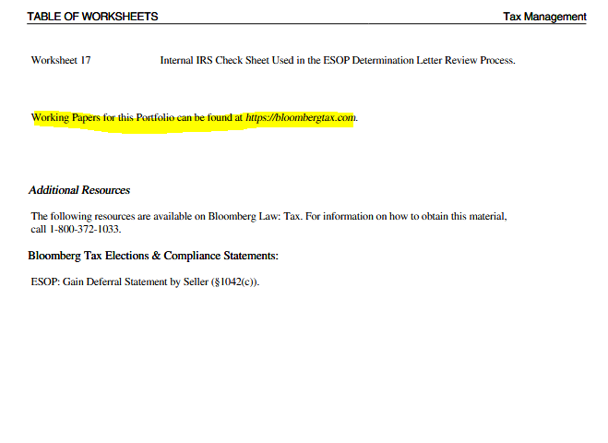
Highlighted remark should exist for all TOWs.
There could be Additional Resources listed separately.

