Slide 1
Current PRTN Workflow
Assess for highest priority
Identifies related PRTN section, copies to .docx file
Mindcrest
Monitors Tracker for relevant dvlpmts
Writes update in .docx file
Reconciles list with what already written
Write any dvlpmts missed initially but on INDG list
Receives INDG case list (weekly) and low priority list
Email .docx files to INDG
Receive .docx files
Review .docx update files
Attach .docx files to corres-ponding Jira ticket
Search TAXD for Open tickets with PropertyMC
label
Create TPQA ticket; check out state file to BWIP
Assign to vendor
(and notify analysts to stay out of file)
Vendor updates file in BWIP
Devlpmt happens at state level
BTAX State Tracker
INDG state tax analyst
INDG state tax analyst
TPQA
Vendor
TPQA
state analyst
Relevancy
determin-ation (“RD”)
Relevant dvlpmts exported to XLS
Import XLS to Jira
Jira tickets: Review for priority
Priority dvlpmts:
Create xls
Priority dvlpmt XLS triage
1. Review vendor work
2. release file to BTAX
3. Close TPQA ticket
QA on BTAX; close TAXD ticket
Lower priority dvlpmt tickets:
State analyst prioritizes / categorizes into backlog.
Tickets addressed by: 1. Analyst works to close them starting with most recent tickets; and
2. Send a month's worth of tickets (oldest first) to Mindcrest. MC then works on them as time permits.
Once complete, MC indicates they're ready for next list and INDG sends to them.
If multiple TAXD tickets for same state, combine files into single TPQA ticket
Type of Jira ticket:
TAXD
TPQA
TAXD

Slide 2

Proposed PRTN Workflow
Mindcrest
Monitor
Tracker
Assess for highest priority
Identify related PRTN section, copy to .docx file
Add redline update in .docx file
Find Jira ticket: 1. attach .docx,
2. add PropertyMC label
and/or monitor Jira dashboard
BTAX State Tracker
Jira dashboard displays PRTN tickets
Devlpmt happens at state level
Relevancy
Deter- mination
(“RD”)
Relevant dvlpmts exported to XLS
Import XLS to Jira to create tickets
Individual development
Tickets exist in Jira
Use dashboard and/or Search TAXD for Open tickets with PropertyMC
label
Create TPQA ticket; check out state file to BWIP
Assign to vendor
(and notify analysts to stay out of file)
Vendor updates file in BWIP
1. Review vendor work
2. Release file to BTAX
3. Close TPQA ticket
QA on BTAX; close TAXD ticket
INDG state tax analyst
TPQA
Vendor
TPQA
state analyst
Type of Jira ticket:
TAXD
TPQA
TAXD

Slide 3
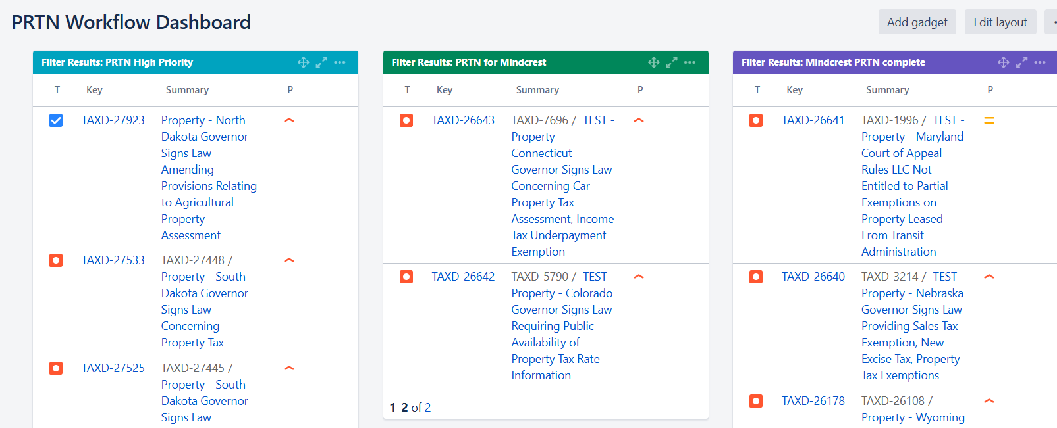
Then, State team by adding “MindCrest” label to tickets, can tag tickets they want to bring to Mindcrest’s attention as needing updates
Then, when Mindcrest finishes their update, they
1. open ticket
2. Attach .docx file
3. Add “PropertyMC” label
This dashboard column displays all results from this Jira filtered search:
project = TAXD AND priority = High AND "Primary Group(s)" = State AND "Tax Type" = "property tax"
Then, that ticket, now marked with PropertyMC and with the file attached displays in this column.
Mindcrest’s work is complete.
The file is ready for those updates to be incorporated into file in publishing system.
project = TAXD AND status in (Open, "In Progress") AND labels = PropertyMC AND "Primary Group(s)" = State AND "Tax Type" = "property tax"
Then, that ticket, now marked for Mindcrest, displays in this column, which displays results from this Jira filtered search:
project = TAXD AND status in (Open, "In Progress") AND priority = High AND labels = MIndcrest AND "Primary Group(s)" = State AND "Tax Type" = "property tax"

