Slide 1
Introduction to Oxygen Web Author
Getting started with the Oxygen Web Author
Spring 2023

Slide 2
Introduction What is Oxygen Web Author?

Slide 3
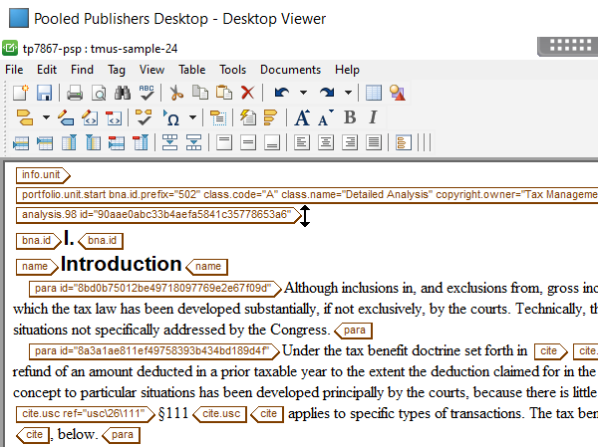
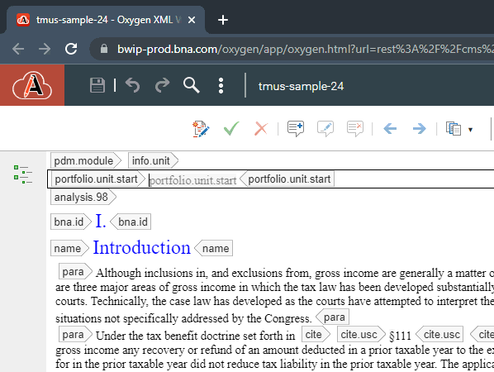
Arbortext Oxygen Web Author
Oxygen is replacing Arbortext as INDG’s structured text editor
It moves us from SGML to XML data and from a Windows application to a web app

Slide 4
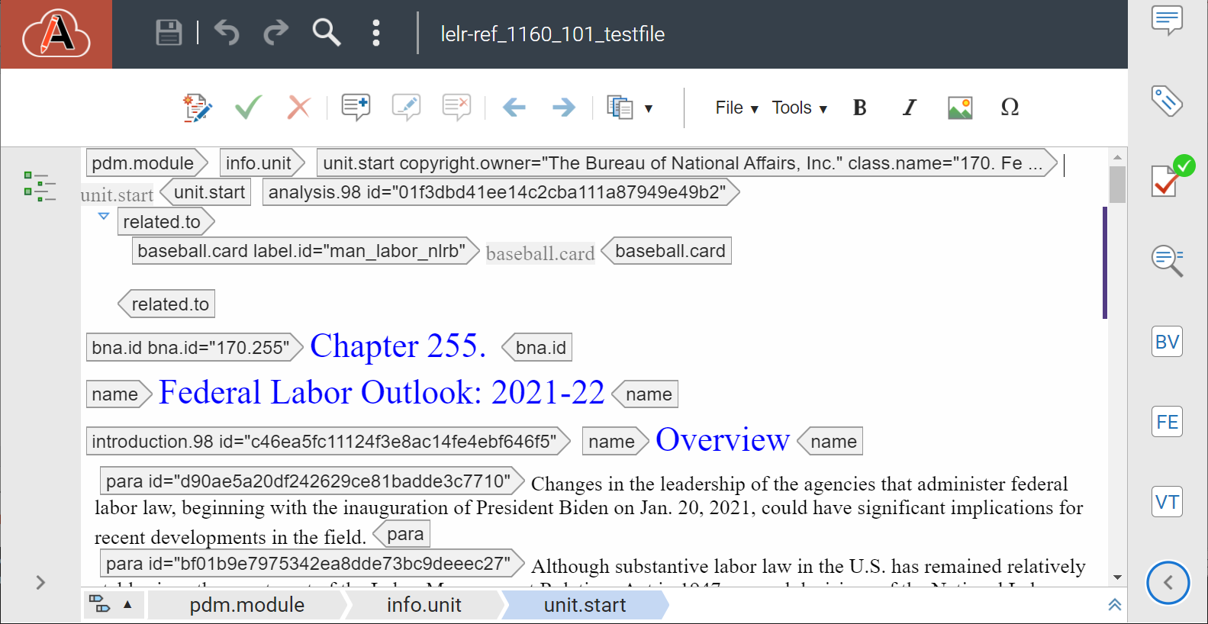
What is XML?
XML is how we store data in Oxygen. XML uses tags or “elements” to create and define the structure of a document’s data
XML is more reliable and tightly structured than SGML, the markup language we used in Arbortext, you will see fewer documents fail to publish
XML allows real-time validation, you will see more frequent data errors when editing, that is a good thing, we’re catching them sooner

Slide 5
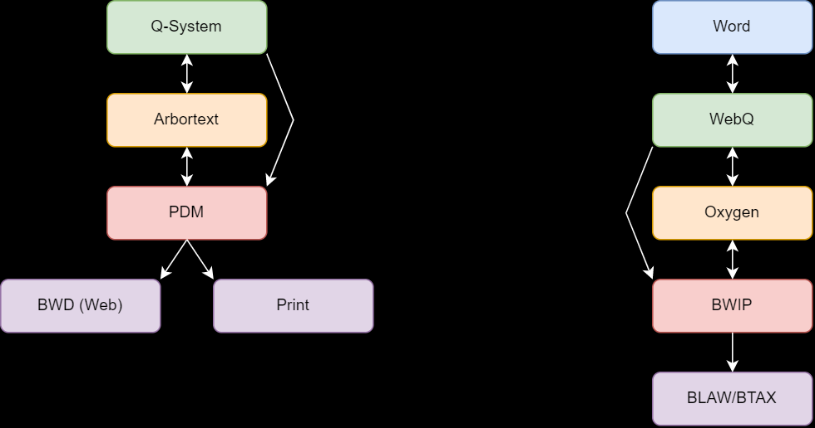
Then Now

Slide 6
Oxygen Development
Oxygen is still being actively developed, the first goal for Oxygen was to launch it with a stable, working, safe configuration so that you all can use it
Much work remains to improve it, you will see things that are not currently supported, and you will see changes over the weeks when you use Oxygen
This training is an introduction, not a complete catalog of Oxygen’s features and use
This training is not the end of our support for you
A full documentation portal is being worked on and will be released soon
You are welcome to attend another of these sessions as there is a lot to absorb
In May we will host weekly office hours so you can come with questions or requests

Slide 7
Navigating Oxygen and Customizing Your View

Slide 8
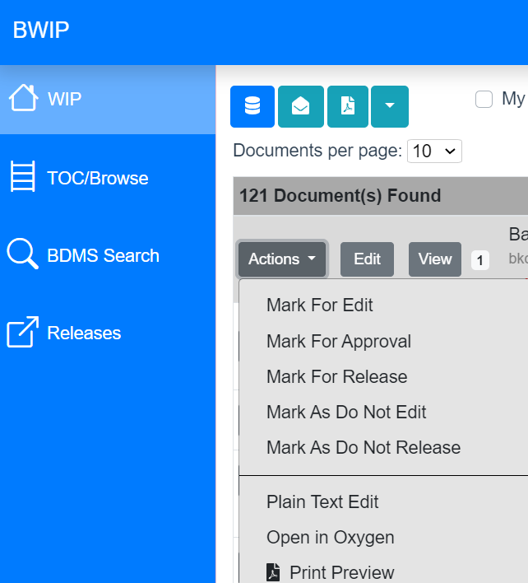
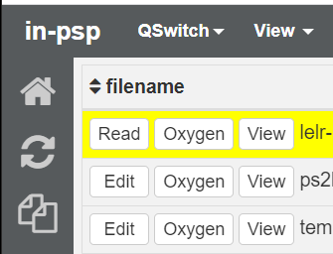
Launch Oxygen
You can launch from BWIP or the WebQ
When you launch it will open a new tab for each document, like the Viewer tool
If you need a sample go to: webq.bna.com/q/in-psp
Opens the file in Oxygen

Slide 9
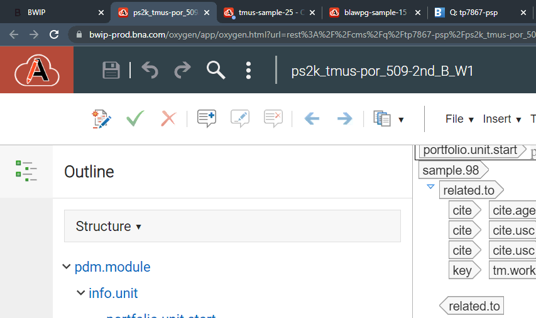
Oxygen – A Web-based Tool
Sample files: webq.bna.com/q/in-psp
Oxygen will open in a browser tab
You can have more than one file open, each will appear in their own tab
Tabs will show the file name which is open
Tip: If your Oxygen display is too small use Control & + or Control and the mouse wheel to zoom in

Slide 10
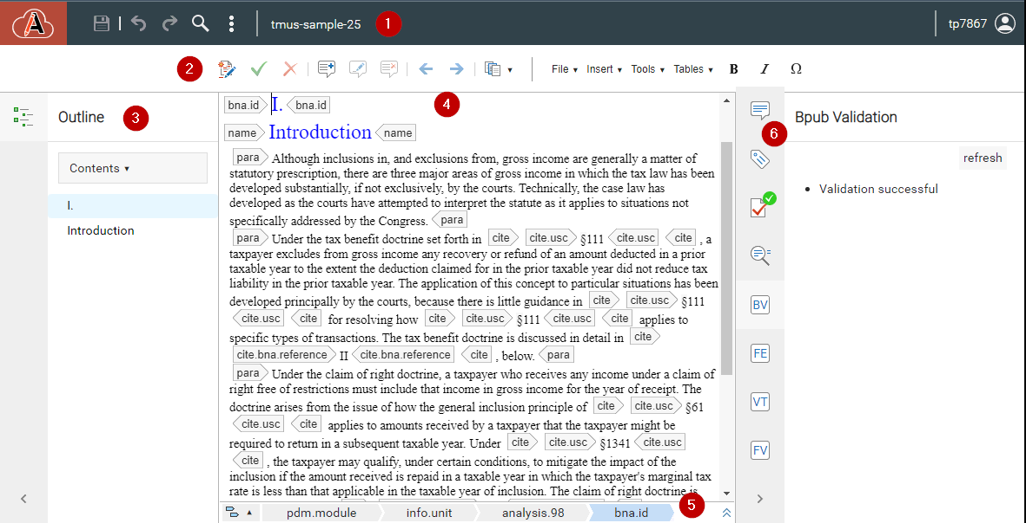
Components of Oxygen
Menu
Toolbar
Outline
Body
Location
Sidebar
Don’t worry if your Oxygen window doesn’t look like this!

Slide 11
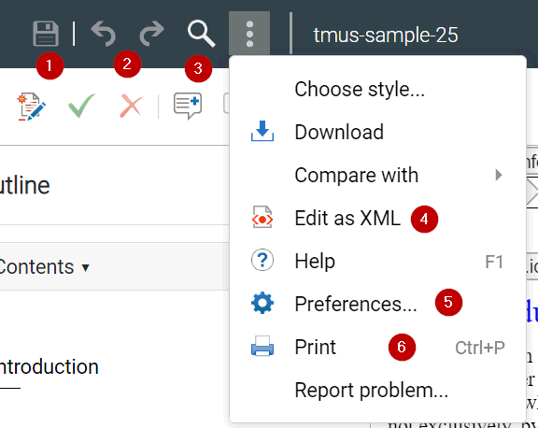
Components of Oxygen –Menu
Save, more on the next slide
Undo (Ctrl + Z), Redo (Ctrl + Y)
Find and Find & Replace (Ctrl + F)
Edit as XML – For power users this will replace the PTE, allows raw editing, use with caution
Preferences – A few basic settings, you likely won’t need to use this
Print – This is to print a copy of the text, does not offer any formatting options
Tip: If your Oxygen display is too small use Control & + or Control and the mouse wheel to zoom in

Slide 12
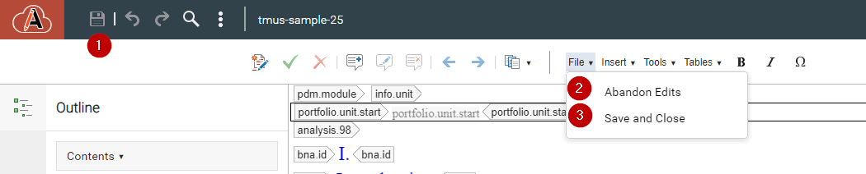
Saving Files in Oxygen
Save, this will save a draft copy of the file. This can be used if your browser or application crashes to avoid lost edits. You should save once in a while when working on a large set of edits but do not need to do it too frequently.
Abandon Edits will discard any changes and close the file.
Save and Close will save your edits to BWIP or the WebQ and close the file.
Oxygen auto-saves every 60 seconds, the manual save button can supplement this for an added layer of security.
Do not close your browser tab! Any files you have open should have Abandon Edits or Save and Close run.
Do not leave documents open overnight, this can cause issues.

Slide 13
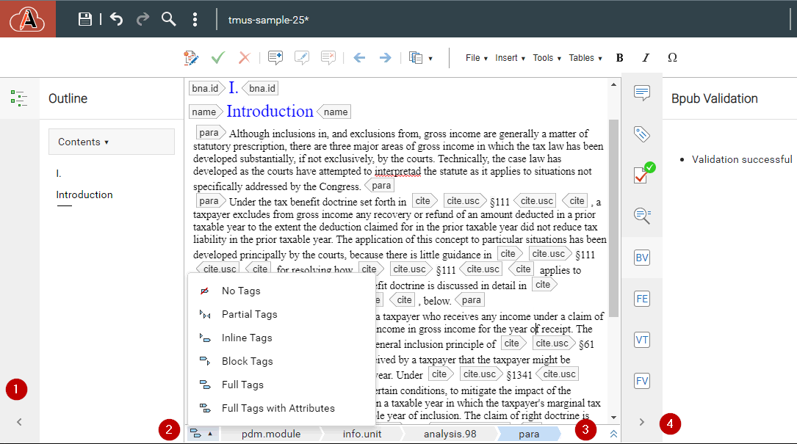
Configuring the Oxygen Display
Show/hide outline
Set tag display mode
Move bar top/bottom
Show/hide validation

Slide 14
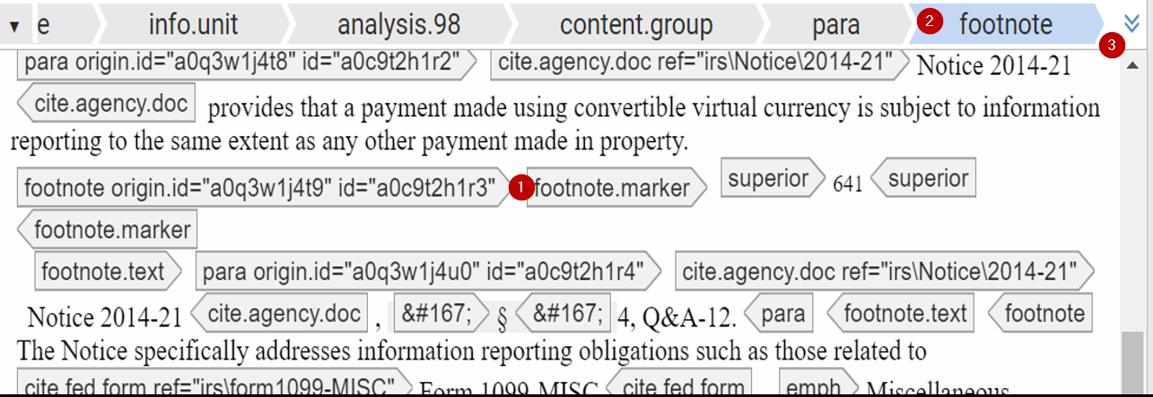
Breadcrumb Trail
Cursor location
Breadcrumb showing element structure, clicking an element will select it and the contents
This arrow moves the breadcrumb trail to the top or bottom of the editing pane

Slide 15
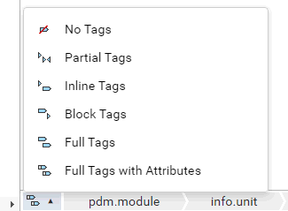




Tag View Mode
On the far left of the breadcrumb trail there is a button to open the tav view menu
Full Tags with Attributes
Block Tags
Full Tags
No tags (not recommended)

Slide 16
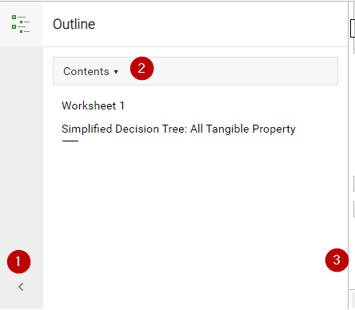
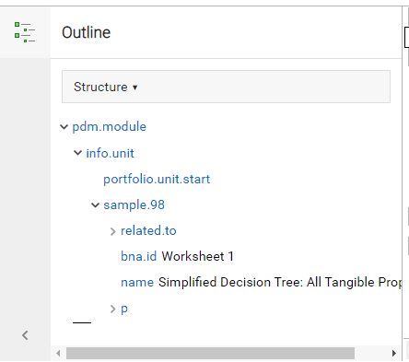
Outline View
Show/hide outline
Switch from Contents to Structure view
Expand/contract Outline panel
Contents: see the text of your document. In analysis.98 documents, you will see the BNA.ID and the content.group name
Contents: see the way the document is tagged and the way elements are nested

Slide 17
Using Oxygen Basic Editing

Slide 18
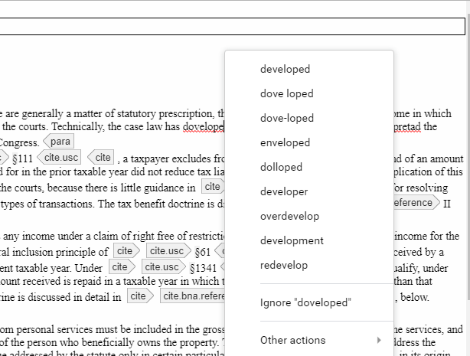
Basic Editing - Text
Text is added, removed, and changed in the body panel
Copy/paste works as normal using keyboard shortcuts (Ctrl + C, Ctrl + X, Ctrl + V)
Spell check is in line with misspelled words highlighted, right clicking will bring up the menu

Slide 19
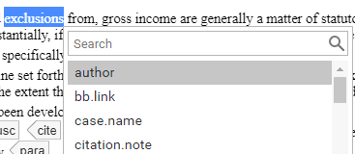

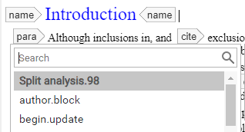
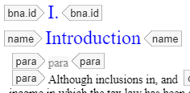
Basic Editing – Adding Tags
The Enter key is used to add a tag
You can select text before adding a tag to wrap that text
Or you can put your cursor before or after text and tags to enter a tag at that spot
You can also Insert Element from the right click menu

Slide 20
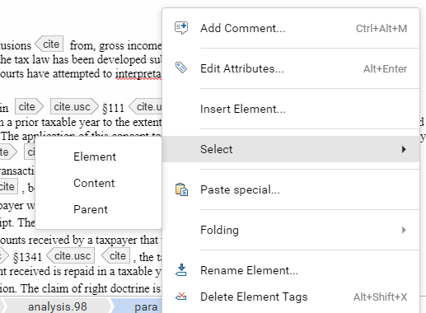
Basic Editing – Right Click Menu
Select replicates the F2 shortcuts:
Element: the text and tags wrapping it
Content: the text inside the tag
Parent: the parent tag and all contents
Rename Element: Change the tag you are inside to another valid tag (e.g. cite to bb.link)
Delete Element Tags: Delete the tag you are inside without removing content
(Add Comment, Edit Attributes, Paste Special, and Folding covered in later slides)

Slide 21
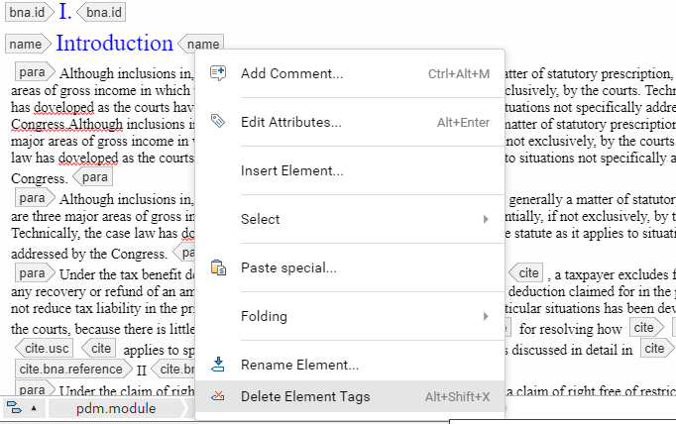
Basic Editing – Don’t Break XML!
Cursor position
Be careful with Delete Element Tags!
Using this tool, or others you can cause XML to be invalid
In the example on the right, we will select delete element with our cursor inside a <para> tag

Slide 22
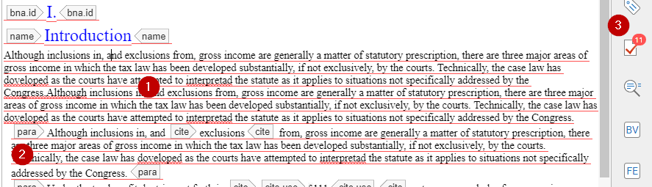
Basic Editing – Oops, You Broke XML
After deleting the <para> element we are left with invalid XML, the text was left but is no longer part of a valid <para>
After 1-2 seconds you will see red lines appear on this invalid text (1)
In this case the entire document has become invalid so sections previously valid will also have a red line (2)
Additionally, the Validation widget on the right will light up with errors, more on this later
If you notice this happen the best thing to try is undo (Ctrl+Z)

Slide 23
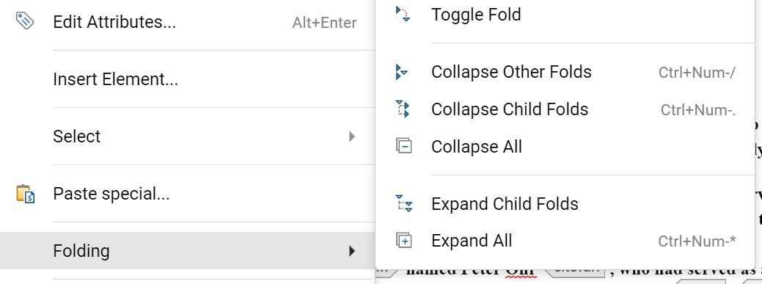
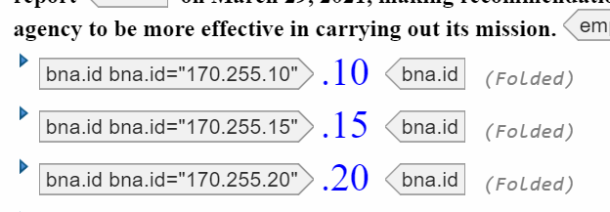
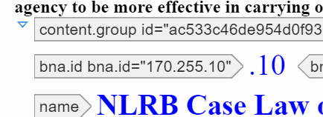
Oxygen Display – Folding
When working with large documents folding allows you to collapse some elements like <content.group> to make editing easier
Folding commands are per-element
Folded elements will display an arrow symbol you can click to expand or close
Only certain elements are foldable

Slide 24
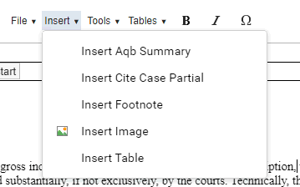
Toolbar Part 1 - Insert
Insert Aqb Summary – not supported at this time, under active development
Insert Cite Case Partial – similar to Arbortext this inserts a case by the BNA Case ID (BLAW Doc ID), a full panel like in Arbortext is in the works
Insert Footnote – similar to Arbortext, we will discuss the Footnote viewer in a later slide
Insert Image – similar to Arboterxt, this inserts an image based on an Orca image ID
Insert table – this is outside the scope of this session, tables are another area of active development

Slide 25
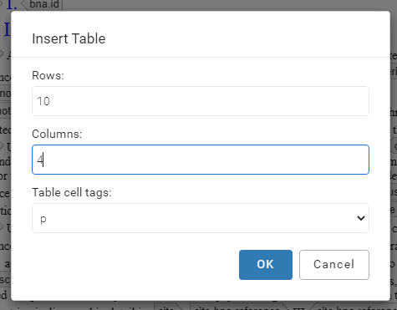
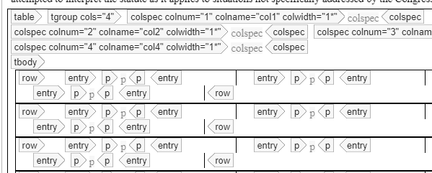
Toolbar Part 1 – Insert Table
The Insert Table menu will allow you to pick the table size and <p> or <text> tags for data
You will need Full Tags with Attributes mode to effectively edit tables
If you need a heading row add a <thread> tag after the first <colspec>
Tables are under active development and will improve with time

Slide 26
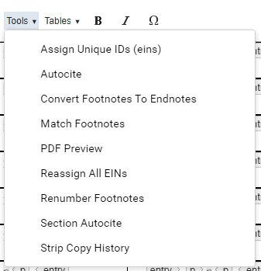
Toolbar Part 2 - Tools
Autocite – opens autocite panel, this is under active development and will be improved
PDF Preview – as with Arbortext this will depend on the document you have open and is not supported by all
Footnote/endnote tools – Similar to Arbortext
EIN tools/copy history – typically used in specific cases, check with production staff if unsure on when to use these

Slide 27
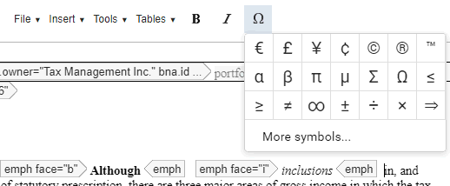
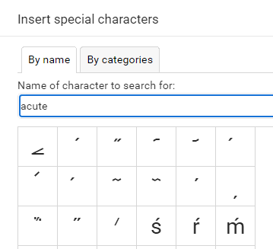
Toolbar Part 3 – Formatting and Symbols
The B and I symbols insert their respective <emph> tagging
The symbol menu allows you to insert special characters and symbols, some are located on this first panel, others you can search or browse for under “More symbols…”
WARNING: not all symbols in this menu are supported by our products. Please don’t add symbols you did not previously use in Arbortext. We’re working to sync the list here with what is supported but for now please use caution.

Slide 28
Right Panel Tools Comments, Attributes, Validation, and More

Slide 29
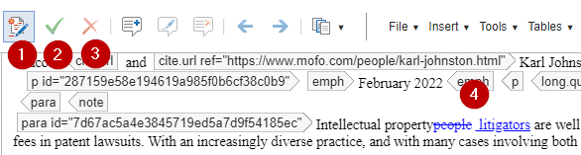
Change Tracking
Oxygen change tracking can be toggled on from the toolbar, when on any edits you make will be shown as pending suggestions which can be approved or rejected. These persist when the document is saved.
Toggle change tracking on
Approve change
Reject change
In-line tracking
Approved changes will be added to the document and show up on product when published, rejected changes are discarded. You can also approve or reject changes by right clicking on them.

Slide 30
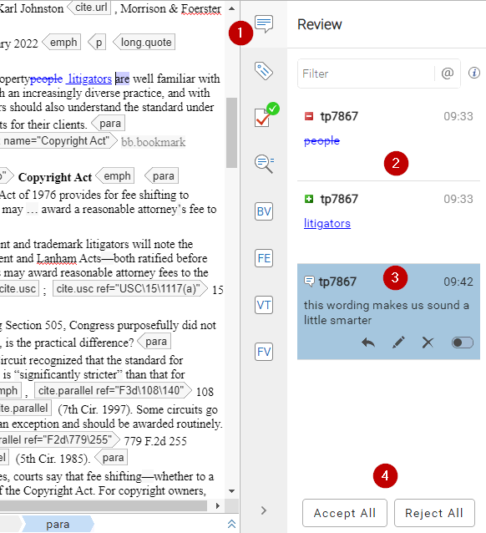

Comment Panel
Change tracking also shows up in the comment panel, the first option on the right pane of Oxygen (1)
You can see all the pending edits in this panel (2)
You can also see comments and reply to them, or delete them when resolved (3)
Comments can be added from the toolbar, right click menu or with Ctrl + Alt + M
You can also accept or reject all pending changes (4)
Comments are replacing sticky notes!

Slide 31
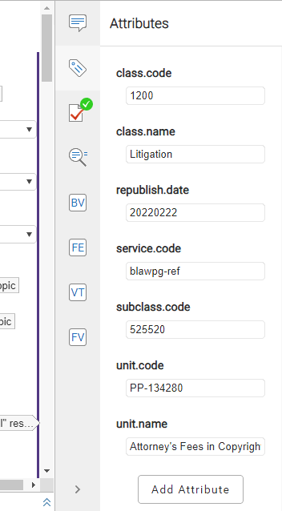
Attribute Panel
The attribute panel is the second option in the right pane
Currently assigned attributes for the tag your cursor is in will be displayed here and can be edited
New attributes can be added with the button at the bottom
This is context sensitive, as you move your cursor this will change to reflect the current tag

Slide 32
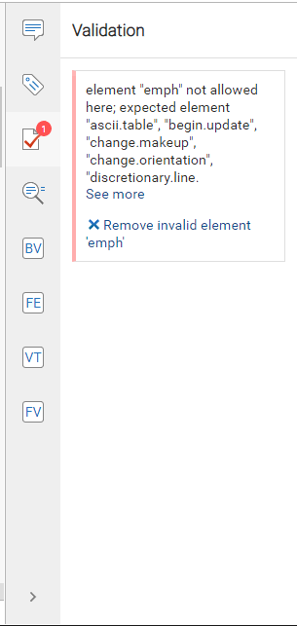
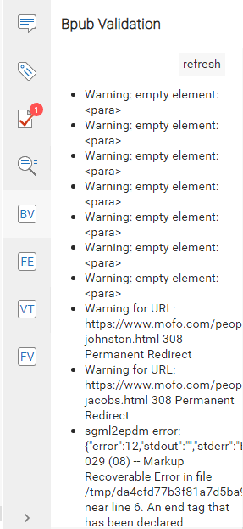
Validation and BPub Validation Panels
The third option (checkmark) is the Validation panel, this will check for XML validity and updates automatically, any errors here are critical and will prevent publishing
The fifth option (BV) is BPub Validation, this only runs when you open it but provides a more complete validation
Warnings in BPub Validation will not prevent publishing but should be reviewed
We’re working to add the “click to error” function

Slide 33
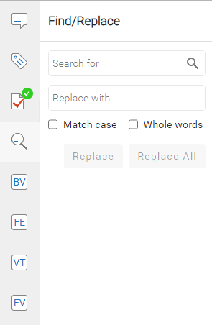
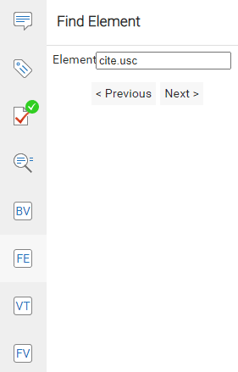
Find/Replace and Find Element
Find/Replace can be opened from the menu, magnifying glass icon, or Ctrl + F
It allows text finding and replacement
Find Element can be opened from the FE button
Find Element allows you to search for an element or tag
Find Element is a custom tool built by INDG and will see future enhancements to more easily search and manipulate XML data

Slide 34
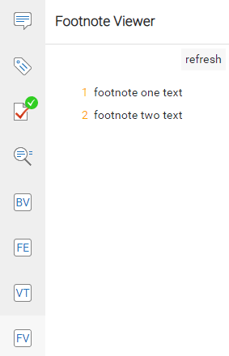
Footnote Viewer
The last option on the right pane, FV is the footnote viewer
This will display the document’s existing footnotes, clicking on one will jump to it in the body text
To see changes to footnotes you must click refresh

Slide 35
What’s Next for Oxygen?

Slide 36
Future Development
Oxygen is still being worked on as the top priority for the publishing team
New possibilities: automatic tax rate data
Virtual office hours starting 11am Friday 5/5, invite to come
Features still being worked on:
Autocite
AQB summaries
Creation of new docs & phasing out the WebQ
Save/Get replacement
Full case citation panel
Arbortext is going away, start using Oxygen today!

Slide 37
Q&A

