Slide 1
IRC Update Training
Module 1: Anatomy of a Federal Code Section
October 5, 2023
Presented by Paula Firestone

Slide 2

Learning Objectives
At the end of this module, you should be able to:
Understand basic Code updating, TPQA workflow & using the shared Code Affected List.
Understand basic facts about the Internal Revenue Code & how we present on BTAX.
Know when to begin updating Code for new law (triggers).
Identify key parts of a Code section & what each section communicates.
Understand how the key parts relate to law.
Locate Code sections in BWIP.
Find Public Laws on-line.

Slide 3
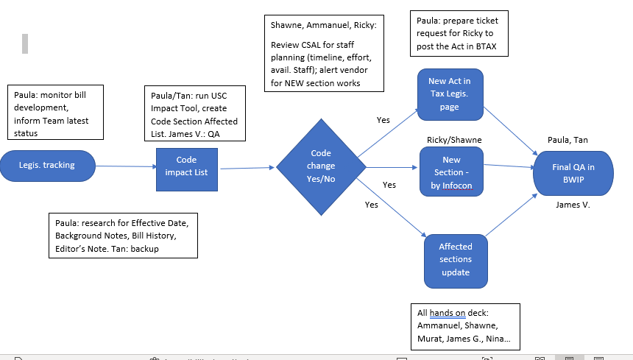
CODE UPDATE FLOWCHART: Created by Tan Nguyen

Slide 4
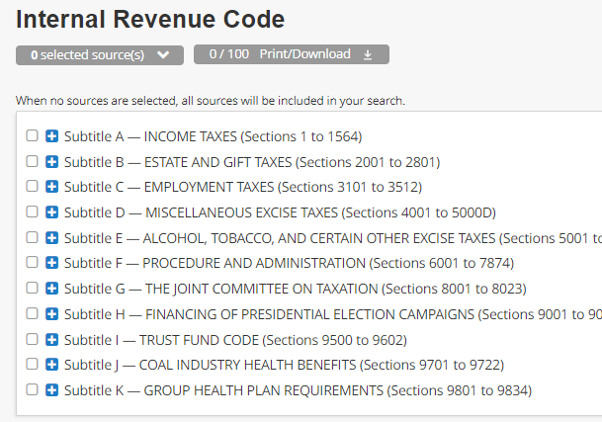

Internal Revenue Code Factsheet: Titles & Broad-Based Facts
Federal statutory code consists of 53 titles.
Each title covers a broad area of the law.
Title 26 = Internal Revenue Code
TPQA maintains = Title 26 only (tax title)
BTAX Title 26:
Subtitle A-Subtitle K
(Secs. 1-9834)
TPQA refers to the Code as:
IRC, USC, Internal Revenue Code or Code.
All Titles have sections
(Represented by § [sec.]
as their basic unit).

Slide 5
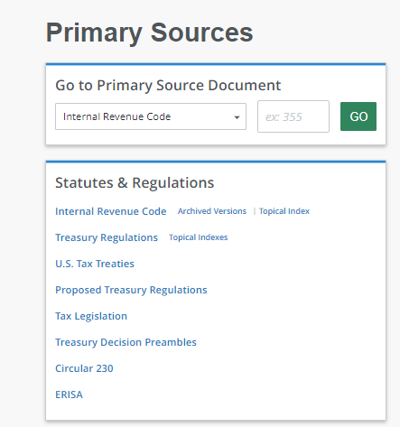
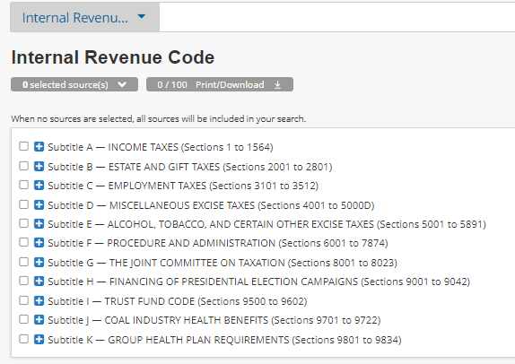
Internal Revenue Code Factsheet: BTAX Display
Our Code Collection consists of Current Code + Archival content for years 2022-1954; 1954 & 1913 Revenue Act.
Code updating concerns Current Code only.
TPQA maintains Archival content though year 2000.
GD maintains pre-2000 content.

Slide 6
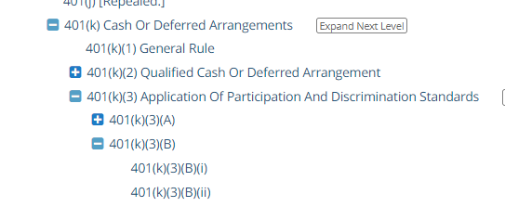
Internal Revenue Code Factsheet: Divisions
26 USC Title 26 is further divided:
Subtitle – Chapter – Subchapter –
Part – Subpart –
Section –
All Sections have paragraphs represented in lower case parentheses. (a), (b), (aa)
Each Section may be further divided:
Paragraph, subparagraph, clause, subclause.

Slide 7
When to Begin Updating Code for New Law: Triggers & Roadmap
TPQA Production begins updating Code following delivery of:
1. Code Affected List Excel Spreadsheet from Content Oversight.
2. PDF of legislation: Enrolled or enacted language.
Code Affected List + Legislation
=
Roadmap for updating Code sections using Oxygen.
When the law has been passed by both the House & the Senate.
When there is available Enrolled or Enacted language on Congress.gov.
When Content Oversight signals TPQA updating should begin.
do not wait until the President has signed into law to update Code Sections.
Do not publish any code section until the president has signed & enacted into law, & Content oversight gives the signal to release files from BWIP.

Slide 8
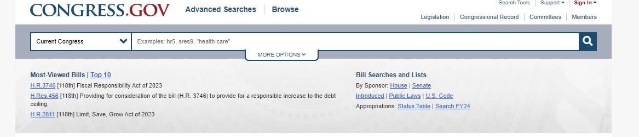
Basic Relationship Between Legislation & Code
Engrossed bill (EH) = Passed by House or Senate.
Do not use for Code updating, as the Engrossed bill submitted to the President may differ.
Enrolled Bill (ENR) =
Final version of the measure agreed to by House & Senate. It’s submitted to President for signature.
Use this version for Code Updating, unless the Enacted law is available.
Enacted Law/Signed by President = Roadmap
Use this version -or ENR- to update Code.

Slide 9
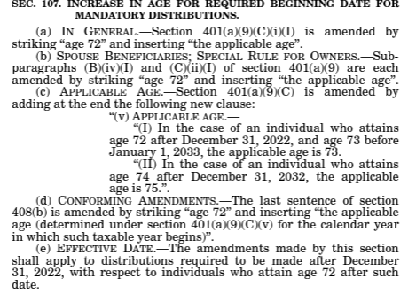
Basic Relationship Between Legislation & Code: Actions / Operations
Sec. 107 = Act Section 107
[Auth: PL 117-328, title I, Div. T]
107(a) = States action to 401(a)(9)(C)(i)(I). [Strike/Insert]
107(b) = States actions to subparas, (B)(iv)(i) & (C)(ii)(I) of 401(a)(9). [Strike/Insert]
107(c) = States action for 401(a)(9)(C)(v). [Adds clause (v)]
107(d) = States action to 408(b). [Strike/Insert]
107(e) = Effective Date for
provisions in Act Sec. 107(a)-(d).
Notes:
Miscellaneous notes are supplementary information that does not directly amend any Code sections.
Firestone will add (or be directed ) to add by analyst.

Slide 10
Basic Relationship Between Legislation & Code
KEY FACTS:
Enacted Law (or Enrolled version) = Roadmap to update
Legislation states Code Operation:
New
Amended: Strike/Insert
Redesignated
Struck
Legislation provides language for update.
Amended text = Always between “quotation marks.”
Cut & paste language between quotations.
Pay attention to punctuation.
Legislation states the Effective Date.
Delayed – or -- on Enactment.
If no effective date is stated, use enactment date of law.
Notes:
Miscellaneous notes are supplementary information that does not directly amend any Code sections.
Firestone will add (or be directed ) to add by analyst.

Slide 11
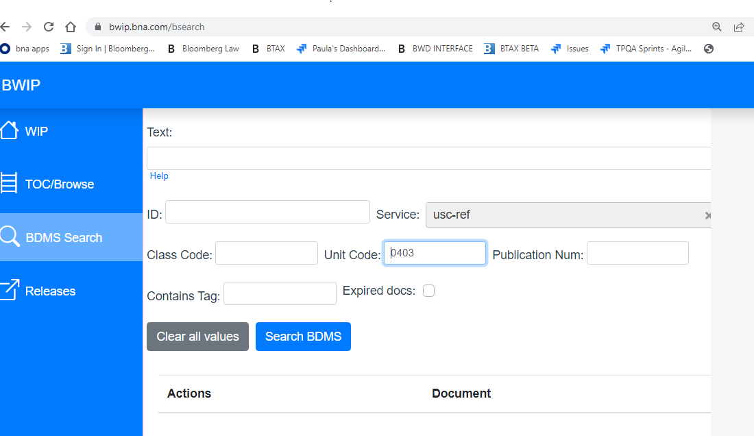
How to Find Code Sections in BWIP
USE BDMS SEARCH
Service = USC-Ref
Unit Code = Sec. number
Use 4-digit identifier sec. number) & “0” as placeholders.
Exs:
26 USC 403 = 0403
26 USC 403A = 0403A
26 USC 72 = 0072
https://bwip.bna.com/bsearch

Slide 12
Key Elements of a Code Section: Code Section Number & Short Name
Code Section Number & Short Name
Section Language
Section History
Background Notes
Amendment to Section
Editor’s Notes in Language if delayed effective date.
Effective Dates to Section

Slide 13
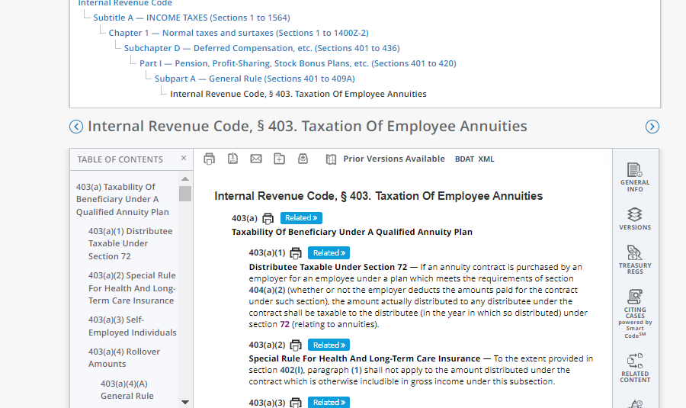
Identifying Code Section Number
Key Facts:
Code Section Number:
Always at top of file,
before section name.
Code section number also displays in breadcrumb along with all sorting information for section.
*Code sec. number is driven by Unit.Start tags & attributes.
Notes:
Sec. number serves as BWIP identifier.
Ex: 26403=0403 [Curent Code; USC-REF]

Slide 14
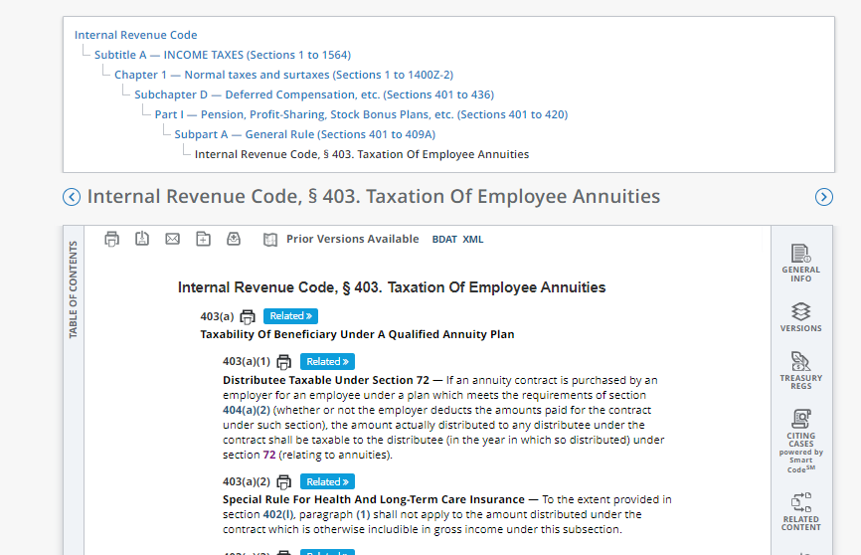
Identifying Code Section Name
Key Facts:
Code Section Name:
Always at top of Code section after section number.
Section name displays in breadcrumb along with all sorting information for section.
*Code name is driven by Unit.Start tags & attributes.
Versions: BLAW generated & maintained.
Notes:
Code section names may be amended by law.
Breadcrumb is generated by the unit.start information in the Oxygen file.
Unless the sort order changes by the legislation (rare), there’s no need to revise the unit.start attributes.
Unit.Start attributes will be discussed in the “New Code Section” training module.

Slide 15
Key Elements of a Code Section: Language
Code Section Number & Short Name
Section Language
Section History
Background Notes
Amendment to Section
Editor’s Notes in Language if delayed effective date.
Effective Dates to Section

Slide 16
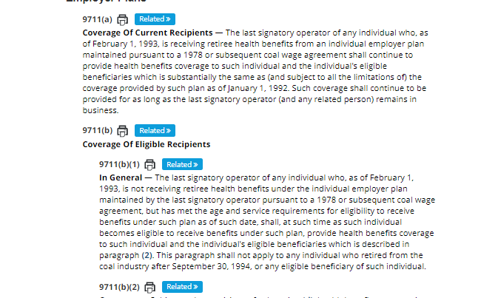
Identifying Code Section Language:
Text of Code section as provided by Public Law (P.L; Pub. L.)
what does language communicate?
The current version of law as enacted.
key facts:
BTAX Language matches official Tax Code as published in the Office of the Law Revision Counsel’s US Code. [OLRC].
Notes:
Screen on right displays language from Sec. 9711

Slide 17
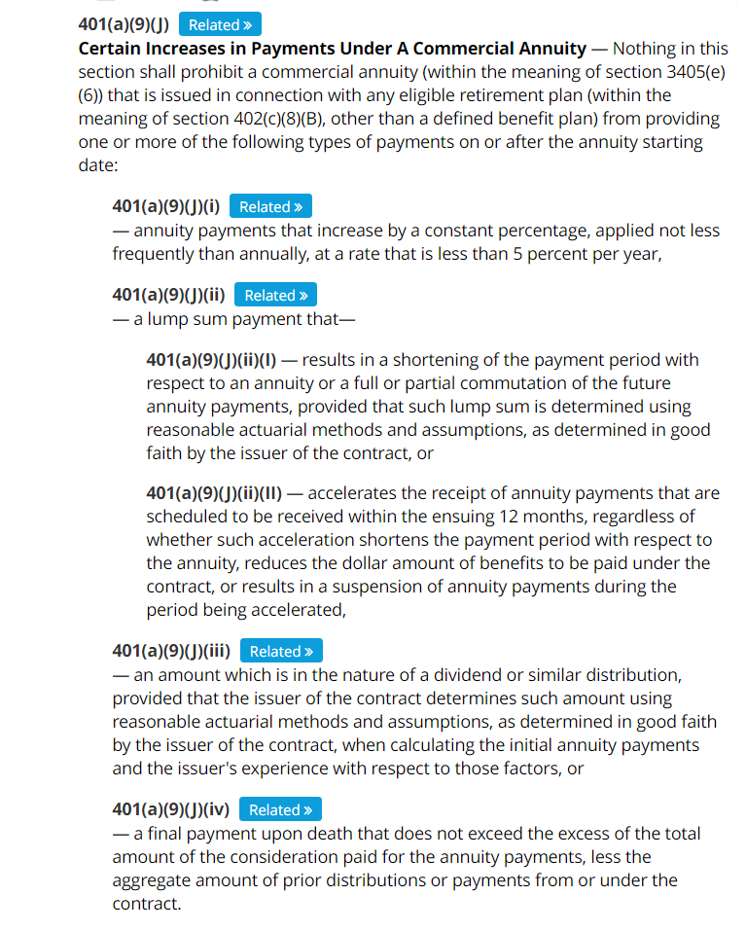
Identifying Key Parts within BTAX: Code Section Language
Key Facts:
Code section language follows in an exacting hierarchy.
When amending Code, levels must be added precisely.
Record revised, redesignated or cut language, so it’s available to paste into Amendment section of Background Notes.
(More in future training module.)
Notes:
Example shown is 401(a)(9)(J).
Note clause (i)-(iv) & subclause (I) & (II) of clause (ii) all are indented appropriately.
Fix levels as you go or TPQA is charged with additional work to correct.

Slide 18
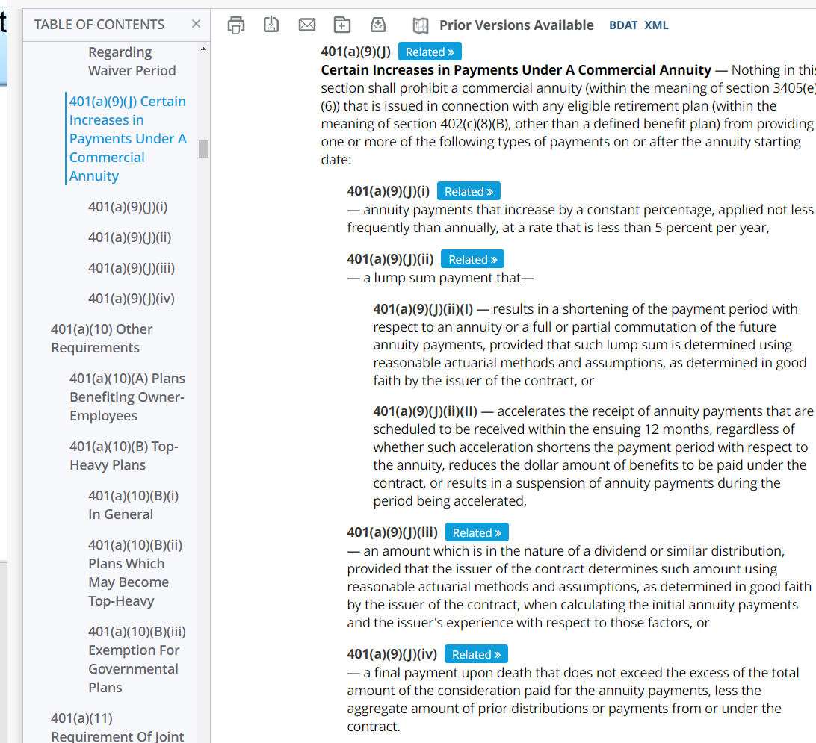
Code Section Language: TOC
Use the Table of Contents on the left rail of each Code section to:
Navigate to lower levels: subsec., par., clause, subclause..
Use the Structure in Oxygen – which mirrors TOC - to update levels
accurately.
Notes:
Example shown is 401(a)(9)(J).
Note clause (i)-(iv) & subclause (I) and (II) of clause (ii) all are indented appropriately.
Fix levels as you go or TPQA is charged with additional work to correct.

Slide 19
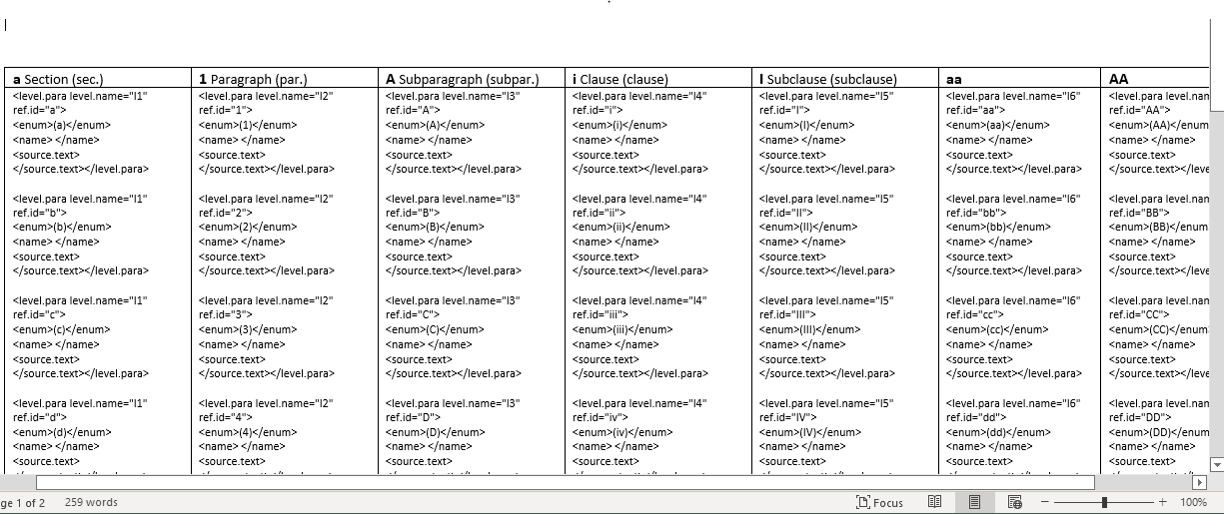
Guide to Identify Section Levels
Notes:
Shwane and Sally created this level cheat sheet, which is useful for amending language and identifying level for Amendment portion of Background Note.

Slide 20
Key Elements of a Code Section: Editor’s Notes
Code Section Number & Short Name
Section Language
Section History
Background Notes
Amendment to Section
Editor’s Notes in Language if delayed effective date.
Effective Dates to Section

Slide 21
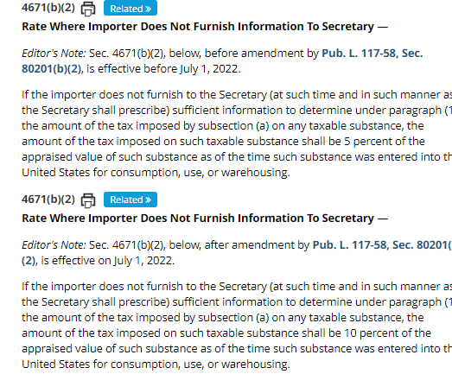
Code Section Language: Editor’s Notes
What are editor’s notes?
Editor’s Notes in Code Section language communicate current law & future law.
In TPQA, we refer to these as Before & After Notes.
Only use if delayed effective date.
Current Code language with “Before” Editor’s Note.
Future Code language with “After” Editor’s Note.
Notes:
Example shown is 401(a)(9)(J).
Note clause (i)-(iv) and subclause (I) and (II) of clause (ii) all are indented appropriately.
Fix levels as you go or TPQA is charged with additional work to correct.

Slide 22
Key Elements of a Code Section: Source Cites/ History
Code Section Number & Short Name
Section Language
Section History
Background Notes
Amendment to Section
Editor’s Notes in Language if delayed effective date.
Effective Dates to Section

Slide 23
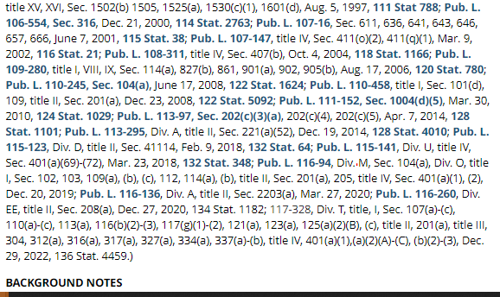
Source Cites/History to Code Section: List of Public Acts (PL)
Key Facts:
what does history communicate?
Subscriber can read History & determine currency, & what laws impacted the Code section.
All sections, including brand new sections, have Source Cites (History) below Code language.
Use formal cite format.
Place cite at the end of the history list, before the period at the end.
Minimum cite = PL, Act Section, Enactment Date, Stat.
Use Division & title if applicable.
Title = Always lower case “t”.
Notes:
Screen on right displays language from Sec. 9711

Slide 24
Key Elements of a Code Section: Background Notes
Code Section Number & Short Name
Section Language
Section History
Background Notes
Amendment to Section
Editor’s Notes in Language if delayed effective date.
Effective Dates to Section

Slide 25
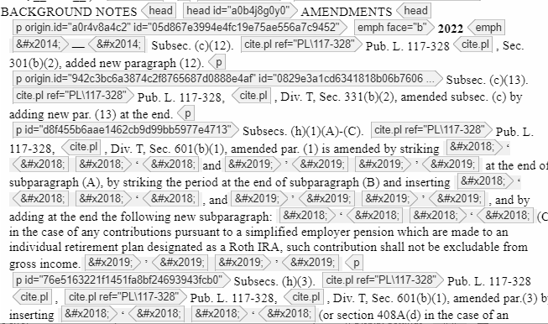
Identifying Key Parts of a Code Section: Background Notes
Key Facts:
what are background notes?
Background Notes follow History & provide Legislative History & Effective Dates for each Act provision.
There are 2 Types of Background Notes in our BTAX Code Sections:
Amendments
Effective Date
Notes:
When the Code section is new, the History section is led by “(Added” + cite and concludes with a period and end paren))
History is a formal cite.
Use title, Divisions if relevant.
Stat number is issued later, once the legislation is officially published in the official Statutes at Large

Slide 26
Key Elements of a Code Section: Background Notes Amendments
Code Section Number & Short Name
Section Language
Section History
Background Notes
Amendment to Section
Editor’s Notes in Language if delayed effective date.
Effective Dates to Section

Slide 27
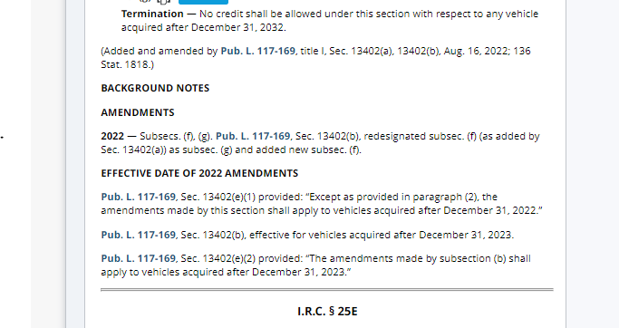
Background Notes: Amendments
Supplementary info providing snapshot of legislative action to the Code section
Key Facts:
What do Background Notes communicate?
Subscriber can read our notes & recreate the Code section prior to amendment.
Added sections Do NOT have amendments.
Added sections do have effective date.
Do not use title in Background Note cites.
If language is redesignated or substantially revised, place that language in quotes.
Notes:
Screen on right displays language from Sec. 9711

Slide 28
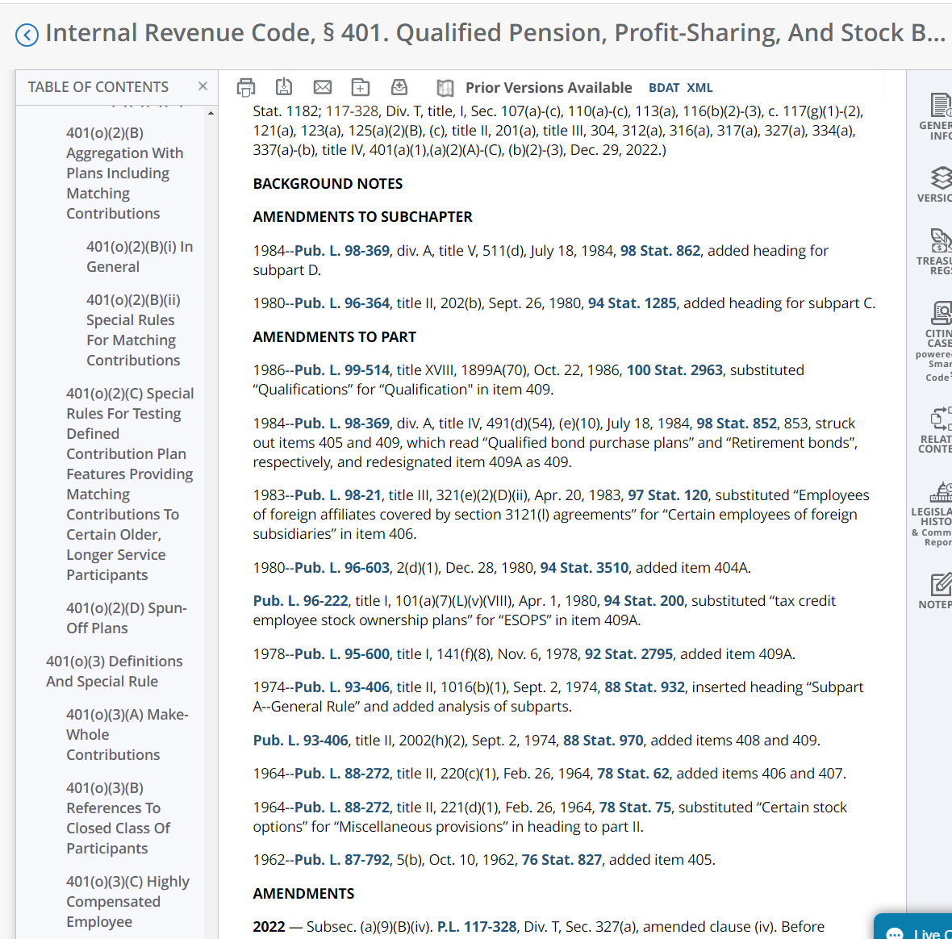
Background Notes: Amendments
Background Notes follow History, & provide
a snapshot of legislation history affecting every Code section.
The Amendments to Subchapter & Amendments to Part represent historical front matter.
TPQA doesn’t amend front matter.
Scroll down for the stand alone heading: “AMENDMENTS” following front matter.
remember:
brand new code Sections do not have amendments.
Notes:
When the Code section is new, the History section is led by “(Added” + cite and concludes with a period and end paren))
History is a formal cite.
Use title, Divisions if relevant.
Stat number is issued later, once the legislation is officially published in the official Statutes at Large

Slide 29
Key Elements of a Code Section: Background Notes – Effective Date
Code Section Number & Short Name
Section Language
Section History
Background Notes
Amendment to Section
Editor’s Notes in Language if delayed effective date.
Effective Dates to Section

Slide 30
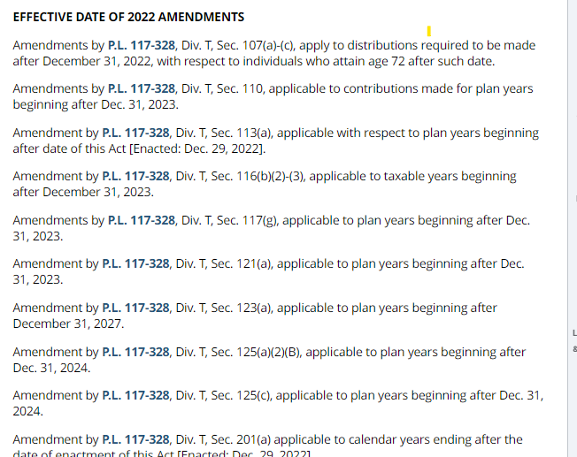
BTAX: Background Notes: Effective Date
KEY FACTS:
effective dates section reflect the effective date of each amendment.
All laws are arranged under year of enactment heading which display in bold face. Refer to heading in illustration: effective date of 2022 amendments
Each amendment has an effective date.
A singular law may be amended by multiple Act sections & have various effective dates.
If the legislation does not provide an effective date, the amendment is in effect on the date of enactment & indicated within brackets. Refer to provision by 113(a) in illustration.
Effective Date Cites DO NOT include title.
btax 26 usc 401
Notes:
When the Code section is new, the History section is led by “(Added” + cite and concludes with a period and end paren))
History is a formal cite.
Use title, Divisions if relevant.
Stat number is issued later, once the legislation is officially published in the official Statutes at Large

Slide 31
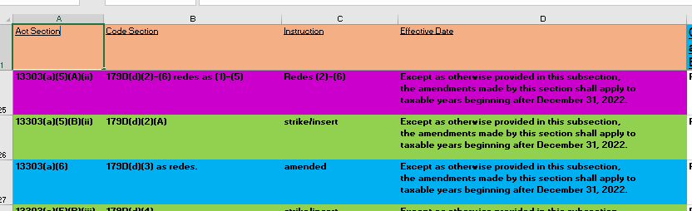
Code Affected Spreadsheet: Delivered by Content Oversight
Refresh shared Code section spreadsheet for TPQA updates.
Check the Effective Date prior to making any updates: Delayed dates indicated Editor’s Notes required.
If the effective date is delayed, e.g., effective after the enactment date, there will need to be (2) versions in the Code section representing before & after language with Editor’s Notes. Standard procedure to communicate present & future law.
(Ed. Notes topic will be covered in detail during our Language & Editor’s Note Training.)
Use both Affected List & Enrolled bill - or Act language - in tandem to update. (Content Oversight will provide.)
Initial/date shared spreadsheet to indicate 1.) the file is checked out under your name; & 2.) when file is ready for QA.
Notes:
More on Editor’s Note in future training module.

Slide 32
Conclusion: A Review of Our Learning Objectives
We’ve reached the end of this module. You should be able to:
Understand basic Code updating, TPQA workflow & using the shared Code Affected List.
Understand basic facts about the Internal Revenue Code & how we present on BTAX
Know when to begin updating Code for new law (triggers).
Identify key parts of a Code section & what each section communicates.
Understand how the key parts relate to law.
Locate Code sections in BWIP.
Find Public Laws on-line.

Slide 33

End of Presentation

Slide 34
RESOURCES
BWIP = Check out Code sections in BDMS. https://bwip.bna.com/wip.
Code Section Shared Affected List [EXCEL spreadsheet] = Content Oversight delivers.
Congress.Gov = Searchable depository of bills & public laws. https://www.congress.gov/
OLRC = https://uscode.house.gov/ Official Code Reference.
Code Documentation/Reference Manuals =
I:\GROUPS\Tax&Accounting\Operations\Content Oversight\Training

Slide 35
RESOURCES: Guide to Identify Section Levels
Notes:
Shwane and Sally created this level cheat sheet, which is useful for amending language and identifying level for Amendment portion of Background Note.

