Slide 1
CONSOLIDATED PORTFOLIO DASHBOARD
OBJECTIVE: Create a JIRA dashboard showing all phases of portfolio production activities
Exports for Authors (TECHNICAL TAX)
Production – Including Anthology, Obsolete Cites (PORTFOLIO PRODUCTION)
Print (PRINT)

Slide 2
STATUS:
Completed
IMPACT OF WORK:
Overview of the stages of the Portfolio Production Workflow
Resource distribution
Increase Efficiency

Slide 3
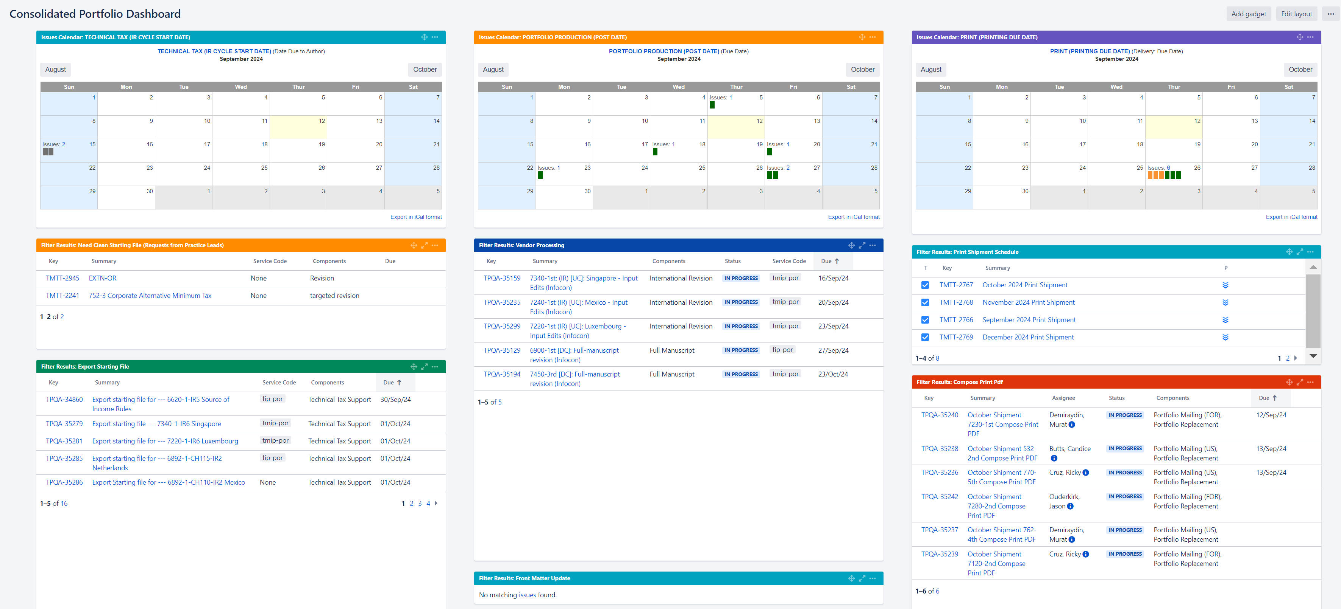

Slide 4
