Slide 1
Vendor Quarterly Check-In
January-March 2025
Notes:
Sally: Welcome to our Q1 vendor presentation. This is a first for us. The team tracks this info on an ongoing basis, tracking spend-to-date, sharing it out, and following up on individual issues as necessary. But now, in our combined LAW/TAX perspective, we decided that it was a good time to institutionalize a quarterly cadence of “this is where we are with the vendor” presentation. So, as our inaugural effort, we will appreciate your input and suggestions.

Slide 2
Agenda
YTD totals, project/operation breakdown
Comparison year-over-year
New work
Attention areas
Q2 Priorities
Notes:
Sarah: We will look at our YTD totals for our vendor work, as well as how those numbers look year over year. We will also look at where we stand in terms of the 2025 budget, and how Q1 hours are breaking down across projects and Forms operations. Our vendors have taken on some new work and we’ll touch on successes (and not) in that regard. There are also some areas which we are targeting where we’re working with the vendor on improving efficiency in their workflows.
And we will wrap up with a look at what the vendor focus will be for Q2.

Slide 3
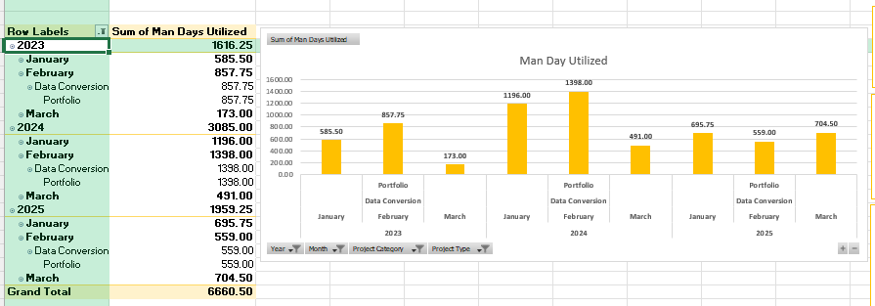
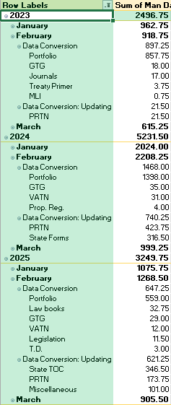

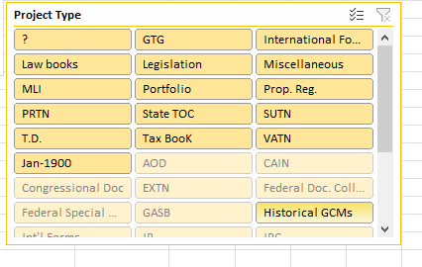
Infocon
2025 BUDGET: $263,000 (26,300 hrs)
QUARTER | HOURS | DOLLARS | % OF TOTAL
Jan-Mar | 4,274 | 42,740 | 16%
Apr-Jun
Jul-Sept
Oct-Dec
Monitoring
Portfolios
Jan-Mar
2023, 2024, 2025
February
2023, 2024, 2025
Wide variety of production tasks
Notes:
Sarah: 2025 budget is $263,000. Our annual budget is built from the previous year, as well as informed by anticipated project needs. Infocon bills @ $10/hr, so that is 26,300 hours of work. We use several different tools to monitor vendor activity. For Infocon, we maintain a dashboard in Excel to track overall hours. They provide a report monthly of their total hours, broken down by project (not individual tasks). We included some examples here to illustrate how we use this dashboard. We use this dashboard primarily for budget planning and overall monitoring. Easy to maintain, this dashboard has been very helpful to quickly drill down, to see what’s going on in an individual project, to compare year-over-year, etc.
And, of course, as you know, all the individual tasks completed by Infocon are tracked in individual Jira tickets. The hours collected in Jira are what give us the more granular view of the level of effort individual tasks require.

Slide 4
Infocon
Q1 Top Three*:
Portfolios (IR updates, some conversion)
International Form collection
Property Tax Navigator updates
PTEN* (special project)
and everything else….
Jan-Mar 2025: 4,274 Hours
Notes:
Sarah: While Infocon does many types of tasks for us, three consistently consume the most hours – portfolios, international forms collection, and Property Tax Navigator updates (PRTN), so they are useful indicators of overall trends. A very notable trend happening with portfolios in Q1 – i.e., hours are significantly lower than in 2024. That bears some examination – is it a trend? What’s driving that change? Will it continue? (Murat???). Also, as you see, PTEN is a lonely, but high, bar in 2025 – that’s a special project (Ammanuel, how far are we through that, and how much longer do you expect that to last?) Looking at the “Other” group of everything else, we see that work is declining there, especially comparing January 24/25. (Ricky, any idea what’s happening there? Has anything notable dropped off, or been delayed?)

Slide 5
Infocon: Q2 Focus, Questions
Running under budget: trend to continue?
Potential POC Forms “create” and “boxing” work? (Q2/Q3)
Ongoing new projects: monitor time
Intl Forms QA
Law Books
Productivity
Audit
Targeted workflow improvement plans
Notes:
Sally:
Q2 attention will
Watch the trends, work with Murat in terms of portfolio volume….
POC….Team very interested in exploring whether Infocon could pick up some Forms WF – balance risk, potentially increase efficiency (stay tuned on Innodata details)

Slide 6
Innodata
Forms Workflow Operations Support
Create
Boxing
Dataflow
Linking
Calcs*
and a little bit of TPQA conversion work….
Fixed Price Contract 10 full-time resources dedicated

Slide 7
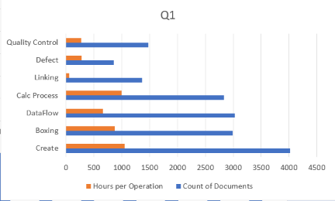
Innodata(Forms)

Slide 8
Innodata(TPQA)
Notes:
TPQA work is very limited.

Slide 9
Innodata: Q2 Focus, Questions
Staffing adjustments
Reduce headcount by 2 (to 8)
Some daytime hours
Address quality decline
Training
best practices
Consider additional tasks
Forms-related projects
Additional TPQA tasks

Slide 10
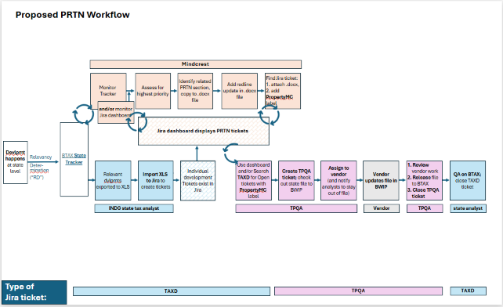
Mindcrest
Revamp PRTN C&A process to streamline convoluted workflow
Complete:
Vendor access to Jira, Outlook
Workflow finalized
Workflow Overview meeting with Mindcrest
Upcoming:
Jira ticket training for vendor
Full implementation

Slide 11


