Slide 1
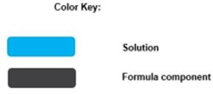
§199A(b)(1): Combined Qualified Business Income Amount
Summary: The Qualified Business Income (QBI) statute prescribes the allowable QBI deduction for tax years beginning after December 31, 2017, and before January 1, 2026.
Combined Qualified Business Income Amount ª
The sum of the deductible amount for each trade or business ^{b}
Qualified publicly traded partnership income ^{d}
Qualified REIT
dividends ^{c}
=
+
20%
×
+

