Slide 1
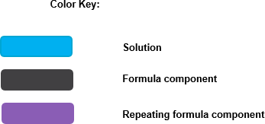
163(j)(4)(C): Excess Taxable Income
Summary: A partner treats previously allocated excess business interest expense as paid or accrued to the extent of allocated excess taxable income (ETI) from the partnership.
Adjusted Taxable Income (ATI) ^{b}
Floor Plan Financing Interest Expense ^{d}
_
Business Interest Expense ^{c}
_
_
Business Interest Income ^{e}
ETI ª
=
×
0.3 × ATI
0.3 × ATI

