Slide 1
Vendor Biweekly SLA Report

Slide 2
A. Current Period Summary
• Throughput: Total Docs completed (Create/Boxing)
• Time Spent: Hours logged in Live vs. Training vs. Downtime
• Quality: Defect ratio, number of defects, error resolution time
• SLA Compliance: Productivity, Quality, Utilization targets

Slide 3
CURRENT PERIOD SUMMARY
Bi-weekly Totals (Period 1: Sep 1-14, 2025)
LIVE | Doc # | Time (hrs) | Defect ratio | Productivity
Create | 27 | 32.1 | #% | ##.#%
Boxing | 29 | 47.75 | #% | ##.#%
Defect | 4 | 13.2
 | 86 | 136.12 | #% | ##.#%
COMBINED | Doc # | Time (hrs) | Defect ratio | Productivity
Live | ## | ###:## | #% | ##.#%
Train | ## | ###:## | #% | ##.#%
Other Learning | ## | ##:##
 | ## | ###:## | #% | ##.#%
TRAIN | Doc # | Time (hrs) | Defect ratio | Productivity
Create | ## | ##:## | #% | ##.#%
Boxing | ## | ##:## | #% | ##.#%
Defect | ## | ##:##
 | ### | ##:## | #% | ##.#%
OTHER LEARNING | Time (hrs)
Learn & Review | ##:##
INDG Training | ##:##
Oversight/mgt | ##:##
 | ###:##
Issues of Note encountered during period: Tues, 9/2, XXX and XXX unable to log into VDI (total downtime=## min) Thur, 9/4, XXX encountered PitStop licensing error (total downtime=# hr) Etc Etc Etc

Slide 4
CURRENT PERIOD SUMMARY
Live, by resource
 | Create | Boxing | Defect
Name1 | 2 | 20 | 4
Name2 | 12 | 4 | 3
Name3 | 5 | 6 | 7
Name4 | 8 | 12 | 2
 | Create | Boxing | Defect
Name1 | 10.4 | 21.9 | 2.1
Name2 | 14.6 | 18.2 | 4.2
Name3 | 23.1 | 6.3 | .2
Name4 | 8 | 24.5 | 1.5
 | Create | Boxing
Name1 | 1.1 | 1.3
Name2 | .91 | 1.4
Name3 | 1.5 | .82
Name4 | 1.2 | 1.0

Slide 5
CURRENT PERIOD SUMMARY
Bi-weekly SLA Compliance (Period 1: Sep 1-14, 2025)
Productivity, Quality, Utilization targets

Slide 6
B. Trend Analysis (Performance Over Time)
Insert charts/graphs here to show:
• Productivity (Docs per resource per week)
• Quality (Defect ratio trend)
• Utilization (Live vs. Training vs. Downtime)

Slide 7

TREND ANALYSIS
By Document Count

Slide 8
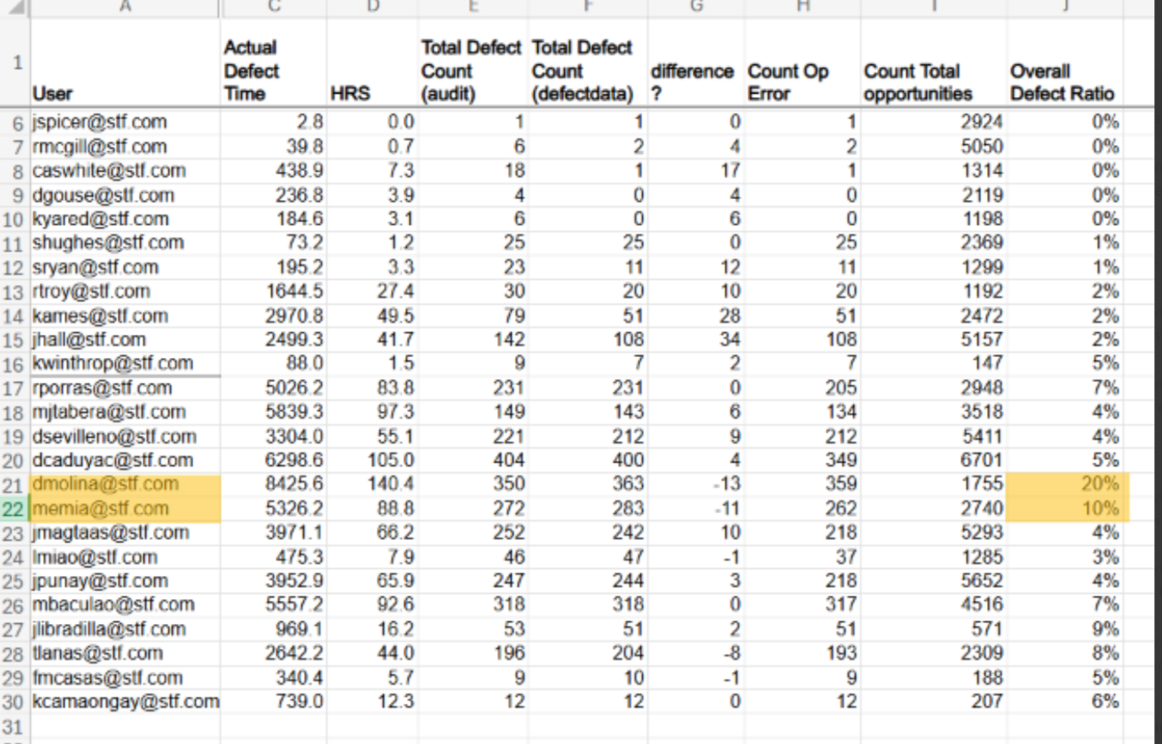
TREND ANALYSIS
By Quality, Productivity
 | Create | Boxing
Name1 | 1.1 | 1.3
Name2 | .91 | 1.4
Name3 | 1.5 | .82
Name4 | 1.2 | 1.0
How can this data inform ongoing productivity/quality metrics?

Slide 9
C. Narrative & Action Items
• Observed issues in this period
• Vendor’s self-reported actions
• Agreed next steps

Slide 10
SLA Framework (Example)
• Productivity SLA: ≥ X Docs per FTE per day in Live Workflow
• Defect Ratio SLA: ≤ Y% error rate (rolling average)
• Resolution SLA: ≥ 90% of defects resolved within Z hours
• Utilization SLA: ≥ 70% of logged time in Live Workflow when available

