Slide 1
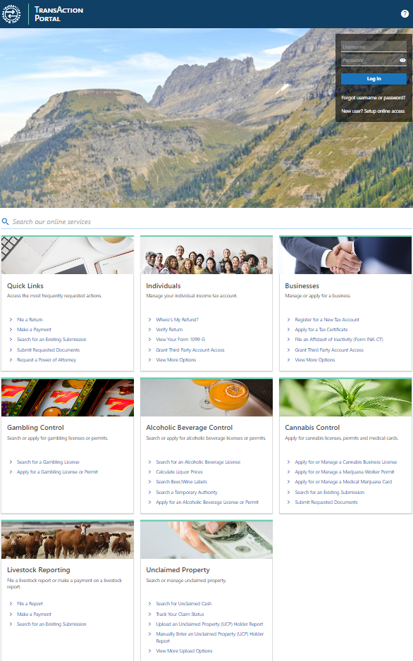

Welcome to the Montana Department of Revenue TransAction Portal (TAP)
Notes:
This is what our home page looks like.
Go over quick links.

Slide 2

TransAction Portal (TAP)
TransAction Portal is a full-service application providing you or your designated representative online access to your Montana tax accounts.
TAP provides individuals, businesses and tax preparers the ability to:
  Manage tax accounts
  Schedule and make payments
  Securely message DOR employees
Notes:
E-Services is also responsible for supporting our online filing/payment portal, TAP.
TAP provides you or your representative 24/7 access to your Montana tax accounts.
Make payments
File returns (some tax types)
Free and secure.
You’ll receive immediate confirmation #.

Slide 3
TAP Highlights & Updates
Highlights
  Securely message DOR
  Submit a Power of Attorney
  Manage Payments & Returns Table – EXPORTABLE!
  IIT Login Verifications
  ACH Credit Payment Registration
Notes:
You can securely message DOR through TAP! This will automatically associate your message to your login and ensure that DOR personnel will see it, no more emailing dead inboxes or riding our loop lines into eternity. Please contact dore-services for detailed instructions.
Before DOR can speak with anyone about a tax account, our staff need to verify that the person they are communicating with is an authorized contact for that account. The easiest and quickest way to do that is to submit a POA on TAP.
Payments & Returns table – we used feedback from our users to improve the convenience and useability of TAP. You can now export information on payments, returns, and balances from TAP. Please contact dore-services@mt.gov for detailed instructions.
IIT Login – Again, based on user feedback, we are improving the process of creating a login for your Individual Income Tax account. Please contact our call center or dore-services for detailed instructions.
ACH Credit Payment Registration – DOR no longer accepts the paper/pdf form for this process. It is entirely on the TAP portal now, which helps to streamline the process and ensure that your payments are going where you mean them to go. Plus no more lost registration forms!

Slide 4
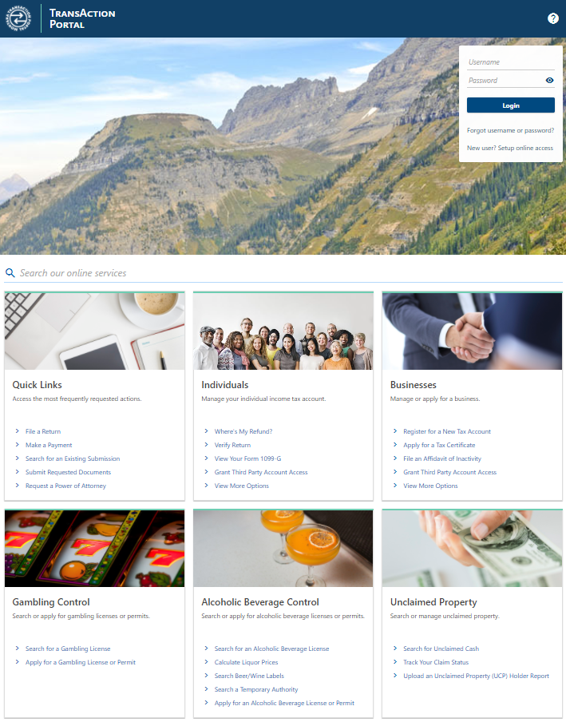
Register for a New Tax Account
Notes:
Earlier we spoke about registering for a new tax account. This is the fastest way to accomplish that.
Make sure to keep your list of authorized contacts up to date with DOR. We cannot and will not discuss your account with anyone without your consent. You can send an email through your profile or submit a Power of Attorney through TAP.

Slide 5
Business Registration Checklist
Business Information
Legal Business Name
Business FEIN or SSN
Reason for Registration – Why you are registering (new, purchased, re open, asset, tax exempt).
Entity Type – Your business structure for tax purposes (LLC, Corp, Partnership, etc.).
First Activity Date – When business operations started or will start in Montana.
Secretary of State ID – Your Montana business filing number, if applicable.
NAICS Code – Federal code describing your primary business activity.
Business Activity Description – What your business does in Montana.
Owner Information
Names, residency, entity types, and SSN/FEIN for each owner.
Contact Information
Person the state can contact about your registration.

Slide 6
Business Registration Checklist Continued
Business Income Taxes
Whether you file on a calendar or fiscal year, plus filing entity details if different.
W 2 / 1099 Withholding
If you have employees or payees subject to Montana withholding.
Mineral Royalty Withholding
Required only if you pay Montana mineral royalties.
Miscellaneous Taxes
Select applicable taxes (e.g., lodging, rental vehicle, telecom, 911).
Business Equipment Tax
Determine if equipment value or parent ownership requires reporting.

Slide 7
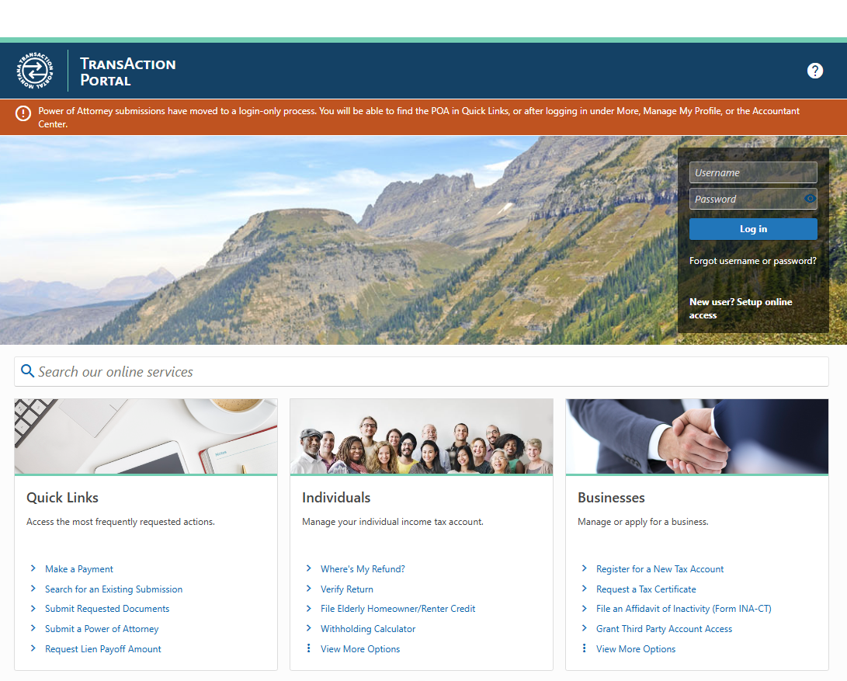

TAP Profiles
Notes:
Once you have your account registered, you can setup online access here.

Slide 8
TAP Profile Best Practices
Only 1 active profile per email address.
  This helps staff provide accurate support.
Register your TAP Profiles with your information.
  The department treats your profile with the same level of scrutiny as a tax account.
  It is the property of the person or business listed on it.
  If we cannot verify your connection to the profile, we will not be able to assist you.
Ensure that correspondence from TAP@mt.gov is marked as “Not Spam”
Setup multiple 2-Step Verifications
  Email
  Text
  Authenticator Applications

Slide 9


User Profiles
New User Profile
  This user has setup their online profile but does not have access to any taxpayers or tax accounts.
Standard User Profile
  A first-party user that has setup online access to a single taxpayer and their tax accounts.
Accountant Profile
  AKA Third-Party Access
  A Third-Party user that has setup online access to multiple taxpayers and their accounts.

Slide 10
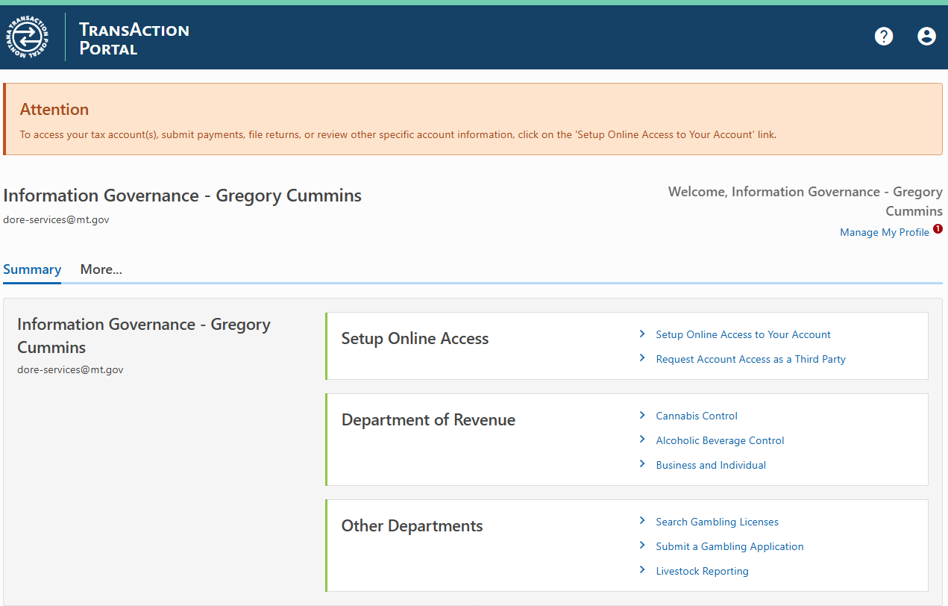
Setup Online Access
Notes:
Once you have your account registered, you can setup online access here.

Slide 11
TAP Access Management
Administrator
  Customer level master login that can control other non-administrator logins from their TAP profile.
Account Manager
  Full authority over the specified tax account.
Limited
  Access to file returns and make payments but will not see balances owed, returns due, or account correspondence.
Notes:
DOR strongly encourages taxpayers to maintain an administrator login for their tax accounts, this allows you to see who has access to your tax information through TAP, to see a full list of those who have been authorized as a contact for your account please send a secure message directly to DOR. Remember to Inspect what you Expect!

Slide 12

Setup Online Access to a Business Tax Account
Required information
  13-digit Account ID assigned by the Department
  FEIN (Federal Employer Identification Number)
  ZIP Code associated with the account
  A letter received from the Department within the last year
    If you don’t have a letter, you can request one. You will be granted limited access until you receive and enter a valid letter ID.
You will receive an authentication code within minutes.
  This code is required when you sign in.

Slide 13
Setup Online Access to an Individual Income Tax Account
The Individual Income Tax Verification now includes additional options!
  Required information
    The double entry of the social security number.
    The selection and completion of two of the following from the most recent return:
      Federal Adjusted Gross Income (FAGI) or Total Gross Household Income from 2EC.
      Last name
      Letter ID from the last 12 months (must be at least 24 hours old)
      13-Digit Montana Tax Account ID

Slide 14
TAP 3RD Party Access
Accountant Center gives accountants and tax preparers the ability to manage their client accounts from one TAP username.
Required information to request access to your client’s tax account
  13-digit Account ID assigned by the Department
  FEIN (Federal Employer Identification Number)
  ZIP Code associated with the account
  THIS MUST BE COMPLETED FOR EACH ACCOUNT YOU NEED ACCESS TO.
  You must have access to a Partnership or S-Corp tax account to complete a PTET payment.
Once you request access, your client will receive instructions via email on how to complete the process.
Notes:
3rd Party Access allows preparers to manage all their clients from one TAP username.
We recommend that both the preparer and client have their own TAP usernames setup, with the client keeping control of the Administrator (master) login.
If you have any questions about setting up 3rd party access, I recommend contacting the Call Center or e-Services for more information.

Slide 15
Submit a Power of Attorney
Power of Attorney submissions have moved to a login-only process.
Find the POA in Quick Links,
or after logging in under
  More…,
  Manage My Profile,
  or the Accountant Center.

Slide 16
Submit a Power of Attorney
Your tax records are confidential. We can't give your tax information to anyone without your written consent. Taxpayers who would like to designate someone else to represent them before the Department of Revenue must complete and submit a Power of Attorney (Form POA).
Important Notes
Spouses filing a joint return must each complete a separate form.
This form will not be honored for any purpose other than representation before the Department of Revenue.
It cannot be used for any other purpose.

Slide 17
Submit a Power of Attorney
Representatives will need to attach a copy of the physically signed authorization form, such as:
  Durables and Statutory POAs (must specify taxes and/or finances)
  MTC Universal POA
  Montana DOR Form POA
  Form 8655
  Form 2848 must include in Section 3 (Tax Matters)
    Montana
    Tax Type
    Form Number
    Applicable Years

Slide 18
Submit a Power of Attorney
POAs for deceased taxpayers will not be accepted!
Authorization for representation of a decedents tax accounts requires a court certified Letter of Appointment of Representative.
For more information and Step-by-Step instructions:
https://revenue.mt.gov/publications/power-of-attorney

Slide 19
Payments in TAP
E-check Payments
  Free processing in TAP
Credit/Debit Card Payments
  Small processing fee
Notes:
E-check payments are free in TAP.
Even though we do not require you to set up a login to make a payment, at this time, we strongly encourage taxpayers to use TAP to monitor their tax accounts and securely interact with DOR.
There is a small processing fee for credit cards. Fee isn’t from us, it’s from the processor.

Slide 20
Other Payment Options
ACH Credit Registration
  Instructions and registration available on TAP.
Standalone Payment API
  Certain Payroll software products allow you to submit your withholding payments directly from their software, without submitting a withholding return.
  Requires your 13-digit Montana Withholding account ID.
  Ask your software provider if they participate in our Vendor Payment Service.
Notes:
Contact dore-services for questions or detailed instructions on either of these options.

Slide 21
Manage Returns & Payments
Exportable table accessible to all TAP users.
  Exports as .ODS spreadsheets
  Use filters to refine exportable data
Filter by:
  Account Type
  Balance, Return, or Payment
    Further filtered by status i.e. outstanding, filed, past due, etc.
  Current or Previous Periods
Notes:
Please contact dore-services for questions or concerns about using this table.

Slide 22
TAP Security
Two-Factor Authentication
Password Reset
Setup multiple methods
Only resettable through email
Reset is time sensitive, expires after 15 minutes.
Check spam/junk folders
Secure messaging to DOR is available in TAP!
Notes:
Here are some cases where you may need/receive and authentication code.
Two Factor authentication code can be received via email or text. You make that selection when setting up your User Id.
If you change cell phone provider, you may not receive text. Please call e-services in case of issues.

Slide 23
On-Line Security
The Department of Revenue takes taxpayer security very seriously.
You can do your part by:
  Updating your browser and software regularly.
  Creating safe passwords and changing them often, consider using passphrases.
  Ensuring that anti-virus protection and firewalls are current.
  Using caution when opening attachments.
  Using trusted Internet sites only.
Notes:
Here are some TIPS to protect your business, employees, and clients data.
Stress cyber and physical security.
Examples of tax prep offices in Montana that have been compromised.

Slide 24
Summary
Functions available on TAP:
  Register new tax accounts
  Make payments
  File certain returns
  Submit 1099s and W-2s
  Submit Montana MW-4s
  Submit a Power of Attorney (POA)
  Secure Messaging to DOR
Benefits of filing and paying online:
  Free to use
  Safe and secure
  One location to e-file and e-pay
  No paper documents to print and mail
  Immediate confirmation that your submission was received

Slide 25

It’s a FREE resource for anyone who assists people in filing taxes and meeting their tax responsibility and for those interested in the state's tax system.
“Montana Tax News You Can Use”
The Montana Department of Revenue invites you to subscribe to its electronic newsletter, Montana Tax News You Can Use.
The e-newsletter keeps tax preparers informed of:
  New developments at the department
  Updated processes
  Issues and trends popping up during tax season in Montana
It’s a FREE resource for anyone who assists people in filing taxes and meeting their tax responsibility and for those interested in the state's tax system.
Notes:
Sign up requires name and email.

Slide 26
Any Questions?

Slide 27
Additional Resources
Helpful Links
Department of Revenue Website
  https://revenue.mt.gov/
TransAction Portal
  https://tap.dor.mt.gov/_/
  Approved Software
    https://revenue.mt.gov/online-services/#ApprovedSoftware
    File an Electronic MW-3, W2, or 1099Wage Witholding Tax Webpagehttps://revenue.mt.gov/taxes/#WageWithholdingTax
Contact Information
Department’s Call Center
  Phone: 406-444-6900
Department’s Information Governance Unit
  Email: DORE-Services@mt.gov
  (406) 444-4457

